Slide 1
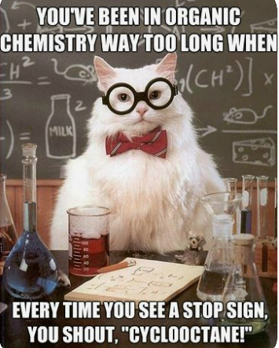

Slide 2
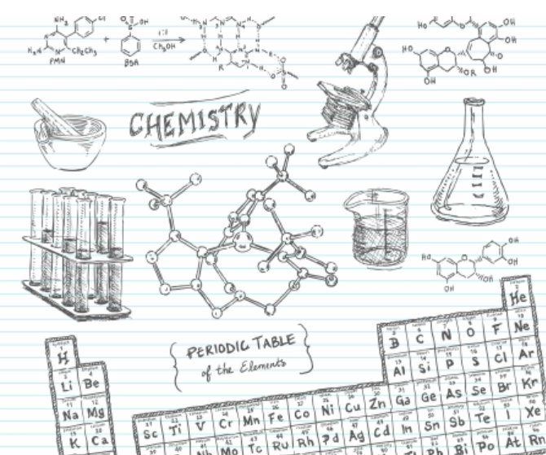
Big Idea: Organic chemistry and its applications have significant implications for human health, society, and the environment.
Essential Questions:
How does organic chemistry apply to your life?
How do the structure and geometry of organic compounds contribute to their usefulness in medicine?
Daily Learning Intentions: I can explore carbon-carbon bonds for rotational ability and geometry (cis and trans isomers). I can identify structural characteristics of several functional groups.

Slide 4
How do the structure and geometry of organic compounds contribute to their usefulness in medicine?
Properties can be very different
Thalidomide example (video on THSS Science site)
Stereoisomerism (enantiomers/ diastereomers)
In the world of chemistry, structure can be the difference between life and death – quite literally.
Stereochemistry is of critical importance to drug action because the shape of a drug molecule is an important factor in determining how it interacts with the various biological molecules (enzymes, receptors, etc.) that it encounters in the body.
Notes:
S enantiomer not good for thalidomide drug

Slide 5
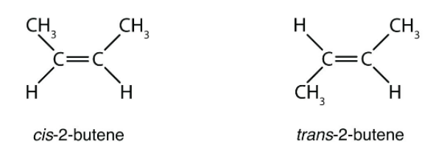
cis/trans isomers (Geometric Isomers)
Stereoisomers have identical molecular formulas and arrangements of atoms. They differ from each other only in the spatial orientation of groups in the molecule.
The simplest forms of stereoisomers are cis and trans isomers, both of which are created by the restricted rotation about a double bond or ring system.
Latin cis, meaning “on this side of” & trans, meaning “across”

Slide 6
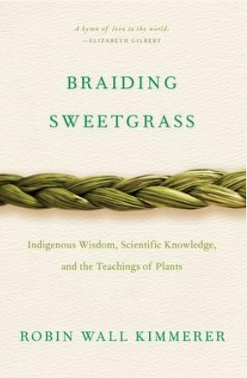
Indigenous Perspectives
Medicine is all around us. Since time immemorial Indigenous peoples in Canada have been using plants and other natural materials as medicine.
Traditional healing refers to the health practices, approaches, knowledge, and beliefs that incorporate First Nations healing and wellness.
Exploring the uses of local traditional medicines: Knowledge shared by First Peoples (Resource posted on THSS Science website – Chemistry 11)

Slide 7
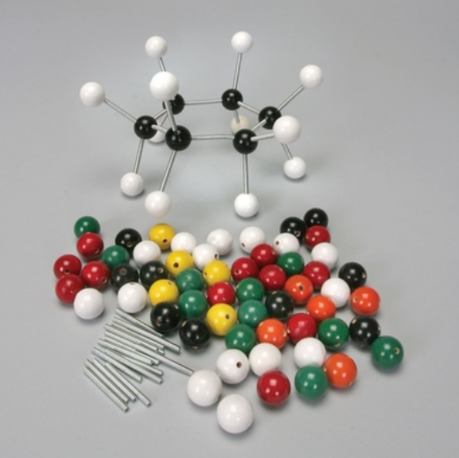
Model Kits
2-3 students share a kit
Let’s build & share out!
Methane (CH₄)
Ethane (C₂H₆)
Ethene (C₂H₄)
cis-2-butene (C₄H₈)
trans-2-butene (C₄H₈)

Slide 8
Organic Functional Groups
In organic chemistry, a functional group is a specific group of atoms or bonds within a compound that is responsible for the characteristic chemical reactions of that compound.
The same functional group will behave in a similar fashion, by undergoing similar reactions, regardless of the compound of which it is a part.
While there are many functional groups, we will only focus on several common ones.

Slide 9
Phenyl
Alkyl Halide

Slide 10
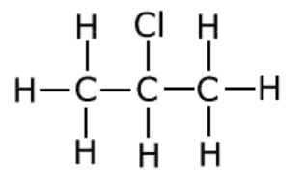
Alkyl Halides: R-X
X = F, Cl, I or Br
Organic compounds containing halogens are called alkyl halides
The prefixes are:
F= fluoro, Cl = chloro, Br = bromo, I = iodo
Naming Alkyl Halides:
Parent Chain
Number parent chain
Name the substituent group
Name the compound
2-chloropropane

Slide 11
Alcohol: R-OH
Organic compounds containing a hydroxyl (-OH) group are called alcohols.
Naming Alcohols:
The parent chain must contain the atom attached to the –OH group. Number the carbon atoms in the parent chain so that the –OH group is given the lowest number.
The name of the parent chain ends with “-ol” instead of “-e”.
Name and identify positions of the branches.
Name the compound
2-propanol
3-methyl-1-butanol

Slide 12
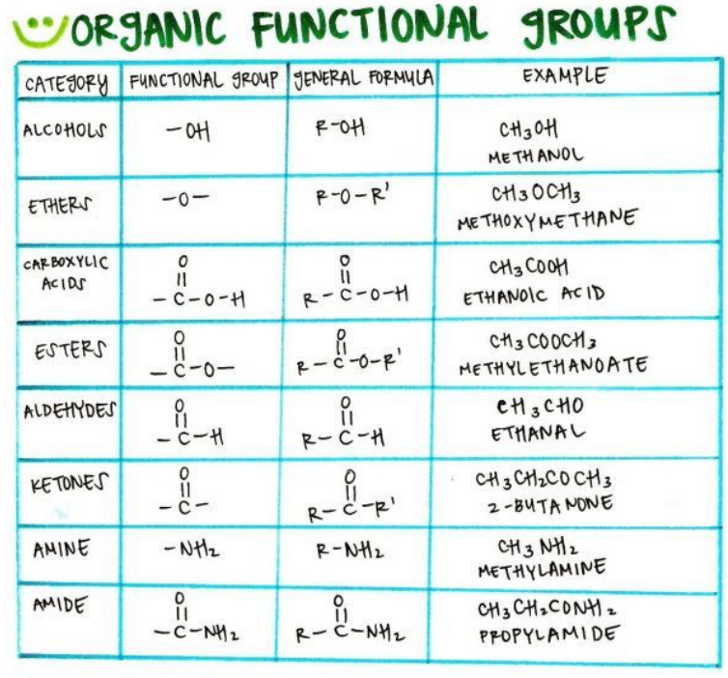
R & R’
= “Rest of the molecule”
Represents a group of carbon and hydrogen atoms of any size.
It is used as an abbreviation since a group of carbon and hydrogen atoms does not affect the functionality of the compound.

Slide 13
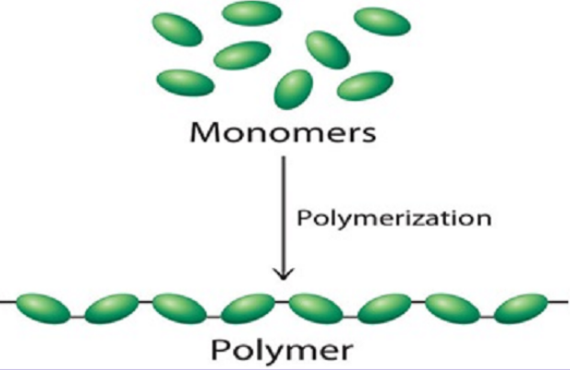
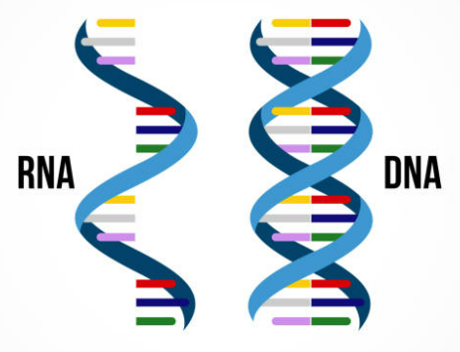
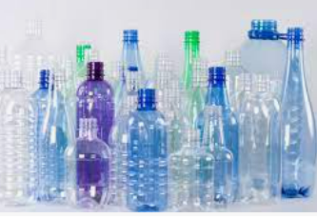
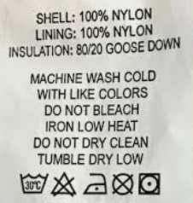
Natural & Synthetic Organic Polymers
Polymers are large molecules made up of small repeating units called monomers
Rubber is a natural polymer
Natural polymers in biological processes:
Human body contains ~100,000 different proteins
(with specific functions)
Proteins are polymers of amino acids
Nucleic acids are high molar mass polymers
(ex. DNA and RNA)
Polyesters and Nylon – ex. synthetic polymers

Slide 14
Esterification
Some esters can be prepared by esterification, a type of condensation reaction in which a carboxylic acid and an alcohol, heated in the presence of a mineral acid catalyst*, form an ester and water (the reaction is reversible):
*A mineral acid catalyst is usually needed to make the reaction occur at a useful rate. Most frequently used is sulfuric acid.

Slide 15
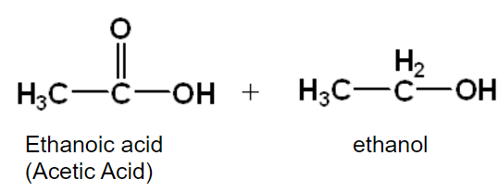
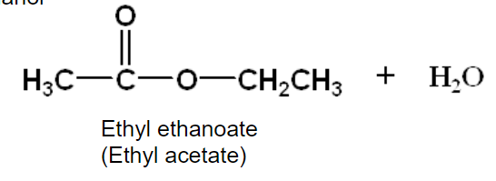
Esterification
Naming esters:
Use the alkyl portion of the alcohol as the first name
Remove the –ic acid of the carboxylic acid and replace it with –ate
The same naming rules apply if the common name of the carboxylic acid is used

Slide 16
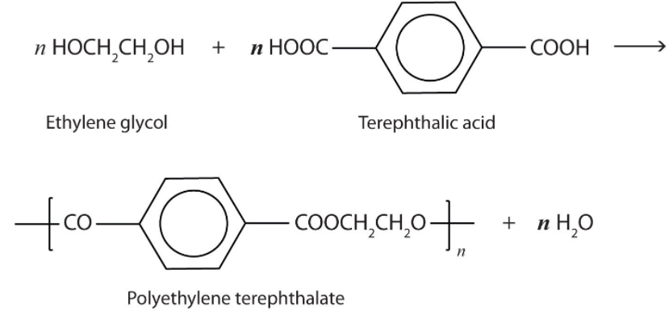
A commercially important esterification reaction is condensation polymerization, in which a reaction occurs between a dicarboxylic acid and a dihydric alcohol (diol), with the elimination of water.
Such a reaction yields an ester that contains a free (unreacted) carboxyl group at one end and a free alcohol group at the other end. Further condensation reactions then occur, producing polyester polymers.
The most important polyester, polyethylene terephthalate (PET), is made from terephthalic acid and ethylene glycol monomers:

Slide 17
Lab 15B – Preparation of Esters
Learning Intention: I can synthesize several esters and try to identify the odor of each. I can write the chemical equations for the formation of each ester using structural formulas.
Conduct lab experiments in a safe methodical manner.
WARNING this lab MUST be carried out in a fume hood.
ALL of the chemicals are POISONOUS and/or CORROSIVE.
Concentrated sulfuric acid is incompatible with water and other chemicals!
Follow the lab directions exactly as written – ask if you are unsure.
Wear Personal Protective Equipment (PPE)
safety glasses (on your eyes…not on your head!), lab apron & nitrile gloves

Slide 18
Summary
Daily Learning Intentions:
Exploring carbon-carbon bonds for rotational ability and geometry (cis and trans isomers).
Names and structures of several functional groups
Polymers (Esterification / Condensation reactions)
One Word Whip Around
Each student chooses one word to answer the question:
“What is one thing you learned in class today”

