Slide 1
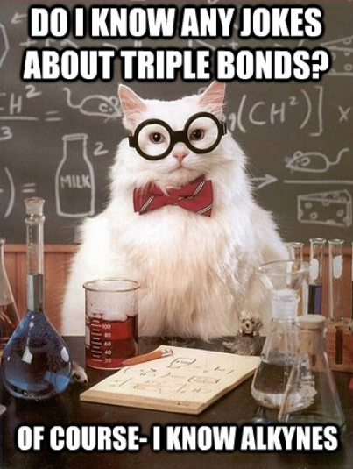

Slide 2
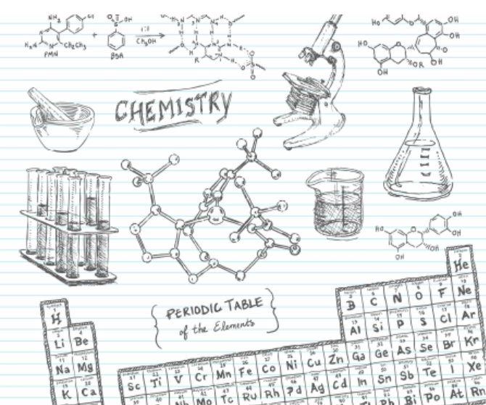
Big Idea: Organic chemistry and its applications have significant implications for human health, society, and the environment.
Essential Questions:
How does organic chemistry apply to your life?
How do organic compounds differ in structure and properties?
Daily Learning Intentions: I can use the IUPAC nomenclature system for naming/drawing alkenes and alkynes. I can identify structural characteristics of benzene.

Slide 3
Meth: "Monkeys"
Eth: "Eat"
Prop: "Peeled"
But: "Bananas"
Gas
@ 20°C
Liquid
@ 20°C
Liquid
@ 20°C
n- prefix = structure as a straight line

Slide 4
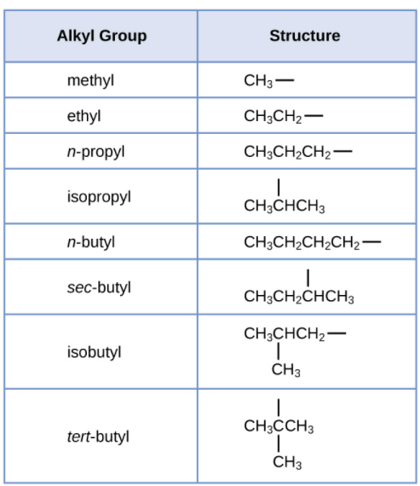
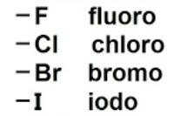
Alkyl Group
Alkyl group contains one less hydrogen than the corresponding alkane
In naming this group, the “-ane” is dropped and the “-yl” is added
Used as prefixes when naming structures
Other common substituents (Alkyl Halides)

Slide 5
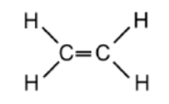
Alkenes
The alkenes (also called olefins) are a family which contain at minimum one carbon-to-carbon double bond. They are considered unsaturated hydrocarbons.
The first member of the alkene family is ethene since at least 2 carbons are needed to have a double carbon-to-carbon bond, the molecule methene does not exist.
The general formula for the alkenes is C_{n}H_{2n}
The names of alkenes end in ‘ene’.
(C₂H₄)

Slide 6
Alkenes
First 9 Alkenes List
NAME | MOLECULAR FORMULA
Ethene | C₂H₄
Propene | C₃H₆
Butene | C₄H₈
Pentene | C₅H₁₀
Hexene | C₆H₁₂
Heptene | C₇H₁₄
Octene | C₈H₁₆
Nonene | C₉H₁₈
Decene | C₁₀H₂₀

Slide 7
Naming Alkenes
Name the parent hydrocarbon by locating the longest carbon chain that contains the double bond and name it according to the number of carbons with the suffix -ene.
Number the carbons of the parent chain so the double bond carbons have the lowest possible numbers.
If the double bond is equidistant from each end, number so the first substituent has the lowest number.
Write out the full name, numbering the substituents according to their position in the chain and list them in alphabetical order.
If there are more than one of the same substituent use the prefixes di, tri, and tetra for two, three, and four substituents respectively. These prefixes are not taken into account in the alphabetical order.
Indicate the double bond by the number of the first alkene carbon.
If more than one double bond is present, indicate their position by using the number of the first carbon of each double bond and use the suffix -diene (for 2 double bonds), -triene (for 3 double bonds), -tetraene (for 4 double bonds), etc.

Slide 8
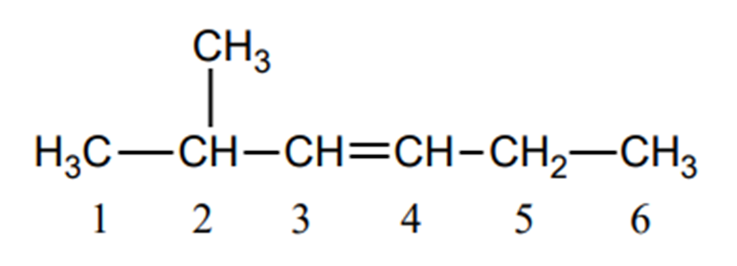
Example #1
6 Carbons
Longest continuous carbon chain with double bond?
Substituent group(s) off the main chain?
Number the chain starting at the nearest double bond –
Location of double bond?
Location of substituent group(s)?
NAME?
1 x CH₃ (methyl)
number left to right (equidistant double bond, but lower subst. group)
Carbon #3
Carbon #2
2-methyl-3-hexene

Slide 9
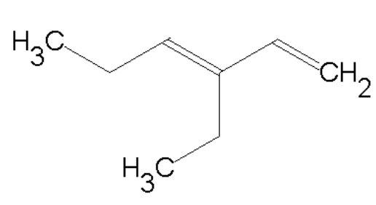
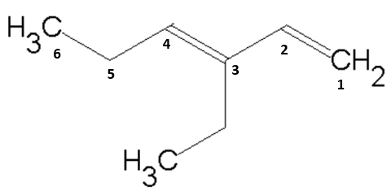
Example #2
6 Carbons
Longest continuous carbon chain with double bond?
Substituent group(s) off the main chain?
Number the chain starting at the nearest double bond –
Location of double bond(s)?
Location of substituent group(s)?
NAME?
1
1 x CH₂CH₃ (ethyl)
number right to left
Carbon #1 & #3
Carbon #3
3-ethyl-1,3-hexadiene

Slide 10
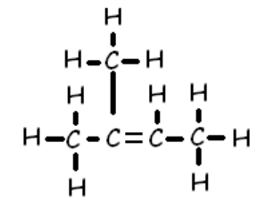
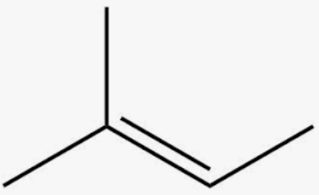
Drawing Structures from an IUPAC name
2-methyl-2-butene
Longest continuous carbon chain?
Substituent group(s) off the main chain?
Lowest possible carbon number of the double bond?
Location of substituent group(s)?
1. 4 Carbons
2. 1 x CH₃ (methyl)
3. Carbon #2
4. Carbon #2

Slide 11
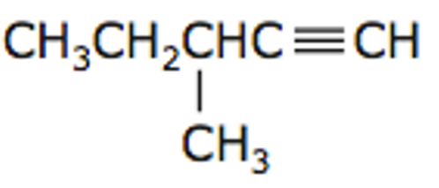
Alkynes
The alkynes are a family which contain at minimum one carbon-to-carbon triple bond. They are considered unsaturated hydrocarbons.
Example: 3-methyl-1-pentyne (C₆H₁₀)
The general formula for the alkenes is C_{n}H_{2n-2}
The names of alkynes end in ‘yne’.

Slide 12
Alkynes
First 9 Alkynes List
NAME | MOLECULAR FORMULA
Ethyne* | C₂H₂
Propyne | C₃H₄
1-Butyne | C₄H₆
1-Pentyne | C₅H₈
1-Hexyne | C₆H₁₀
1-Heptyne | C₇H₁₂
1-Octyne | C₈H₁₄
1-Nonyne | C₉H₁₆
1-Decyne | C₁₀H₁₈
*Ethyne – commonly known as Acetylene

Slide 13
Naming Alkynes
Name the parent hydrocarbon by locating the longest carbon chain that contains the triple bond and name it according to the number of carbons with the suffix -yne.
Number the carbons of the parent chain so the triple bond carbons have the lowest possible numbers.
If the triple bond is equidistant from each end, number so the first substituent has the lowest number.
Write out the full name, numbering the substituents according to their position in the chain and list them in alphabetical order.
If there are more than one of the same substituent use the prefixes di, tri, and tetra. These prefixes are not considered in the alphabetical order.
Indicate the triple bond by the number of the first alkyne carbon.
If more than one triple bond is present, indicate their position by using the number of the first carbon of each triple bond and use the suffix -diyne (for 2 triple bonds), -triyne (for 3 triple bonds), -tetrayne (for 4 triple bonds), etc.

Slide 14
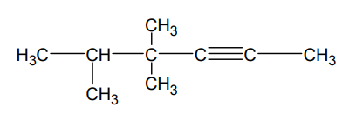
Example
6 Carbons
Longest continuous carbon chain with triple bond?
Substituent group(s) off the main chain?
Number the chain starting at the nearest triple bond –
Location of the triple bond?
Location of substituent group(s)?
NAME?
3 x CH₃ (methyl)
number right to left
Carbon #2
Carbon #4 (x2) & #5
4,4,5-trimethyl-2-hexyne

Slide 15
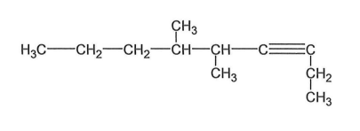
Example
9 Carbons
Longest continuous carbon chain with triple bond?
Substituent group(s) off the main chain?
Number the chain starting at the nearest triple bond –
Location of triple bond?
Location of substituent group(s)?
NAME?
2 x CH₃ (methyl)
number right to left
Carbon #3
Carbon #5 & #6
5,6-dimethyl-3-nonyne

Slide 16
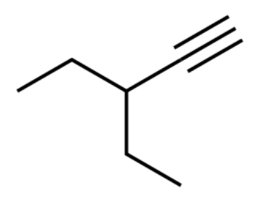
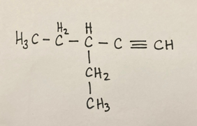
Drawing Structures from an IUPAC name
3-ethyl-1-pentyne
Longest continuous carbon chain?
Substituent group(s) off the main chain?
Carbon number of triple bond (-yne)?
Location of substituent group(s)?
1. 5 Carbons
2. 1 x CH₂CH₃ (ethyl)
3. Carbon #1
4. Carbon #3

Slide 17
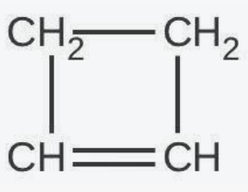
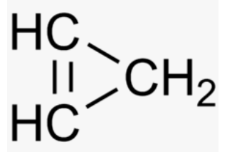
Cycloalkenes
Cycloalkenes are alkenes that consist of three or more carbon atoms linked together with at least one carbon-carbon double bond to form a structural ring but has no aromatic character.
Cycloalkenes have the general formula C_{n}H_{2(n-m).} The letter m represents the number of double bonds. They are considered unsaturated.
Cyclopropene
Cyclobutene

Slide 18
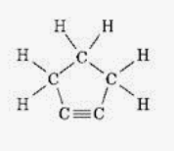
Cycloalkynes
Cycloalkynes have a general formula C_{n}H_{2n−4}. They are considered unsaturated.
Because of the linear nature of the C–C≡C–C alkyne unit, cycloalkynes can be highly strained and can only exist when the number of carbon atoms in the ring is great enough to provide the flexibility necessary to accommodate this geometry.
For example, cyclopentyne is an extremely unstable molecule.
it is a small membered ring structure
it has a triple bond in the molecule

Slide 19
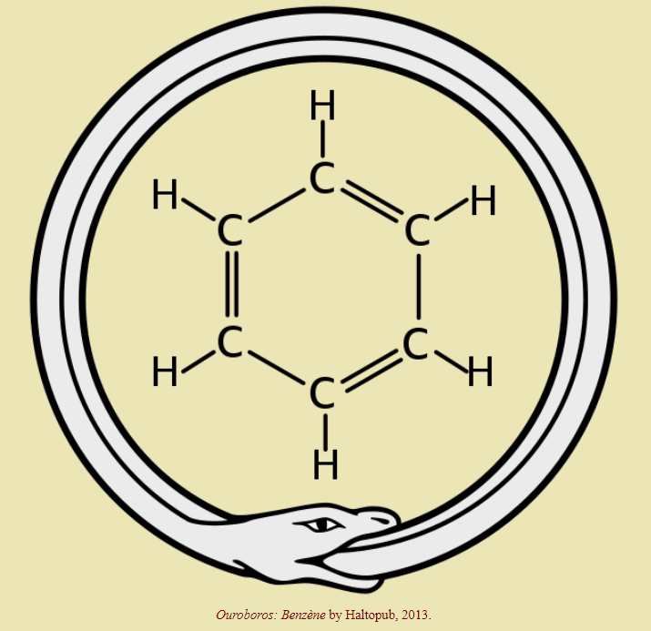
Aromatic Hydrocarbons
Contain one of more benzene rings (C₆H₆)
Benzene is a widely used, colourless liquid with a distinct odour and is a carcinogen (cancer-causing agent).
German chemist August Kekulé visualized the ring structure of benzene in 1865.
He claimed to have pictured the ring structure of benzene after dreaming of a snake eating its own tail.

Slide 20
Benzene Structural Drawings

Slide 22
Summary
Daily Learning Intentions:
Naming alkenes and alkynes
Cycloalkenes, cycloalkynes & benzene (characteristics)
The Daily Dozen - Grab an Index card from the front of the room & choose two questions from the list on the next slide to respond to about today’s lesson.
Preview next lesson: Exploring carbon-carbon bonds for rotational ability and geometry (cis and trans isomers). Characteristics of several functional groups.

Slide 23
The Daily Dozen
Grab an Index card from the front of the room.
Choose two questions from the list below to respond to about today’s lesson.
1.) The thing that made the most sense to me today was…
2.) One thing that I just don’t understand is…
3.) When someone asks me what I did in Chemistry today, I can say…
4.) One thing I would like more information about is…
5.) I need more examples of…
6.) I enjoyed…
7.) The most important concept that we discussed today was…
8.) Today’s class would have been even better if we had…
9.) I was confused by…
10.) The thing we did in class today that best fit my learning style was…
11.) The one thing the teacher did today that worked well for me was…
12.) The one thing the teacher did today that did not work well for me was…

