Slide 2
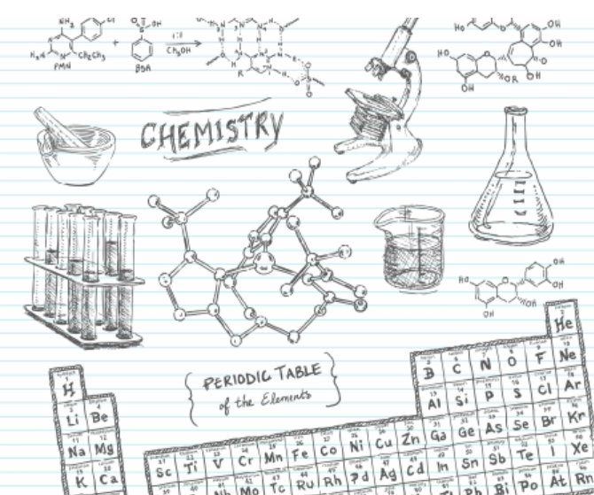
Big Idea: Organic chemistry and its applications have significant implications for human health, society, and the environment.
Essential Questions:
How does organic chemistry apply to your life?
How do organic compounds differ in structure and properties?
Daily Learning Intentions: I can recognize classifications of hydrocarbons and use the IUPAC nomenclature system for drawing/naming alkanes. I can identify structural isomers and key characteristics of cycloalkanes.

Slide 3
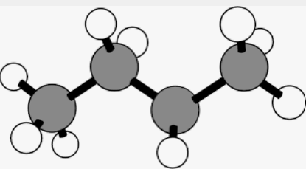
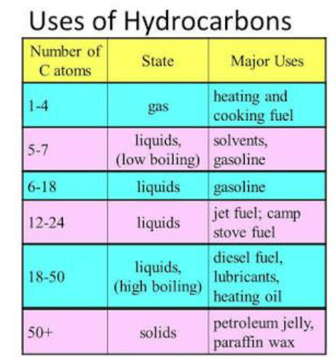
Hydrocarbons
Simplest organic compound
Contain only carbon & hydrogen
Many of the natural fuel sources we use are hydrocarbons
Hydrocarbons can be divided into Aliphatic and Aromatic

Slide 4
Chang textbook

Slide 5
Aliphatic Hydrocarbons
Aliphatic hydrocarbons have no benzene rings
They are divided into 4 categories:
Alkanes – single covalent bonds present
Cycloalkanes - ring shaped
Alkenes – contain at minimum 1 double bond between carbons
Alkynes – contain at minimum 1 triple bond between carbons

Slide 6
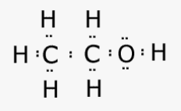
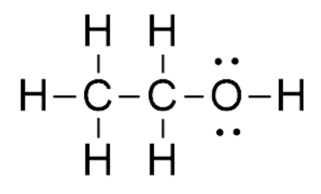
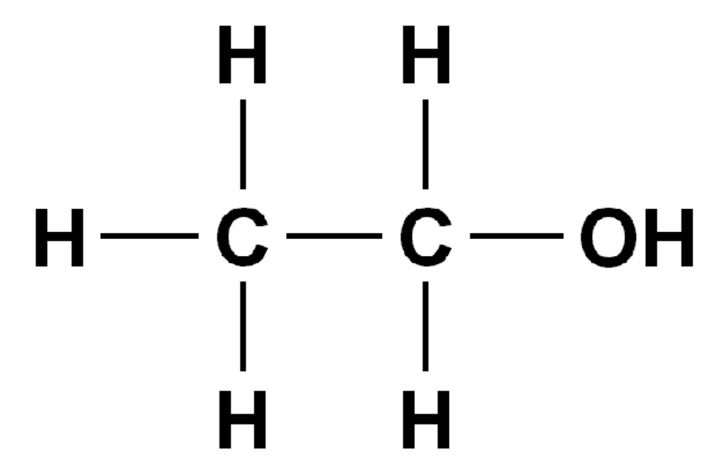
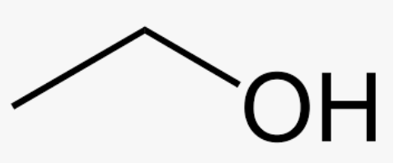
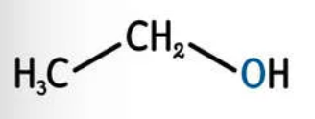
Drawing the Structure of Organic Molecules Example: Ethanol (Ethyl Alcohol)
C₂H₅OH
Molecular formula
Electron Dot / Lewis structure
CH₃CH₂OH
Condensed structural formula
Skeletal structural formula
Structural formula

Slide 7
Try It with Propane (C₃H₈)
Draw the Electron Dot / Lewis structure
Draw the Structural formula
Draw the Condensed structural formula
Draw the Skeletal formula

Slide 8
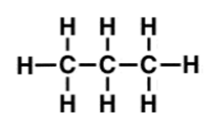
Propane (C₃H₈)
Draw the Electron Dot / Lewis structure
Draw the Structural formula
Draw the Condensed structural formula
Draw the Skeletal formula

Slide 9
What’s in a Name?

Slide 10
IUPAC Naming
The IUPAC (International Union of Pure and Applied Chemistry) system of nomenclature aims to ensure:
that every organic compound has a unique, unambiguous name.
that the IUPAC name of any compound conveys the structure of that compound to a person familiar with the system.

Slide 11
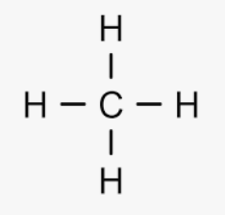
Alkanes
Hydrocarbons that only contain single bonds.
Alkanes are said to be saturated hydrocarbons because their hydrogen content is at a maximum (i.e., there is no room for other atoms to bond to the carbon skeleton).
Alkane general formula is C_{n}H_{2n+2}
All alkanes have a molecular formula which will match the general formula.
A general formula is used to represent the overall formula for a group of compounds.
The names of alkanes all end in “ane”.
Methane

Slide 12
Meth: "Monkeys"
Eth: "Eat"
Prop: "Peeled"
But: "Bananas"
Gas
@ 20°C
Liquid
@ 20°C
Liquid
@ 20°C
n- prefix = structure as a straight line

Slide 13
Structural Isomers
Isomers are compounds with different physical and chemical properties but the same molecular formula.
Greek isos meaning “equal”, and meros meaning “part”, a concept and term introduced by the Swedish scientist Jacob Berzelius in 1830.
In organic chemistry, there are many cases of isomerism.
Structural isomers, or constitutional isomers have the same molecular formula but a different bonding arrangement among the atoms.

Slide 15
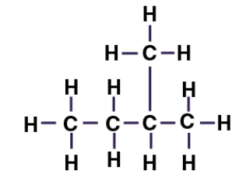
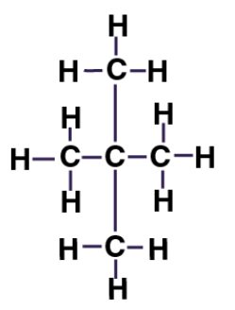
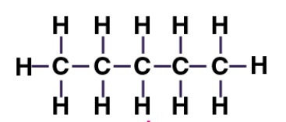
Example of Structural Isomers
Pentane (C₅H₁₂)
2-methylbutane
(isopentane)
(C₅H₁₂)
2,2-dimethylpropane
(neopentane)
(C₅H₁₂)

Slide 16
Examples

Slide 17
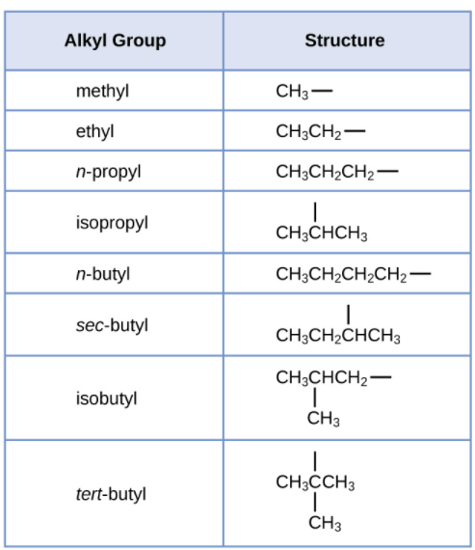
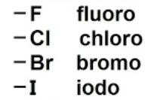
Alkyl Group
Alkyl group contains one less hydrogen than the corresponding alkane
In naming this group, the “-ane” is dropped and the “-yl” is added
Used as prefixes when naming structures
Other common substituents (Alkyl Halides)

Slide 18
IUPAC Rules for Alkane Nomenclature
Find and name the longest continuous carbon chain (parent chain).
Identify and name groups attached to this chain.
Number the chain consecutively, starting at the end nearest a substituent group.
Designate the location of each substituent group by an appropriate number and name.
Assemble the name, listing groups in alphabetical order.
Separate numbers from words with hyphens (-)
Separate numbers from other numbers with commas (,)
6. The prefixes di, tri, tetra etc., used to designate several groups of the same kind, are not considered when alphabetizing.

Slide 19
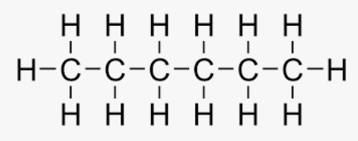
Example 1:
Longest continuous carbon chain?
Substituent group(s) off the main chain?
Number the chain starting at the nearest substituent group –
Location of substituent group(s)?
NAME?
6 Carbons
No
number in either direction as it will be the same
Not applicable
Hexane

Slide 20
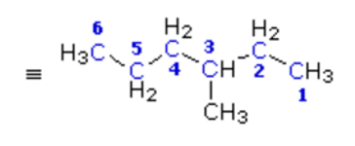
Example 2:
Longest continuous carbon chain?
Substituent group(s) off the main chain?
Number the chain starting at the nearest substituent group –
4. Location of substituent group(s)?
NAME?
6 Carbons
CH₃ (methyl)
number right to left in this case
Carbon #3
3-methylhexane

Slide 21
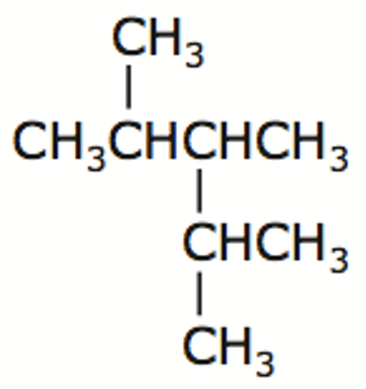
Example 3:
1
2
3
4
5
5 Carbons
Longest continuous carbon chain?
Substituent group(s) off the main chain?
Number the chain starting at the nearest substituent group –
4. Location of substituent group(s)?
NAME?
3 x CH₃ (methyl)
number in either direction as it will be the same
Carbons #2, 3 & 4
2,3,4-trimethylpentane

Slide 22
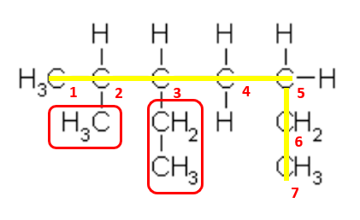
Drawing Structures from an IUPAC name
3-ethyl-2-methylheptane
Longest continuous carbon chain?
Substituent group(s) off the main chain?
Number the chain starting at the nearest substituent group
Location of substituent group(s)?
1. 7 Carbons
2. 1 x CH₃ (methyl) & 1 x CH₂CH₃ (ethyl)
3. number left to right
4. Carbons #2 & 3

Slide 23
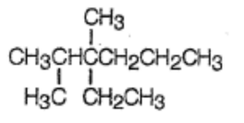
Drawing Structures from an IUPAC name
3-ethyl-2,3-dimethylhexane
Longest continuous carbon chain?
Substituent group(s) off the main chain?
Number the chain starting at the nearest substituent group
Location of substituent group(s)?
1. 6 Carbons
2. 2 x CH₃ (methyl) & 1 x CH₂CH₃ (ethyl)
3. number left to right
4. Carbons #2 & 3

Slide 24
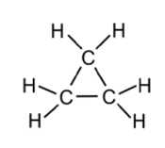
Cycloalkanes
As well as forming chains, carbon atoms can also bond to form rings.
Compounds whose molecules contain rings of carbon atoms with only single bonds are called cycloalkanes. They are saturated hydrocarbons.
There are also polycyclic alkanes, which are molecules that contain two or more cycloalkanes that are joined, forming multiple rings.
The general formula for the cycloalkanes is C_{n}H_{2n}
Example: cyclopropane
Cyclic hydrocarbons have the prefix "cyclo-".

Slide 25
Summary
Daily Learning Intentions:
Classification of hydrocarbons & different structure formulas
Alkanes, alkyl groups, substituent groups, structural isomers & naming
Cycloalkanes (definition)
The Daily Dozen - Grab an Index card from the front of the room & choose two questions from the list on the next slide to respond to about today’s lesson.
Preview next lesson: Alkenes & Alkynes

Slide 26
The Daily Dozen
Grab an Index card from the front of the room.
Choose two questions from the list below to respond to about today’s lesson.
1.) The thing that made the most sense to me today was…
2.) One thing that I just don’t understand is…
3.) When someone asks me what I did in Chemistry today, I can say…
4.) One thing I would like more information about is…
5.) I need more examples of…
6.) I enjoyed…
7.) The most important concept that we discussed today was…
8.) Today’s class would have been even better if we had…
9.) I was confused by…
10.) The thing we did in class today that best fit my learning style was…
11.) The one thing the teacher did today that worked well for me was…
12.) The one thing the teacher did today that did not work well for me was…

