Slide 1
Organic Chemistry
Chemistry 11
Chapters 24 & 25

Slide 2
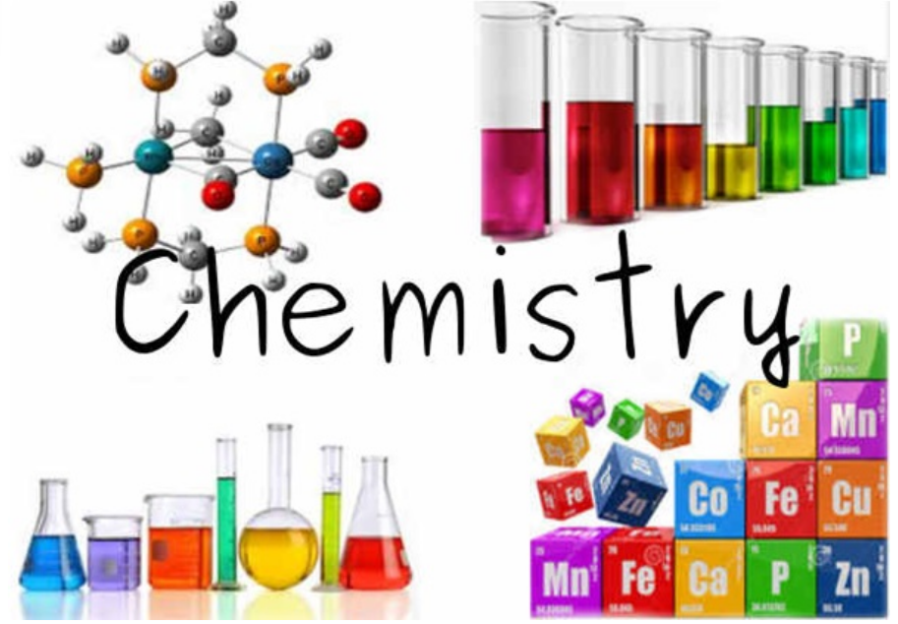
Big Idea: Organic chemistry and its applications have significant implications for human health, society, and the environment.
Essential Questions:
How is carbon the basis for all living things?
How does organic chemistry apply to your life?
Daily Learning Intention: I can identify some major sources of organic chemicals and uses of organic molecules in my life.

Slide 3
Question:
Think about the word ‘ORGANIC’
What is the first thought that comes to your mind?
How would you define something as being organic?
Does this definition fit with Organic Chemistry?

Slide 4
Organic Chemistry – Historical Origins
Originally, organic chemistry was defined as the study of compounds created by living organisms. Before 1828, all organic compounds were obtained from living organisms.
In 1828, urea (the compound contained in animal urine) was synthesized from inorganic substances by German scientist Frederich Wohler in his laboratory, paving the way for a new definition of organic chemistry.

Slide 5
Organic Chemistry
Organic compounds became any chemical compound which contains carbon.
So, what about Inorganic Carbon Compounds? Confusing!
Even if a compound contains carbon, it may not be classified as an organic compound.
For historical reasons, a few classes of carbon-containing compounds (e.g., carbonate salts and cyanide salts), along with a few other exceptions (e.g., carbon dioxide), are not classified as organic compounds and are considered inorganic.
Most organic compounds contain carbon and hydrogen, but they may also include any number of other elements (e.g., nitrogen, oxygen, halogens, phosphorus, silicon, sulfur).

Slide 6
Why is Carbon Special?

Slide 7
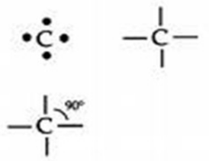
Organic Compounds
The backbone of organic compounds is carbon because it has 4 valence electrons & each atom can form 4 separate bonds.
Organic chemicals get their diversity from the many ways carbon-carbon bonds form: Single, double, triple bonds; chains & ring structures.
The branch of chemistry that deals with carbon compounds is called organic chemistry.

Slide 8
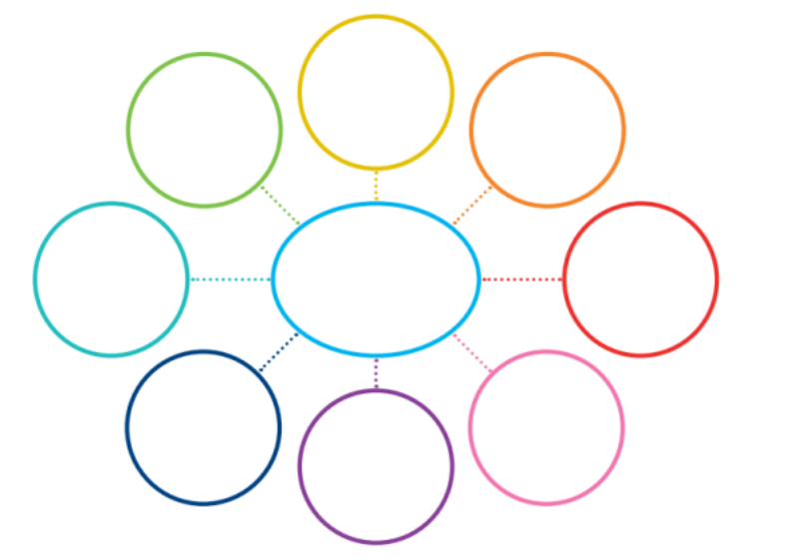
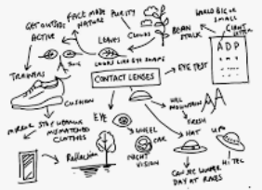
Think – Pair – Share What are some major sources of organic chemicals and uses of organic molecules? (How does organic chemistry apply to your life?)
Graphic organizer / Mind map
Lists
Drawings / Doodles
Or a combination!

Slide 9
Thefactfactor.com

Slide 11
Follow-up Questions…
Sources of organic compounds
Uses of organic molecules
What are the positive impacts / effects?
What are the negative impacts / effects?
Does organic chemistry affect everyone’s life in the same way?
Why or why not?

Slide 12
Organic Chemistry: Unit Learning Intentions
Carbon is the backbone of all organic molecules.
Identify several major sources of organic chemicals and uses of organic molecules around us.
Introduce Aliphatic (Alkanes, Cycloalkanes, Alkenes, Alkynes) & Aromatic (ex. Benzene) Hydrocarbon classes.
Explore definitions of:
Saturated / Unsaturated
Alkyl substituent groups
Halide substituent groups: fluoro, chloro, bromo, iodo
Other functional groups: alcohol, aldehyde, ketone, ester, organic acid, ester, amine, and/or amide.

Slide 13
Organic Chemistry: Unit Learning Intentions (con’t)
Review and apply structural forms & IUPAC System naming rules. Name and draw structures for hydrocarbons up to C-10 in length.
Using molecular models compare the types of bonds formed between carbon atoms and those of other elements such as chlorine, oxygen, and nitrogen.
Explore carbon-carbon bonds for rotational ability and geometry (cis and trans isomers).
Recognize / draw a Benzene ring and explain how the term “resonance” applies.
Brief introduction to Polymer chemistry

Slide 14
Wrap-Up
Daily Learning Intention: I can identify some major sources of organic chemicals and uses of organic molecules in my life.
Exit Ticket – Please take one, fill it out and hand it back to me before you leave today.
Preview next lesson:
Hydrocarbon classifications – Alkanes and Naming Rules

