Slide 1
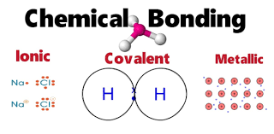
Chapter 9
Chemical Bonding I: Basics

Slide 2
9.1: Lewis Dot Diagrams
Lewis structures show the outer most VALENCE electrons (The electrons involved in bonding).
Gilbert Lewis hypothesized that elements gain or lose e⁻ to fill their outer most (or empty) to become more stable.
Completing Lewis Dot Diagrams for elements can be a really good way of seeing/explaining why certain elements gain e⁻ and why others lose e⁻.

Slide 3
9.1: Lewis Dot Diagrams
When deciding how many dots (electrons) to draw you refer to the GROUP number on the periodic table.
Let’s draw chlorine for example:
Neutral Atom
Ion (Cl⁻_{(aq)})
Cl
How many dots do I draw?

Slide 4
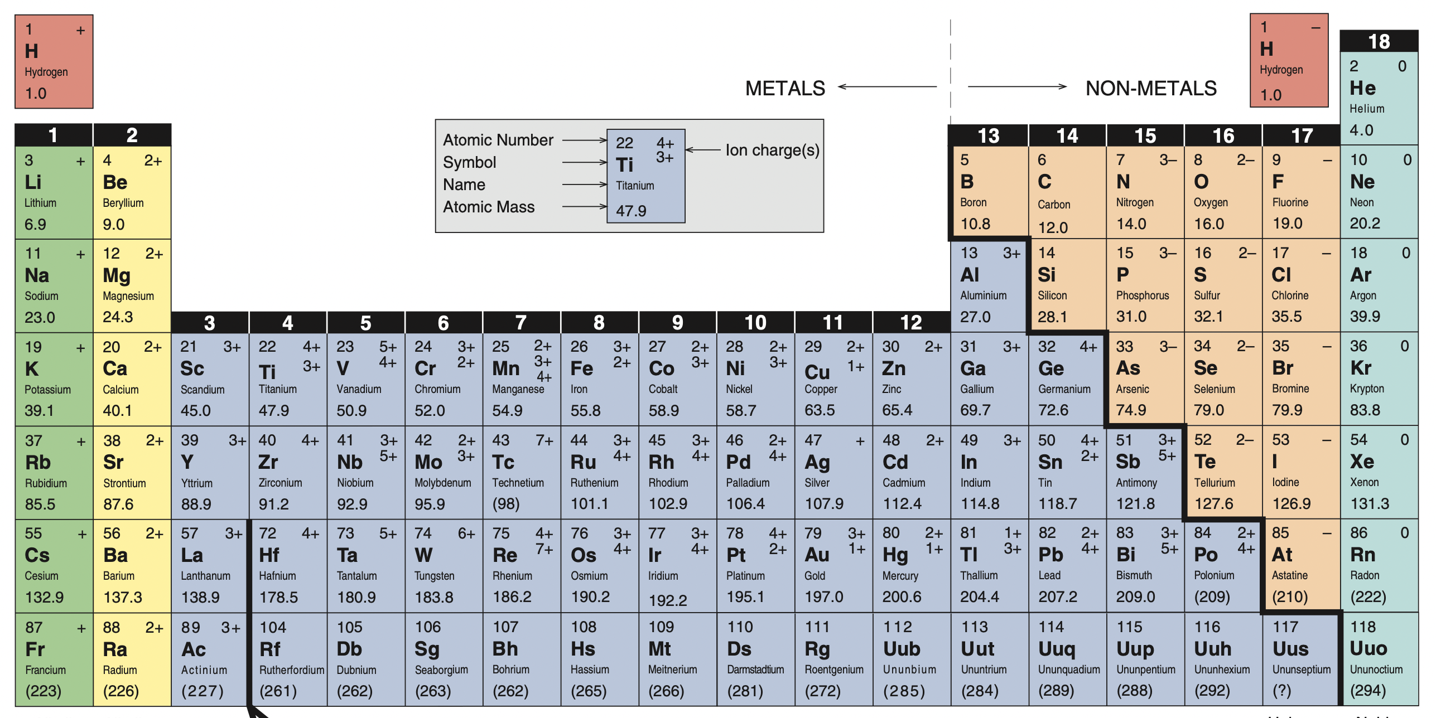
9.1: Lewis Dot Diagrams
It’s in Group VII.(7)
So draw 7 dots.

Slide 5
9.1: Lewis Dot Diagrams
Neutral Atom
Ion (Cl⁻_{(aq)})
Cl
Cl
DONE
What did you notice?

Slide 6
9.1: Lewis Dot Diagrams
When deciding how many dots (electrons) to draw you refer to the GROUP number on the periodic table.
Let’s draw Magnesium for example:
Neutral Atom
Ion (Cl⁻_{(aq)})
Mg
How many dots do I draw?

Slide 7
9.1: Lewis Dot Diagrams
It’s in Group II.(2)
So draw 2 dots.

Slide 8
9.1: Lewis Dot Diagrams
Neutral Atom
Ion (Mg²⁺_{(aq)})
Mg
Mg
DONE
DONE
What did you notice?
What did you notice?

Slide 9
9.1: Lewis Dot Diagrams
Neutral Atom
Ion (Cl⁻_{(aq)})
Mg
Cl
Ion (Mg²⁺_{(aq)})
Cl
Mg
MgCl₂

Slide 10
9.2: The Ionic Bond
Ionic bonds are formed from the GAIN or LOSS of electrons (Like the previous slide with MgCl₂)
The anion GAINS electrons and becomes negatively charged in an ionic compound.
-
F
+ e⁻
-->
F

Slide 11
Example 9.1
Use Lewis symbols to show the formation of aluminum oxide (Al₂O₃) from its elements.
`
`
Al
Al
[Al]³⁺
+ [Al]³⁺
`
`
`
`
+
[ O ] ²⁻
O
O
O
[ O ] ²⁻
`
`
`
`
`
`
+
[ O ] ²⁻

Slide 12
Example 9.1
Use Lewis symbols to show the formation of aluminum oxide (Al₂O₃) from its elements.
Al
Al
Atoms
(Neutral Charge)
O
O
O

Slide 13
Example 9.1
Use Lewis symbols to show the formation of aluminum oxide (Al₂O₃) from its elements.
Al
Al
Electron Transfer
(Ionic Bonds)
O
O
O

Slide 14
Example 9.1
Use Lewis symbols to show the formation of aluminum oxide (Al₂O₃) from its elements.
[ ] ³⁺
Al
Al
[ ] ³⁺
Ions
(“Excited State”)
[ ] ²⁻
O
O
O
[ ] ²⁻

Slide 15
Example: Practice Exercise 9.1
Use Lewis dot symbols to represent the formation of barium hydride (BaH₂).

Slide 16
9.3: Lattice Energy of Ionic Compounds (Basic Overview)
We see and write Ionic compounds in SIMPLEST RATIOS like Fe₂O₃
Lattice energy of an Ionic compound is ALL the bonds in 1 mol of compound…not its simple formula…

Slide 17
9.3: Lattice Energy of Ionic Compounds (Basic Overview)
X
Lattice energy of an Ionic compound is ALL the bonds in 1 mol of compound…not its simple formula…
Fe₂O₃
O
O
Fe
Fe
O

Slide 18
9.4: The Covalent Bond
In Covalent Compounds (Non-Metal and Non-metal) the electrons that form the bonds are SHARED, NOT transferred as in Ionic Compounds.
NH₃
(Ammonia)
H
N

Slide 19
9.4: The Covalent Bond
In Covalent Compounds (Non-Metal and Non-metal) the electrons that form the bonds are SHARED, NOT transferred as in Ionic Compounds.
NH₃
Bonding electrons
(Ammonia)
H
H
N
H
Lone Pair

Slide 20
Comparison of the Properties of Covalent and Ionic Compounds
TRANSFERRING electrons is a stronger bond than SHARING electrons.
Thus, covalent (share electrons) compounds are usually gasses (g) or liquids (l).
Solid covalent compounds do exist, but they have really low melting points….Melt at really low temperature.

Slide 21
9.5: Electronegativity
Electronegativity:
The ability of an atom to draw electrons towards itself.
The LARGER an atom’s electronegativity the stronger its ability to take electrons and form negative ions.

Slide 22
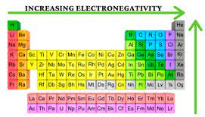
9.5: Electronegativity

Slide 23
9.5: Electronegativity
Large differences in electronegativity of elements that are joined together cause the negative electron to move closer to the electronegative element.
H
H
N
N

Slide 24
9.5: Electronegativity

Slide 25
9.5: Electronegativity
Large differences in electronegativity of elements that are joined together cause the negative electron to move closer to the electronegative element.
H
H
N
N

Slide 26
Example 9.2
Classify the following bonds as ionic, polar covalent, or covalent: a) the bond in HCl, b) the bond in KF, and c) C-C bond in H₃CCH₃.
H
H
Cl
Cl

Slide 27
9.5: Electronegativity

Slide 28
Example 9.2
Classify the following bonds as ionic, polar covalent, or covalent: a) the bond in HCl, b) the bond in KF, and c) C-C bond in H₃CCH₃.
A bond dipole shows the uneven sharing of electrons. Positive pole (+) pointing towards negative pole.
H
H
Cl
Cl

Slide 29
Example 9.2
Classify the following bonds as ionic, polar covalent, or covalent: a) the bond in HCl, b) the bond in KF, and c) C-C bond in H₃CCH₃.
K
K
F
F

Slide 30
9.5: Electronegativity

Slide 31
Example 9.2
Classify the following bonds as ionic, polar covalent, or covalent: a) the bond in HCl, b) the bond in KF, and c) C-C bond in H₃CCH₃.
K
K
F
F

Slide 32
Example 9.2
Classify the following bonds as ionic, polar covalent, or covalent: a) the bond in HCl, b) the bond in KF, and c) C-C bond in H₃CCH₃.
Both atoms are the same...so same electronegativity. No Polarity. No Dipole.
C
C
C
C

Slide 33
Example: Practice Exercise 9.2
Which of the following bonds is covalent , which is polar covalent, and which is Ionic? a) the bond in CsCl, b) The bond in H₂S, c) The N-N bond in H₂NNH₂.

Slide 34
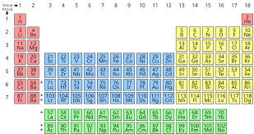
9.6: Writing Lewis Structures
When drawing the Lewis structure for a compound you should:
Step 1. Determine which atom has the highest bonding capacity and put it in the middle. (if it forms multiple bond it will probably join to multiple other things..)
H₂O →
H
O
H
Group 1 = 1 dot or 1 bonding capacity.
Group 16 = 6 dots or 6 bonding capacity.

Slide 35
9.6: Writing Lewis Structures
Step 2. Place the dots around each atom placing ONLY 1 dot at a time in a clockwise direction.
(1)
(6)
(1)
H₂O →
H
O
H
Notice how O has 2 single dots and there are two Hs…interesting.
H
O
H

Slide 36
9.6: Writing Lewis Structures
*Whenever you have TWO single electrons right next to each other they can form a bond (-).
H₂O →
H
O
H
H
O
H
H
O
H

Slide 37
Example 9.3
Write the Lewis structure for nitrogen trifluoride (NF₃) in which all three F atoms are bonded to the N (central) atom.
Highest Bonding Capacity
(N in Group 15)
N
F
F
F
F
N
F
F
F
N
F
F

Slide 38
Example: Practice Exercise 9.3
Write the Lewis structure for carbon disulfide (CS₂).

Slide 39
Example 9.4
Write the Lewis structure for nitric acid (HNO₃) in which the three O atoms are bonded to the central N atom and the ionizable H atom is bonded to one of the O atoms.
Highest Bonding Capacity
(N in Group 15)
N
O
O
O
H
O
N
O
H
O
N
O
H
O
O

Slide 40
Example: Practice Exercise 9.4
Write the Lewis structure for formic acid (HCOOH).

Slide 41
9.7: Formal Charge and Lewis Structure (Basic Concept)
When drawing the Lewis structure for a compound you should:
Step 3: After placing the number of “dots” (electrons) determined by the group that the element is in.
Oxygen (O) in in group 16….so 6 electrons (dots).
Example:
O
Anymore electron “dots” and you will overpower the valence protons (+).

Slide 42
9.7: Formal Charge and Lewis Structure (Basic Concept)
If can add “extra” electron dots to a neutral (same # of dots as group number).
But if you do, you change the element’s (or compounds) FORMAL CHARGE.
Oxygen (O) in in group 16….so 6 electrons (dots).
Example:
O
Anymore electron “dots” and you will overpower the valence protons (+).

Slide 43
9.7: Formal Charge and Lewis Structure (Basic Concept)
If can add “extra” electron dots to a neutral (same # of dots as group number).
But if you do, you change the element’s (or compounds) FORMAL CHARGE.
Example:
-
2-
Add another dot and you make the formal charge 1 more -.
O

Slide 44
Example 9.5
Write the Lewis structure for the carbonate ion (CO3²⁻).
Highest Bonding Capacity
(C in Group 14)
C
O
O
O
2-
O
C
O
O
C
O
O
O

Slide 45
Example: Practice Exercise 9.5
Write the Lewis structure for the nitrite ion (NO₂⁻).

Slide 46
9.8: The Concept of Resonance
As you probably noticed you can add “dots” electrons and bonds to DIFFERENT elements in a compound.
Different “Versions” or “Configurations” of ”dots and bonds” around an element in a compound is called Resonance.

Slide 47
9.9: Exceptions to the Octet Rule (Basic Concepts)
Just that they do exist.
We don’t learn…thus we don’t “Test” about exceptions.

Slide 48
9.10: Bond Enthalpy (Basics Relating to Stability)
All you need to know about enthalpy is:
1. Large negative 𝚫H is very reactive and spontaneously reacts.
2. Large positive 𝚫H is very stable.

Slide 49
Key Words
Bond Enthalpy (P. 385)
Bond Length (P.368)
Covalent Bond (P. 366)
Covalent Compound (P. 366)
Double Bond (P. 367)
Electronegativity (P. 369)
Formal Charge (P. 375)
Ionic Bond (P. 359)
Lattice energy (P. 361)
Lewis Dot Diagram (P. 358)
Lewis Structure (P. 366)
Lone Pair (P. 366)
Multiple Bond (P. 367)
Octet Rule (P. 367)
Polar Covalent Bond (P. 369)
Resonance (P. 378)
Resonance structure (P. 378)
Single Bond (P. 367)
Triple Bond (P. 367)

