Slide 1
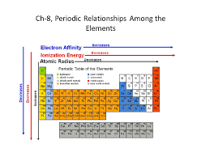
Chapter 8
Periodic Relationships Among the Elements

Slide 2
8.1: Development of the Periodic Table
In 1864 John Newland noticed that classifying elements according to atomic mass would group similar elements together…
Newland’s “Law of Octaves” did not work beyond Calcium and thus was not universally accepted.
In 1869 multiple scientists such as Dmitri Mendeleev proposed the modern arrangement of the periodic table.

Slide 3
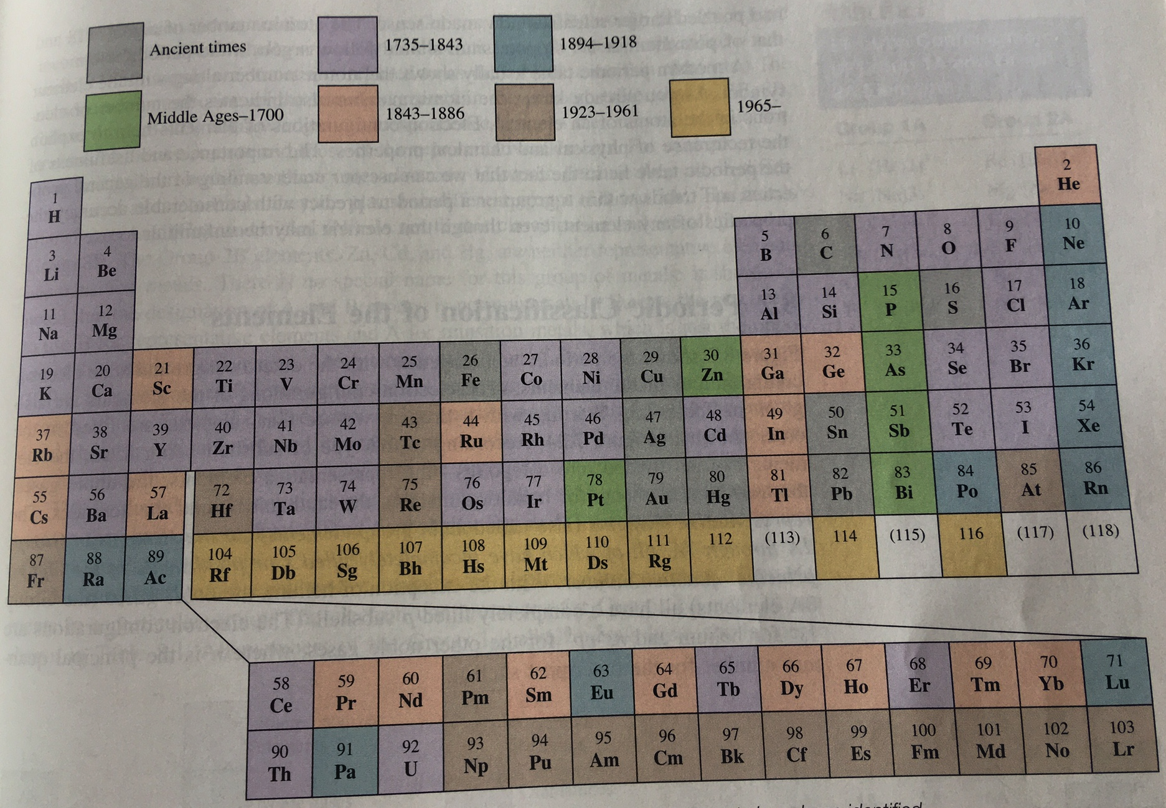
8.1: Development of the Periodic Table

Slide 4
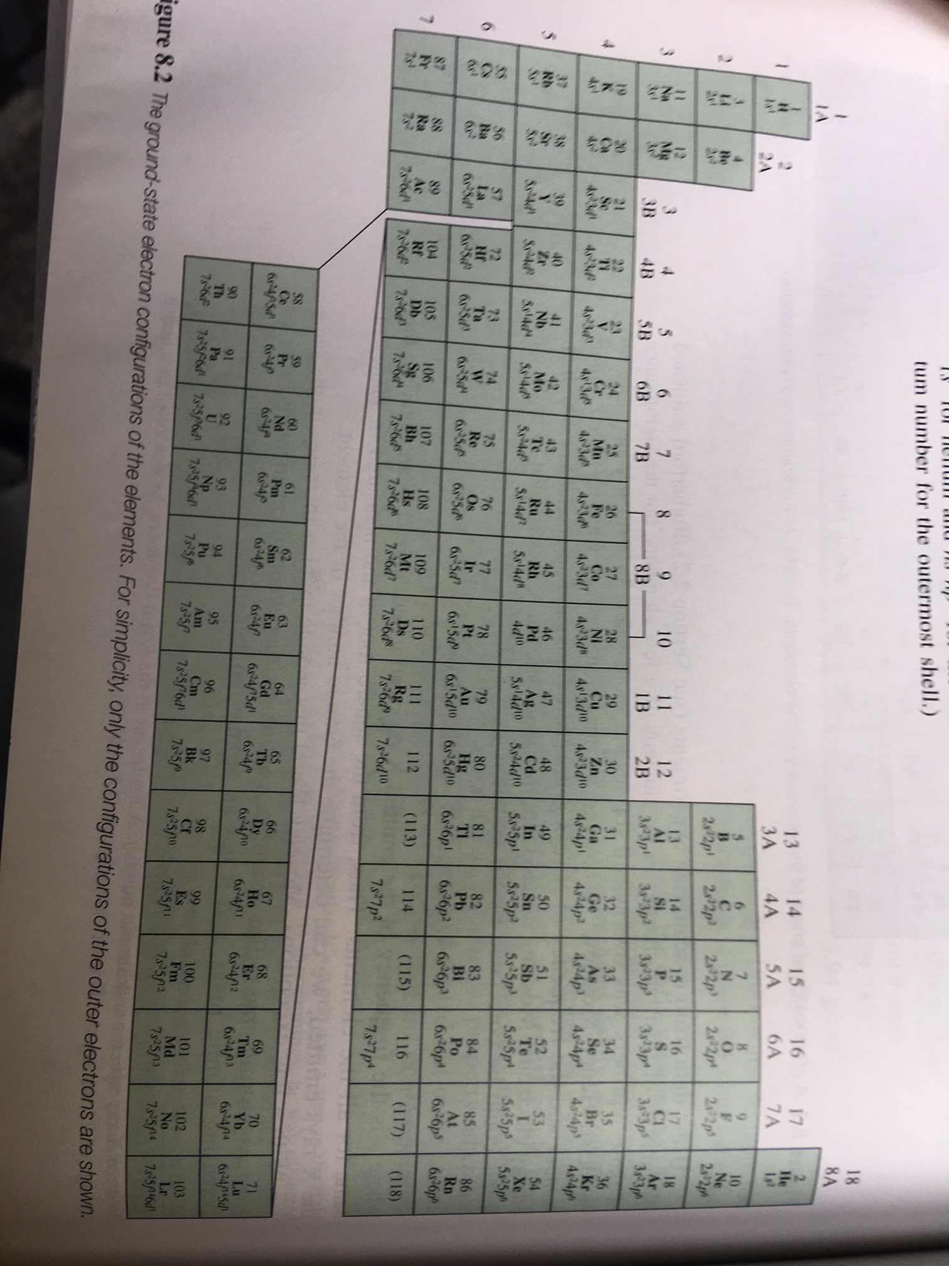
8.2: Periodic Classification of the Elements
Representative Elements
Transition Metals
Lanthanides
Actinides

Slide 5
Example 8.1
An atom of a certain element has 15 electrons. Without consulting a periodic table, answer the following questions: a) What is the ground-state electron configuration of the element? b) How should the elements be classified? c) Is the element diamagnetic or paramagnetic?
??? (15)
a)
1s
2s
2p
3s
3p
1s²2s²2p⁶3s²3p³
b)
Group 5A (15)
c)
Unpaired electron orbitals so Paramagnetic.

Slide 6
Example: Practice Exercise 8.1
An atom of a certain element has 20 electrons. a) Write the ground-state electron configuration of the element. b) classify the element, c) determine whether the element is diamagnetic or paramagnetic.

Slide 7
Representing Free Elements in Chemical Equations
Most elements on the periodic table exist as individual molecules so we represent them with their symbol from the periodic table.
Calcium → Ca
Iron → Fe
Silver → Ag
Lithium → Li
Some elements on the periodic table do not exist as individual molecules so we represent them with their symbol from the periodic table and a subscript.
Who cares?
Sulfur → S₈
Screws up Balancing
Hydrogen → H₂
Oxygen → O₂
Phosphorus → P₄

Slide 8
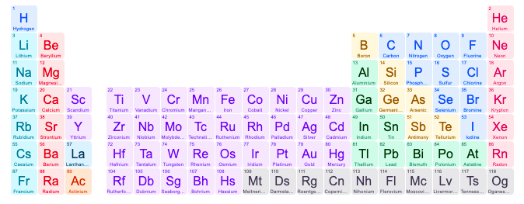
N₂
O₂
F₂
Cl₂
The “Power 7”
P₄
Br₂
H₂
S₈
I₂

Slide 9
Electron Classifications of Cations and Anions
When elements change from Atom (neutral) to ions (charged) they either gain or lose e⁻.
The gaining or losing e- is done to fill or empty the last orbital.
Lose e⁻
Li (3)
Li (3)
1s
2s
1s
2s
Atom (NEUTRAL)
Li⁺
Ion (Charged)

Slide 10
8.3: Periodic Variations in Physical Properties
O (8)
Gain 2e⁻
1s
2s
2p
1s
2s
2p
Atom (NEUTRAL)
O²⁻
Ion (Charged)

Slide 11
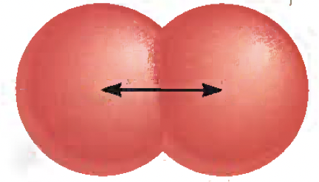
Atomic Radius
Atomic Radius:
Is ½ the distance between two neighboring (next to each other) neclei (plural of nucleus). **TWO OF THE SAME ELEMENT**
Just like with magnets, the positive nucleus (has positive protons) is attracted to the negatively charged electrons.
And just like magnets, the further they are apart from each other (atomic radius), the weaker the attraction (Pull).

Slide 12
Atomic Radius
Atomic Radius affects all kind of things like:
Boiling/Condensing Point
Density
Freezing/Melting Point
Ionization energy (Energy involved in bonding and electrons exchanges)
Elements on the periodic table have a trend/pattern of increasing atomic radius.

Slide 13
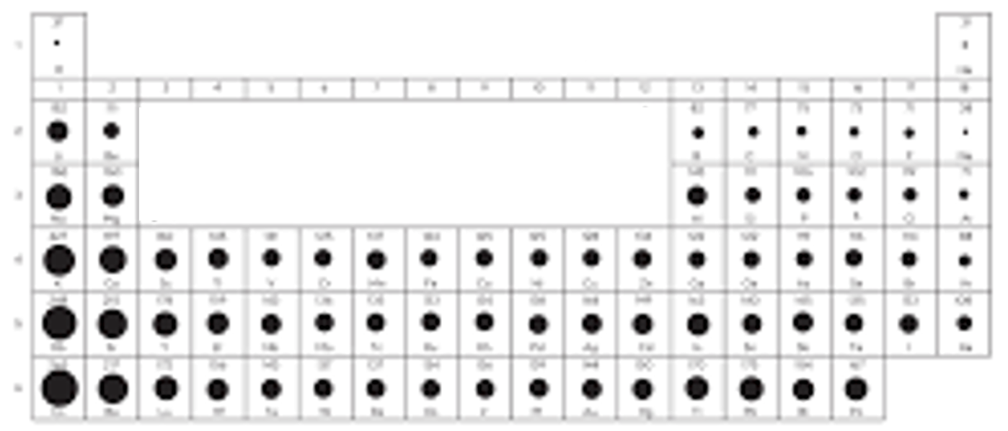
Atomic Radius
Elements on the periodic table have a trend/pattern of increasing atomic radius.
Atomic radius increases as you go down (increase atomic number) in a family.
Atomic radius increases from Non-metals to Metals.

Slide 14
Example 8.2
Referring to a periodic table, arrange the following atoms in order of increasing atomic radius: P, Si, N.
P
Si
N
P
Si

Slide 15
Example: Practice Exercise 8.2
Arrange the following atoms in order of decreasing radius: C, Li, Be.

Slide 16
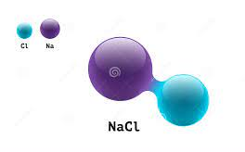
Ionic Radius
Ionic Radius:
Is ½ the distance between two neighboring (next to each other) cation and anion.
Ionic radius is greatly impacted by the number of e- an element has.

Slide 17
Ionic Radius
Ionic Radius:
Thus, when metals lose e⁻ and become cations they get smaller.
+ 1e⁻
Na⁺
(Cation)
Na
(neutral atom)

Slide 18
Ionic Radius
Ionic Radius:
Vice Versa, when non-metals gain e⁻ and become Anions they get bigger.
+ 1e⁻
Cl
(neutral atom)
Cl⁻
(Anion)

Slide 19
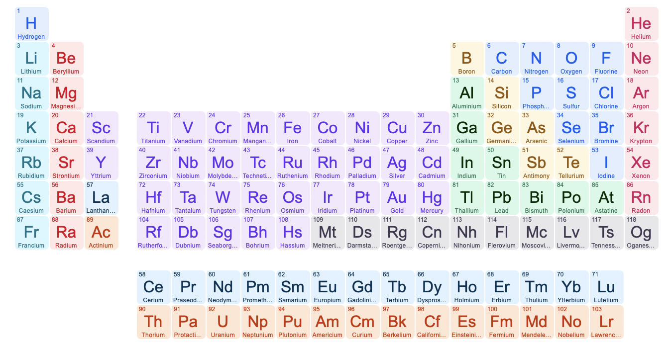
Example 8.3
For each of the following pairs, indicate which one of the two species is larger: a) N³⁻ or F⁻
b) Mg²⁺ or Ca²⁺ c) Fe²⁺ or Fe³⁺.
N³⁻
7 e-
+ 3 e-
=
10 e-
=

Slide 20
Example 8.3
For each of the following pairs, indicate which one of the two species is larger: a) N³⁻ or F⁻
b) Mg²⁺ or Ca²⁺ c) Fe²⁺ or Fe³⁺.
F⁻
9 e-
+ 1 e-
=
10 e-
=

Slide 21
Example 8.3
For each of the following pairs, indicate which one of the two species is larger: a) N³⁻ or F⁻
b) Mg²⁺ or Ca²⁺ c) Fe²⁺ or Fe³⁺.
N³⁻
7 e-
+ 3 e-
=
10 e-
=
SAME....not helpful.
F⁻
9 e-
+ 1 e-
=
10 e-
=

Slide 22
Example 8.3
For each of the following pairs, indicate which one of the two species is larger: a) N³⁻ or F⁻
b) Mg²⁺ or Ca²⁺ c) Fe²⁺ or Fe³⁺.

Slide 23
Example 8.3
For each of the following pairs, indicate which one of the two species is larger: a) N³⁻ or F⁻
b) Mg²⁺ or Ca²⁺ c) Fe²⁺ or Fe³⁺.
Nitrogen has less protons than Fluorine.
Nitrogen is bigger.

Slide 24
Example 8.3
For each of the following pairs, indicate which one of the two species is larger: a) N³⁻ or F⁻
b) Mg²⁺ or Ca²⁺ c) Fe²⁺ or Fe³⁺.
Calcium has WAY more protons and electrons than Magnesium.
Calcium is A LOT bigger.

Slide 25
Example 8.3
For each of the following pairs, indicate which one of the two species is larger: a) N³⁻ or F⁻
b) Mg²⁺ or Ca²⁺ c) Fe²⁺ or Fe³⁺.
Fe 3⁺ has 1 less e⁻.
Fe²⁺ is bigger.

Slide 26
Example: Practice Exercise 8.3
Select the smaller ion in each of the following pairs: a) K⁺ or Li+ b) Au⁺ or Au³⁺ c)P³⁻ or N³⁻.

Slide 27
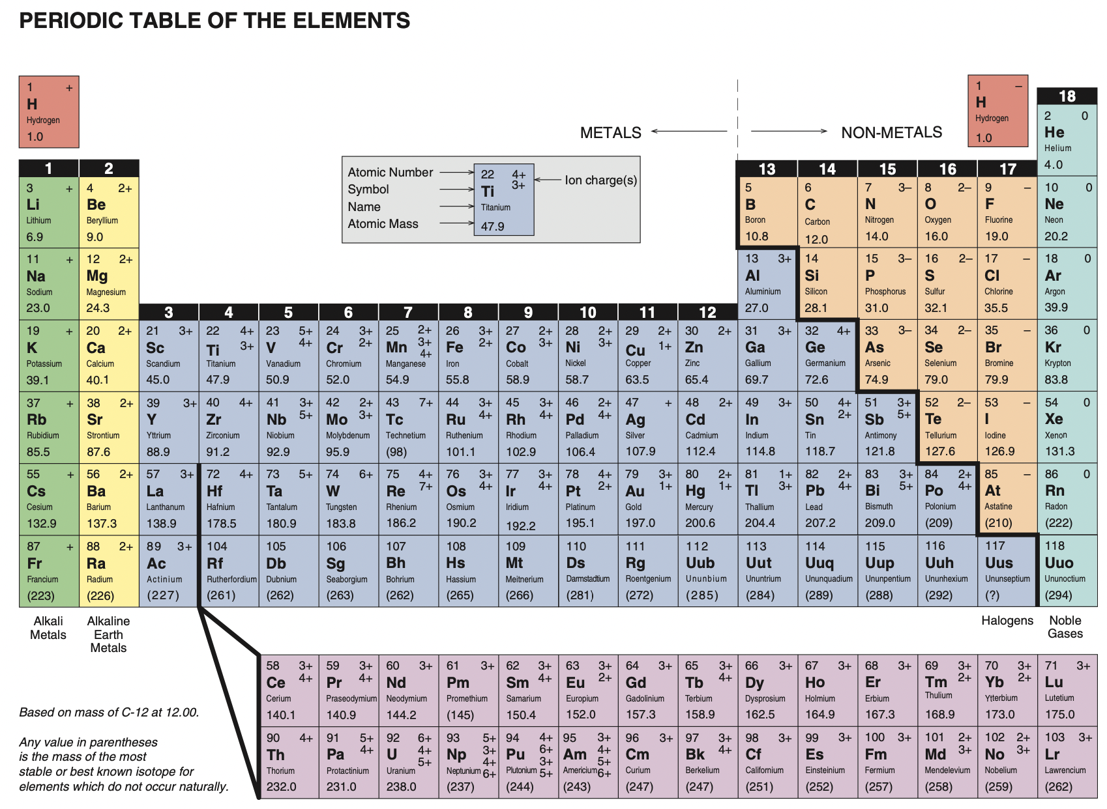
Variation of Physical Properties Across a Period and Within a Group
As you move from Right to Left ACROSS a period (horizontal), you move from non-metals to metalloids to transition metals to metals.

Slide 28
Variation of Physical Properties Across a Period and Within a Group
Also,
As you move ACROSS a period to metals you move from diatomic non-metals to single element metals.

Slide 29
Variation of Physical Properties Across a Period and Within a Group
As you move to metals, you INCREASE boiling and Melting points.

Slide 30
8.4: Ionization Energy
Ionization Energy:
Is the minimum amount of energy needed to remove an electron (AKA become positively charged)
Li _{(s)}
+ _{Energy}
Li⁺ _{(aq)} + e⁻
Metals that lose electrons to form Positive Cations have LOW Ionization energy.

Slide 31
8.4: Ionization Energy
Ionization Energy:
Is the minimum amount of energy needed to remove an electron (AKA become positively charged)
Cl₂ _{(g)}
+ _{Energy}
Cl⁺ _{(g)} + e⁻
Non-metals that DO NOT lose electrons to form Positive Cations have HIGH Ionization energy.

Slide 32
Example 8.4
a) Which atom should have a smaller first ionization energy: oxygen or sulfur? b) Which atom should have a higher second ionization energy: lithium or beryllium?
O = 1S² 2S² 2P⁴
S = 1S² 2S² 2P⁶ 3S² 3P⁴
* The 4 electrons in Sulfur the outermost orbital are further from the positive nucleus, thus easier to strip away THUS = Lower Ionization Energy.

Slide 33
Example 8.4
a) Which atom should have a smaller first ionization energy: oxygen or sulfur? b) Which atom should have a higher second ionization energy: lithium or beryllium?
Li = 1S² 2S¹
Be = 1S² 2S²
* Be’s second electron is in 2S…Li’s second electron is in S1…closer to positive nucleus. THUS Li is higher.

Slide 34
Example: Practice Exercise 8.4
Which of the following atoms should have a larger first ionization energy N or P? b) Which of the following atoms should have a smaller second ionization energy: Na or Mg?

Slide 35
8.5: Electron Affinity
Electron Affinity:
Is the minimum amount of energy needed to gain an electron from an Ion (AKA become negatively charged)
Cl₂ _{(g)}
+ e⁻ + _{Energy}
Cl⁻ _{(g)}

Slide 36
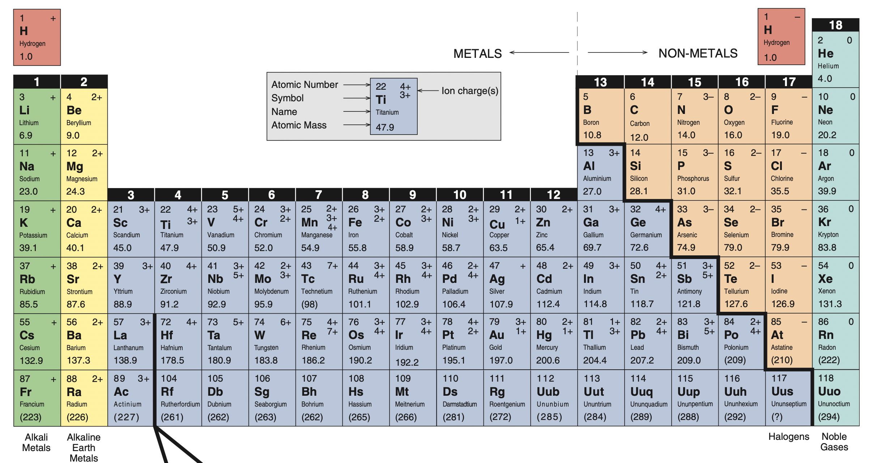
Example 8.5
Why are electron affinities of the alkaline earth metals, shown in Table 8.3, either negative or small positive values?

Slide 37
Example 8.5
Why are electron affinities of the alkaline earth metals, shown in Table 8.3, either negative or small positive values?

Slide 38
Example 8.5
Why are electron affinities of the alkaline earth metals, shown in Table 8.3, either negative or small positive values?
Alkaline earth metals want to become POSTIVE.
POSTIVE charge means LOSE electrons.
Electron affinity is the ability to gain electrons…..metals don’t GAIN.

Slide 39
Example 8.5
Why are electron affinities of the alkaline earth metals, shown in Table 8.3, either negative or small positive values?
So all the negative and small numbers makes sense.
Large numbers would mean they want to…they don’t!

Slide 40
Example: Practice Exercise 8.5
Is it likely that Ar will form the anion Ar^{-?}

Slide 41
8.6: Variation in Chemical Properties of the Representative Elements
There are general trends on the periodic table that we have learned throughout chemistry.
These general trends have EXCEPTIONS, we know the exceptions exist, but they DO NOT make the trends we have learned any less valid.
We LEARN and TEST using the trends, not the exceptions.

Slide 42
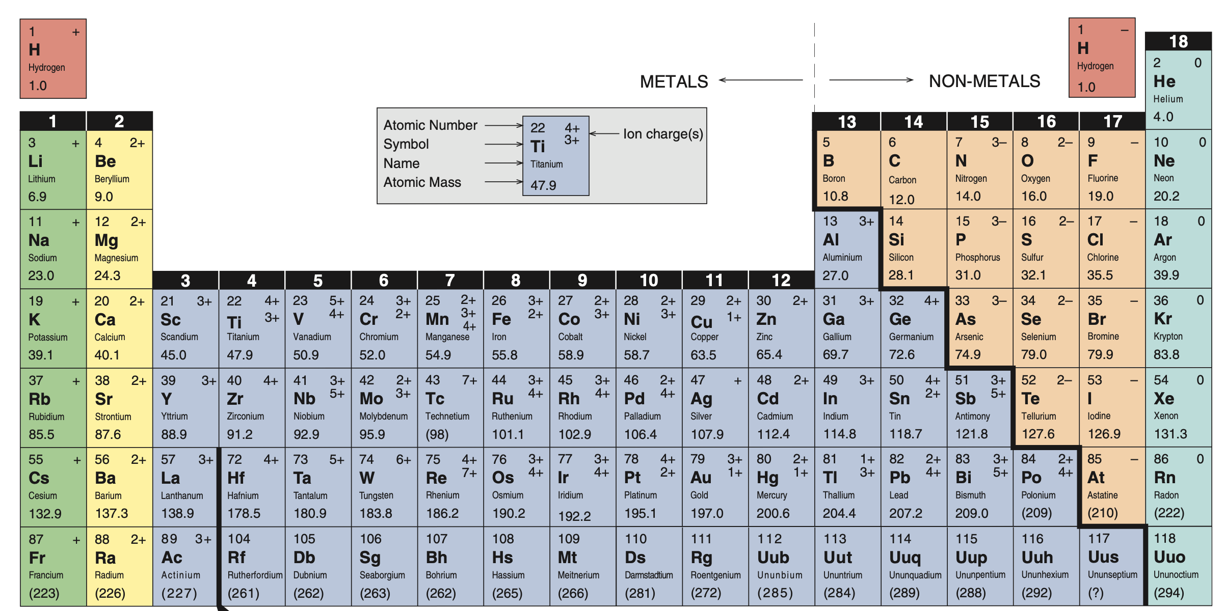
General Trends in Chemical Properties
Non-metals
Metals

Slide 43
General Trends in Chemical Properties
Metaloids
Transition Metals

Slide 44
General Trends in Chemical Properties
Atomic Radius INCREASES

Slide 45
General Trends in Chemical Properties
Groups Share Properties

Slide 46
Reactivity
More Reactive
More Reactive

Slide 47
Properties of Oxides Across a Period (Acidic to Basic Trends)
As most/all other elements will form a compound with oxygen (an Oxide), there are GENERAL TRENDS we can look at.
We learn and REMEMBER (AKA Testable...) General Trends NOT exceptions.

Slide 48
Properties of Oxides Across a Period (Acidic to Basic Trends)
Acidic
Oxides
Neutral
(Amphoteric) Oxides
Basic Oxides

Slide 49
Key Words
Atomic Radius (P. 323)
Electron affinity (P. 333)
Ionic radius (P. 325)
Ionization Energy (P. 329)
Representative
elements (P. 322)
Valence electrons (P. 320)

