Slide 1
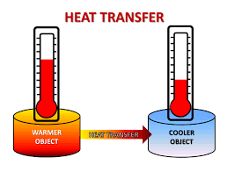
Chapter 6
Thermochemistry

Slide 2
6.1: Nature of energy and Types of energy
Energy is such a broad term, we know their are different kinds of energy, from “I’m tired and don’t have the energy” to “the battery is dead, it does not have any energy and needs to be recharged.
Energy’s definition is the ability to do work…..not very helpful at first, but lets think more about it and how energy relates to chemistry.
There are 4 Main types of energy that chemists are quite familiar with:
Radiant Energy
Thermal Energy
Chemical Energy
Potential Energy

Slide 3
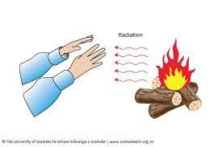
6.1: Nature of energy and Types of energy (Radiant)
Radiant Energy:
Also called Solar Energy (as the sun is BIG example), is the energy that comes “off” or “from” an object.
All those ”beams” of light are radiant energy.
Hot objects also give off radiant heat.
“Cold? Get closer to the fire”.

Slide 4
6.1: Nature of energy and Types of energy (Thermal)
Thermal Energy:
Is a measure of the movement of particles.
High Thermal Energy = Particles move a lot.
Low Thermal Energy = Particles DON’T move very much.
Some reactions in Chemistry produce a lot of thermal energy….but is that the same as heat?
It’s cold in the house, I need to turn the temperature up…how is that related to energy?

Slide 5
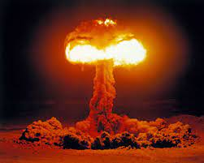
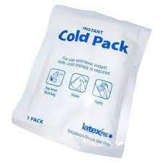
6.1: Nature of energy and Types of energy (Chemical)
Chemical Energy:
Is the energy STORED in chemical bonds….this energy is often released in chemical reactions.
Some reactions RELEASE Chemical Energy.
Some reactions ABSORB Chemical Energy.

Slide 6
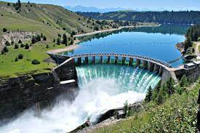
6.1: Nature of energy and Types of energy (Potential)
Potential Energy:
Is the energy due to an element or object POSITION.
HIGH Potential Energy.
LOW Potential Energy.
“But moving water has HIGH kinetic energy”…Interesting observation imaginary/invisible student…

Slide 7
6.1: Nature of energy and Types of energy (Other Types of Energy)
Electromagnetic Energy
Ionizing Energy
Light Energy
Kinetic Energy
Solar Energy
Elastic Potential Energy
Sound Energy
Bond Energy
Nuclear Energy
Electrical Energy
Chemical Potential Energy
Wind Energy
Friction Energy
Gravitational Energy
Mechanical Energy

Slide 8
Law of Conservation of Energy
The Law of Conservation of Energy is the basis for all energy transfers.
The Law of Conservation of Energy states that:
Energy is not created OR destroyed, simply transferred from one form/type to another. Total energy stays the same.
Remember that FRICTION is always taking energy…

Slide 9
6.2: Energy Changes in Chemical Reactions
Energy changes from a reaction are often just as useful and practical (happen everyday) as any of the mass relationships we looked at previously.
We use Hydrocarbons to heat our homes and to produce energy.
Energy
General Equation:
C_{x}H_{2x+2} + O₂ → CO₂ + H₂O

Slide 10
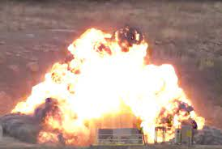
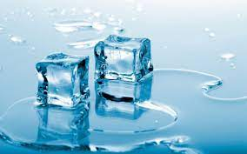
6.2: Energy Changes in Chemical Reactions
ALL reactions either:
Produce energy (Exothermic)
Explosion
Absorb energy (Endothermic)
Endo means inside or under the skin…
Melting

Slide 11
6.2: Energy Changes in Chemical Reactions (Exothermic)
Produce energy (Exothermic)
Explosion
Energy
General Equation:
Compound → Product + Product
+ Energy

Slide 12
6.2: Energy Changes in Chemical Reactions (Endothermic)
Absorb energy (endothermic)
Melting
Energy
General Equation:
Compound → Product + Product
+ Energy

Slide 13
6.2: Energy Changes in Chemical Reactions (Exothermic)
Produce energy (Exothermic)
Reactants
Energy Released
Energy
Products
Time
General Equation:
Compound → Product + Product
+ Energy

Slide 14
6.2: Energy Changes in Chemical Reactions (Endothermic)
Absorb energy (endothermic)
Products
Energy
Energy Absorbed
Reactants
Time
General Equation:
Compound → Product + Product
+ Energy

Slide 15
6.2: Energy Changes in Chemical Reactions (Exothermic Enthalpy)
Produce energy (Exothermic)
Exothermic reactions release energy to the surroundings.
Exothermic reactions release energy and have an associated ⁻𝚫H.
General Equation:
Compound → Product + Product
+ Energy

Slide 16
6.2: Energy Changes in Chemical Reactions (Endothermic Enthalpy)
Absorb energy (endothermic)
Endothermic reactions take in energy from the surroundings.
Endothermic reactions absorb energy and have an associated ⁺𝚫H.
General Equation:
Compound → Product + Product
+ Energy

Slide 17
Systems
There are 3 types of systems (also referred to as surroundings OR Environment):
1. Open Systems:
Exchange both matter AND heat with surroundings.
2. Closed Systems:
Exchange ONLY heat with surroundings.
3. Isolated Systems:
DON’T exchange matter or heat with surroundings….(No example…purely theoretical)

Slide 18
6.5: Calorimetry
Energy cant me measured directly….there’s no thermometer or machine to measure energy.
Instead we measure what gain does to determine is something gave off or absorbed energy.
If something gained energy its temperature rises.
If something lost energy its temperature drops.

Slide 19
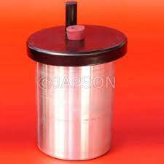
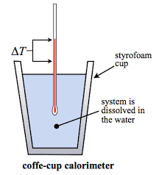
6.5: Calorimetry
If the liquid (usually water) gains energy its temperature rises.
Actual Calorimeter
But here’s the tricky part. It’s a trade off.
If the liquid (surroundings) gained energy and heated up then must have come from somewhere.

Slide 20
6.5: Calorimetry
The energy to heat up the liquid (surroundings) came from the reaction.
Actual Calorimeter
Reactions that give off energy are called ____________.
Exothermic

Slide 21
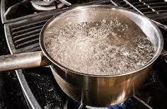
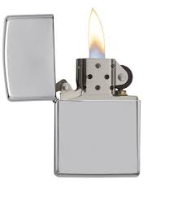
Specific Heat and Heat Capacity
If we know what the liquid that gained energy is AND the temperature change we can calculate the total amount of energy gained or lost.
As you have noticed, water or any liquid takes a certain amount of energy to raise or lower its temperature.
Not a good choice…

Slide 22
Key Words
Calorimetry (P. 239)
Chemical energy (P. 224)
Closed System (P. 225)
Endothermic Process (P. 226)
Energy (P. 224)
Enthalpy (H) (P. 234)
Enthalpy of reaction
(𝚫H_{rxn}) (P. 235)
Exothermic process ((P. 226)
First law of thermodynamics (P. 227)
Heat (P. 225)
Heat Capacity (C) (P. 239)
Isolated System (P. 225)
Law of conservation of energy (P. 224)
Open system (P. 225)
Potential energy (P. 225)
Radiant energy (P. 224)
Specific heat (s) (P. 239)
Standard enthalpy of formation (𝚫H∘_{f}) (P. 246)
Standard enthalpy of reaction
(𝚫H∘_{rxn}) (P. 246)
Surroundings (P. 225)
System (P. 225)
Thermal energy (P. 224))
Thermochemical
equation (P. 236)

