Slide 1
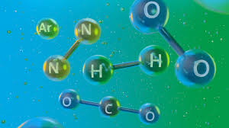
Chapter 5
Gases

Slide 2
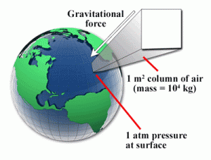
5.1: Substances that Exist as Gases
All the air that is above us all the way to the outer limits of our atmosphere pushes down on us.
The pressure of all that air is equal to 1 atmosphere of pressure (1 atm).
Some of the Covalent and Non-metal’s are gases at 1 atm and 25∘C.
Ionic Compounds and Metal Elements are NOT.

Slide 3
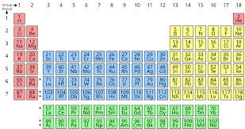
5.1: Substances that Exist as Gases
Hydrogen breaks all the rules and acts weird…

Slide 4
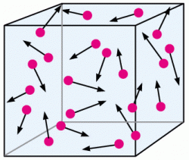
What do we know about Gases
We know that gases are composed of particles that are REALLY SPREAD OUT.
- Gases take the shape AND volume of their container.
- Gases can be compressed….pushed together. (Pneumatics)
Gases will (eventually) mix evenly.
(Fart in the corner and eventually it mixes (spreads to the entire room)
- Gases have low densities.

Slide 5
5.2: Pressure of Gases
Gases are always moving so we are usually unaware of air pressure changes….(unless you go up or down fast and your ears pop).
The time when you really noticed air pressure is when you drink from a straw.

Slide 6
SI Unit of Pressure
The most measurable property of a gas is its pressure.
Force
Pressure =
Area
Pressure is measured 1 Pascals.
1 atm = 101325 Pa = 760 mmHg

Slide 7
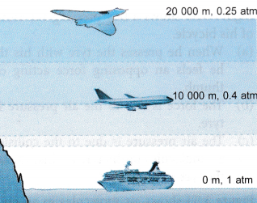
Atmospheric Pressure
Another measure of pressure is atm.
Atm is the pressure of ALL the air above us.
Air pressure changes wherever you are….here in Maple Ridge its pretty much sea level so 1 atm.

Slide 8
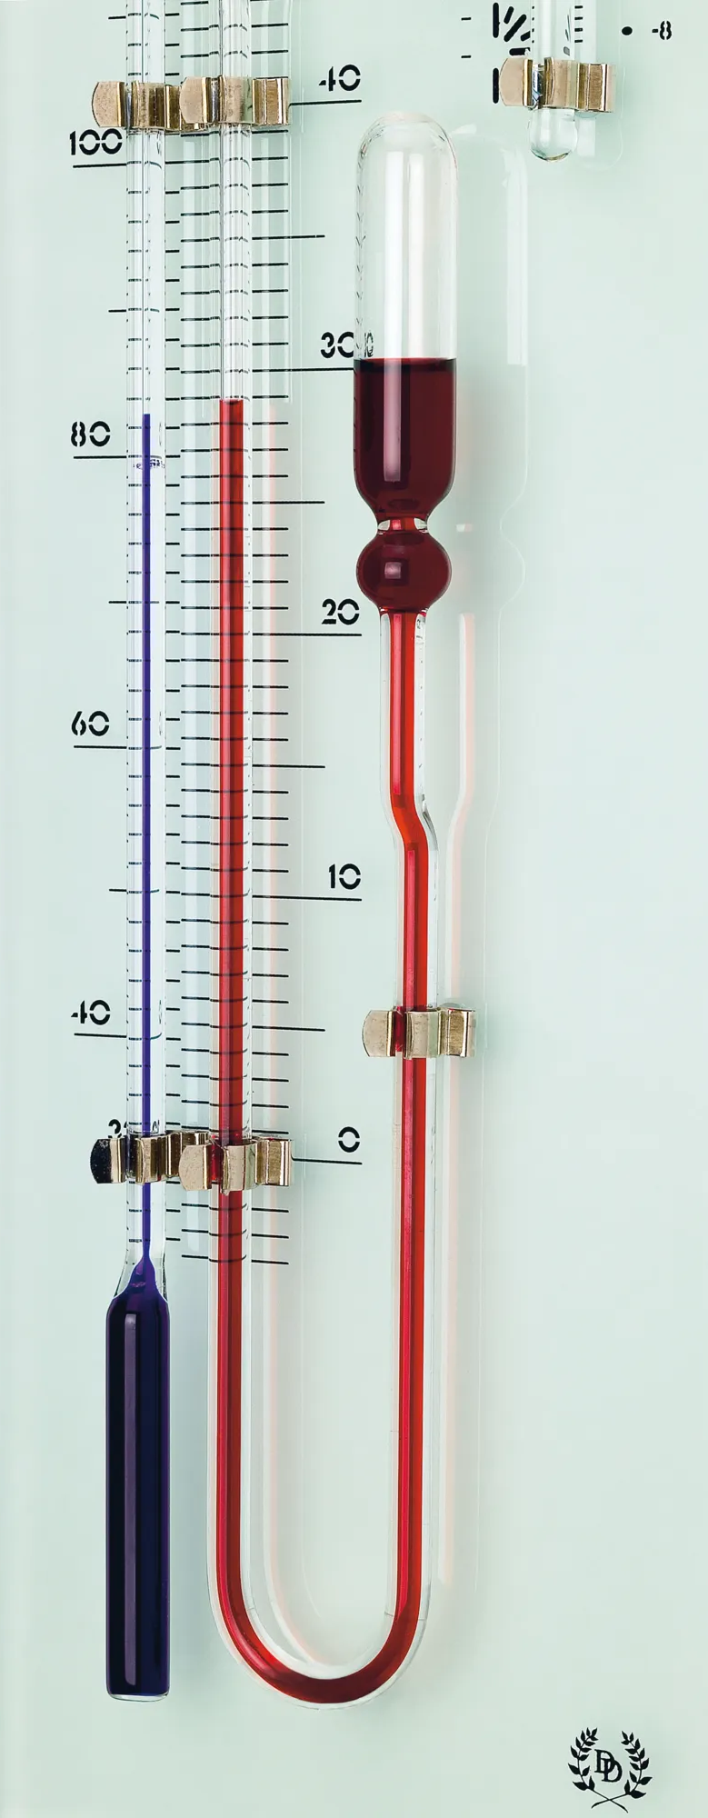
Barometer
A barometer is an instrument that measures pressure by:
- The air pressure around us pushes down on the liquid reservoir.
-The liquid (reservoir) then is forced up the scale.
The first Barometer has Mercury (Hg) as the liquid that moved mm up the scale….hence mm Hg

Slide 9
Different Units of Pressure
Pressure is measured 1 Pascals.
And mmHg (Millimeters of Mercury).
And Atm (Atmospheres).
1 atm = 101325 Pa = 760 mmHg
1000 Pa = 1 kPa

Slide 10
Standard Temperature Atmospheric Pressure
The usual (Standard) temperature and pressure used for experiments is called Standard Temperature and Pressure (STP).
**The Temperature and Pressure that an experiment is done at affects the outcome of the experiment so you NEED TO SPECIFY the “Conditions” (Temperature and Pressure) you have for the exp you do.**

Slide 11
Example 5.1
3 sig figs
The pressure outside a jet plane flying at high altitude falls considerably below standard atmospheric pressure. Therefore the air inside the cabin must be pressurized to protect the passengers. What is the pressure in atmospheres in the cabin if the barometer
reading is 688 mmHg?
1 atm = 101325 Pa = 760 mmHg
1 atm
X
760 mmHg
688 mmHg
X = (1 atm)(688 mmHg) = (688) ➗760 mmHg
= 0.9052631579 atm
= 0.905 atm

Slide 12
Example: Practice Exercise 5.1
Convert 749 mmHg to atmospheres.

Slide 13
Example 5.2
3 sig figs
The atmospheric pressure in San Francisco on a certain day was 732 mmHg. What was the pressure in kPa?
1 atm = 101325 Pa = 760 mmHg
760 mmHg
732 mmHg
X
101325 Pa
X = (101325 Pa)(732 mmHg) = (74169900) ➗760 mmHg
= 97591.97368 Pa
➗1000 Pa/kPa
= 97.59197368 Pa
= 97.6 kPa

Slide 14
Example: Practice Exercise 5.2
Convert 295 mmHg to kilopascals.

Slide 15
5.3: The Gas Laws
Over the years and countless experiments, scientists have come up with a set Laws that explain gas behaviour.
They are:
Charles Law
Boyles Laws
Gay-Lussaccs Law
Combined Gas Law (Ideal Gas Law)

Slide 16
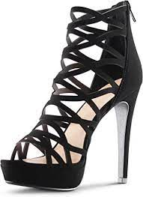
Boyles Law
Boyle learned that as you increase pressure you decrease volume.
ALL the weight is put onto one small area/volume…OUCH!
P = 20 kpa.
P = 40 kpa.
He found that pressure is the result of molecules pushing against the sides of the container….smaller container – more pushing.

Slide 17
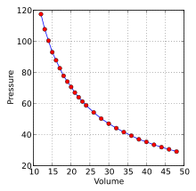
Boyles Law
He determine that if you multiply the pressure and volume in one situation.
As you increase pressure you decrease volume. (Inverse)
Its equal to multiplying pressure and volume in another situation.
Hence:
P₁V₁ = P₂V₂

Slide 18
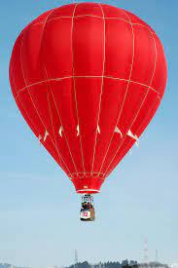
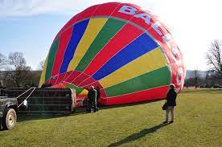
Charles Law
Charles learned that as you increase temperature you increase volume. (Expansion)
Vice Vera, if you decrease temperature, you decrease volume. (Shrink)

Slide 19
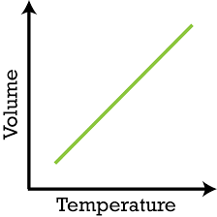
Charles Law
He determine that if you divide the volume and temperature in one situation.
Its equal to dividing volume and temperature in another situation.
V₁ = V₂
Hence:
T₁ = T₂

Slide 20
Absolute Zero
So we have a problem…anything divided or multiplied by “0” wrecks the equation.
So any equation with temperature (T) at 0∘C = 0
So we need a scientific temperature scale that is related to how much molecules move/vibrate.

Slide 21
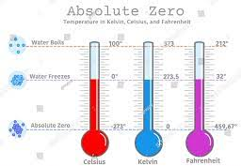
Absolute Zero
The Kelvin Scale
= 273 K

Slide 22
Gay-Lussac’s Law
Did the same calculations and noticed the same relationship between volume and temperature that Charles did.

Slide 23
Avogadro’s Law
Avogadro summarize/reinforced the theories of Boyle’s and Charles, but he also added that everything was made of particles.
Avogadro’s explanation that everything is made of particle (mols) explained and reinforced both Charles and Boyle’s Laws.

Slide 24
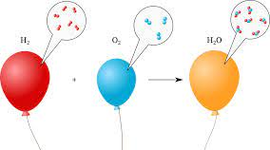
Avogadro’s Law
Avogadro further explained that not only are gases made of particles.
But the amount of particles of Reactants is related (Ratio) to the number of particles of Products.
We know particles more commonly as the amount Mol (n).

Slide 25
5.4: The Ideal Gas Law
The ideal gas law combines all three Laws (Boyle’s, Charles, and Avogadro’s).
Ideal Gas Constant
(0.0821 L• atm)
Volume (L)
PV = nRT
K•mol
Ideal Gas Law =
Temperature (K)
Pressure (atm)
Mols (n)

Slide 26
5.4: The Ideal Gas Law
Quite often questions just mention ”at STP”…this means the temp = 0∘C (273.15 K) AND 1 atm = 101.325 kPa.
Ideal Gas Constant
(0.0821 L• atm)
Volume (L)
PV = nRT
K•mol
Ideal Gas Law =
Temperature (K)
Pressure (atm)
Mols (n)

Slide 27
5.4: The Ideal Gas Law
You can use the Ideal Gas Law for ANY question, you just cover (don’t include) the variable you don’t need or get in the question.
PV = nRT
Ideal Gas Law =
So out of all the formulas, PV = nRT is the one to remember.

Slide 28
Example 5.3
Sulfur hexafluoride (SF₆) is a colorless, odourless, very unreactive gas. Calculate the pressure (in atm) exerted by 1.82 moles of the gas in a steal vessel of volume 5.43 L at 69.5∘C.
Colours DON’T mean anything, just wanted the variable to stand out.
P = ???
PV = nRT
n = 1.82 mol
V = 5.43 L
P = nRT
T = 69.5 ∘C
+ 273.15
V
R =
(0.0821 L• atm)
P = (1.82 mol)(0.0821….)(T)
K•mol
(5.43 L)

Slide 29
Example 5.3
Sulfur hexafluoride (SF₆) is a colorless, odourless, very unreactive gas. Calculate the pressure (in atm) exerted by 1.82 moles of the gas in a steal vessel of volume 5.43 L at 69.5∘C.
Colours DON’T mean anything, just wanted the variable to stand out.
P = ???
PV = nRT
n = 1.82 mol
V = 5.43 L
P = nRT
T = 342.5 K
V
R =
(0.0821 L• atm)
P = (1.82 mol)(0.0821….)(342.5 K)
P = (1.82 mol)(0.0821….)(T)
K•mol
(5.43 L)

Slide 30
Example 5.3
3 sig figs
Sulfur hexafluoride (SF₆) is a colorless, odourless, very unreactive gas. Calculate the pressure (in atm) exerted by 1.82 moles of the gas in a steal vessel of volume 5.43 L at 69.5∘C.
P = (1.82 mol)(0.0821….)(342.5 K)
(5.43 L)
= 51.177035
(5.43 L)
= 9.42486832
~ 9.42
atm

Slide 31
Example: Practice Exercise 5.3
Calculate the volume (in liters) occupied by 2.12 moles of nitric oxide (NO) at 6.54 atm and 76∘C.

Slide 32
Example 5.4
Calculate the volume (in liters) occupied by 7.40 g of NH₃ at STP.
V = ???
n = m
M
n = 0.435 mol
n = 7.40 g
P = 1 atm
17.0 g /mol
T = 273 K
n = 0.4352941175 mol
R =
(0.0821 L• atm)
K•mol

Slide 33
Example 5.4
3 sig figs
Calculate the volume (in liters) occupied by 7.40 g of NH₃ at STP.
PV = nRT
V = ???
n = 0.435 mol
V = nRT
P = 1 atm
P
V = (0.435 mol)(0.0821…)(273 K)
T = 273 K
1 atm
R =
(0.0821 L• atm)
V = 9.7497855
K•mol
V ~ 9.75 L
1 atm

Slide 34
Example: Practice Exercise 5.4
What is the volume (in liters) occupied by 49.8 g of HCl at STP?

Slide 35
Example 5.5
An inflate helium balloon with a volume of 0.55L at sea level (1.0 atm) is allowed to rise to a height of 6.5 km, where the pressure is about 0.40 atm. Assuming that the temperature remains constant , what is the final volume of the balloon?
V = ???
Cross off what doesn’t change.
PV = nRT
P = 0.40 atm
= 1
P’V’ = nRT’
Right?
1 = 1
1

Slide 36
Example 5.5
2 sig figs
An inflate helium balloon with a volume of 0.55L at sea level (1.0 atm) is allowed to rise to a height of 6.5 km, where the pressure is about 0.40 atm. Assuming that the temperature remains constant , what is the final volume of the balloon?
V = ???
P_{i}V_{i}
Want this.
P₂V₂
P = 0.40 atm
P_{i}V_{i}
= (1 atm)(0.55 L)
= 0.55
= 1.375 L
~ 1.4 L
P₂
(0.40 atm)
(0.40 atm)

Slide 37
Example: Practice Exercise 5.5
A sample of chlorine gas occupies a volume of 946 mL at a pressure of 726 mmHg. Calculate the pressure of the gas (in mmHg) if the volume is reduced at a constant temperature to 154 mL.

Slide 38
Example 5.6
Argon is an inert gas use in light bulbs to retard the vaporization of tungsten filament. A certain light bulb containing argon at 1.20 atm and 18∘C is heated to 85∘C at a constant volume. Calculate its final pressure (in atm).
PV = nRT
P = ???
P’V’ = nRT’
P = 358 K – 291 k = 67 K
P’ = PT‘
P = T
T
P’ = T’
Rearrange to isolate variable.
Want this.

Slide 39
Example 5.6
2 sig figs
Argon is an inert gas use in light bulbs to retard the vaporization of tungsten filament. A certain light bulb containing argon at 1.20 atm and 18∘C is heated to 85∘C at a constant volume. Calculate its final pressure (in atm).
P’ = PT‘
= (1.20 atm)(291 T)
= 429.6
= 1.47628866 atm
T
(358 K)
(358 K)
= 1.5 atm

Slide 40
Example: Practice Exercise 5.6
A sample of oxygen initially at 0.97 atm is cooled from 21∘C to -68∘C at a constant volume. What is the final pressure (in atm)?

Slide 41
Example 5.7
A small bubble rises from the bottom of a lake, where the temperature and pressure are 8∘C and 6.4 atm, to the water’s surface, where the temperature is 25∘C and the pressure is 1.0 atm. Calculate the final volume (in mL) of the bubble if its initial volume was 2.1 mL.
V = ???
P = 6.4 atm to 1.0 atm = 5.4 atm
T = 281 K to 298 K = 17 K
PV = nRT
PV = T
P’V’ = nRT’
P’V’ = T’

Slide 42
Example 5.7
A small bubble rises from the bottom of a lake, where the temperature and pressure are 8∘C and 6.4 atm, to the water’s surface, where the temperature is 25∘C and the pressure is 1.0 atm. Calculate the final volume (in mL) of the bubble if its initial volume was 2.1 mL.
(V’)
PV = T
(V’)
PV = TV’
(T’)
(T’)
P’ = T’
P’V’ = T’
T’PV = TV’
T’PV = V’
P’ =
P’T =

Slide 43
Example 5.7
1 sig figs
A small bubble rises from the bottom of a lake, where the temperature and pressure are 8∘C and 6.4 atm, to the water’s surface, where the temperature is 25∘C and the pressure is 1.0 atm. Calculate the final volume (in mL) of the bubble if its initial volume was 2.1 mL.
T’PV = V’
(298 K)(6.4 atm)(0.0021 L) = V’
(1.0 atm)(281 K)
P’T =
V’ = 0.0142531 L
4.00512= V’
V’ ~ 1 x10¹ mL
V’ = 14.2531 mL
281

Slide 44
Example: Practice Exercise 5.7
A gas initially at 4.0 L, 1.2 atm, and 66∘C undergoes a change so that its final volume and temperature are 1.7 L and 42∘C. What is its final pressure? Assume the number of moles remains unchanged.

Slide 45
Density Calculations
If we continue to rearrange the ideal gas equation wen can isolate “n”….and since “n” was part of so many other equations we can rearrange MORE!
PV = nRT
n = PV
RT

Slide 46
5.5: Gas Stoichiometry
As mentioned previously, if you can use the ideal gas formula to get “n” (mols) then you can use a balanced chemical equation (Ratios) to do stoichiometry.
Amount of Reactant(s) (Grams or Volume)
Moles
of Reactants
Moles
of
Product
Amount of Product(s) (Grams or Volume)
Use
PV = nRT OR ITS GIVEN TO YOY ALREADY.
n = mass
Molar Mass
Mols x (N)
G
m = nM

Slide 47
Example 5.11
Calculate the volume of O₂ (in liters) required for the complete combustion of 7.64 L of
acetylene (C₂H₂) measured at the same temperature and pressure.
G
N
2 C₂H_{2(g)} + 5 O_{2(g)} →4 CO_{2(g)} + 4 H₂O_{(g)}
V = 7.64 L
V = ??? L
These conditions are an EXCEPTION to stoichiometry and the ideal gas law.
Avogadro said that volumes of gases are DIRECTLY related by a balanced chemical reaction.

Slide 48
Example 5.11
Calculate the volume of O₂ (in liters) required for the complete combustion of 7.64 L of
acetylene (C₂H₂) measured at the same temperature and pressure.
G
N
2 C₂H_{2(g)} + 5 O_{2(g)} →4 CO_{2(g)} + 4 H₂O_{(g)}
V = 7.64 L
V = 19.1 L
V = ??? L
5
2
( )

Slide 49
Example: Practice Exercise 5.11
Assume no change in temperature and pressure, calculate the volume of O₂ (in liters) required for the complete combustion 14.9 L of butane (C₄H₁₀)

Slide 50
Example 5.12
Sodium azide (NaN3) is used in some automobile air bags. The impact of a collision triggers the decomposition of NaN3 as follows:
2 NaN_{3(s)} → 2 Na_{(s)} + 3 N_{2(g)}
The nitrogen gas quickly inflates the bag between the driver and the windshield and dashboard. Calculate the volume of N₂ generated at 80∘C and 823 mmHg by the decomposition of 60.0 g of NaN₃.

Slide 51
Example 5.12
The nitrogen gas quickly inflates the bag between the driver and the windshield and dashboard. Calculate the volume of N₂ generated at 80∘C and 823 mmHg by the decomposition of 60.0 g of NaN₃.
G
N
2 NaN_{3(s)} → 2 Na_{(s)} + 3 N_{2(g)}
m = 60.0 g
V = ??? L
m
PV = nRT
n =
M
V = nRT
n =
60.0 g
65.02 g/mol
P
n = 0.92279298677 mol
3
2
n = 1.38418948015 mol
( )

Slide 52
Example 5.12
The nitrogen gas quickly inflates the bag between the driver and the windshield and dashboard. Calculate the volume of N₂ generated at 80∘C and 823 mmHg by the decomposition of 60.0 g of NaN₃.
G
N
2 NaN_{3(s)} → 2 Na_{(s)} + 3 N_{2(g)}
PV = nRT
m = 60.0 g
V = ??? L
V = nRT
V = (1.38418948015 mol)(0.0821)(353 K)
P
P
(1.08289474 atm)
1 atm = 101325 Pa = 760 mmHg
760 mmHg
823 mmHg
n = 1.38418948015 mol
1 atm
x

Slide 53
Example 5.12
2 sig figs
The nitrogen gas quickly inflates the bag between the driver and the windshield and dashboard. Calculate the volume of N₂ generated at 80∘C and 823 mmHg by the decomposition of 60.0 g of NaN₃.
G
N
2 NaN_{3(s)} → 2 Na_{(s)} + 3 N_{2(g)}
PV = nRT
m = 60.0 g
V = ??? L
V = nRT
~ 37 L
OR
3.7 x 10¹ L
P
V = (1.38418948015 mol)(0.0821)(353 K)
= 40.1156105811
1.08289474
(1.08289474 atm)
= 37.0447921661 L

Slide 54
Example: Practice Exercise 5.12
The equation for the metabolic break down of glucose (C₆H₁₂O₆) is the same is the same as the equation for the combustion of glucose in air:
1 C₃H₁₂O_{6(s)} + 3 O_{2(g)}→ 3 CO_{2(g)} + 3 H₂O_{(l)}

Slide 55
Example 5.13
Aqueous lithium hydroxide solution is used to purify air in spacecrafts and submarines because it absorbs carbon dioxide, which is an end product of metabolism, according to the equation:
2 LiOH_{(aq)} + 1 CO_{2(g)}→ 1 Li₂CO_{3(s)} + 1 H₂O_{(l)}
The pressure of carbon dioxide inside the cabin of a submarine having a volume of 2.4 x10⁵ L is 7.9 x 10⁻³ atm at 312 K. A solution of lithium hydroxide (LiOH) of negligible volume is introduced into the cabin. Eventually the pressure of CO₂ falls to 1.2 x 10⁻⁴ atm. How many grams of lithium carbonate (LiCO₃) are formed by this process?

Slide 56
Example 5.13
The pressure of carbon dioxide inside the cabin of a submarine having a volume of 2.4 x10⁵ L is 7.9 x 10⁻³ atm at 312 K. A solution of lithium hydroxide (LiOH) of negligible volume is introduced into the cabin. Eventually the pressure of CO₂ falls to 1.2 x 10⁻⁴ atm. How many grams of lithium carbonate (LiCO₃) are formed by this process?
G
N
2 LiOH_{(aq)} + 1 CO_{2(g)}→ 1 Li₂CO_{3(s)} + 1 H₂O_{(l)}
PV = nRT
V = 2.4 x 10⁵ L
m = ??? g
P = 7.9 x 10⁻³ atm
T = 312 K
PV = n
P_{final} = 1.2 x 10⁻⁴ atm
RT
(7.8 x 10⁻³ atm)(2.4 x 10⁵ L)= n
= 1872
= 73.0816077954 mol
n =
(0.0821)(312 K)
25.6152

Slide 57
Example 5.13
2 sig figs
The pressure of carbon dioxide inside the cabin of a submarine having a volume of 2.4 x10⁵ L is 7.9 x 10⁻³ atm at 312 K. A solution of lithium hydroxide (LiOH) of negligible volume is introduced into the cabin. Eventually the pressure of CO₂ falls to 1.2 x 10⁻⁴ atm. How many grams of lithium carbonate (LiCO₃) are formed by this process?
G
N
2 LiOH_{(aq)} + 1 CO_{2(g)}→ 1 Li₂CO_{3(s)} + 1 H₂O_{(l)}
m ~ 5.4 x 10³ g
V = 2.4 x 10⁵ L
m = ??? g
m =
nM
P = 7.9 x 10⁻³ atm
P = 1.2 x 10⁻⁴ atm
T = 312 K
P_{final} = 1.2 x 10⁻⁴ atm
= (73.0816077954 mol)
(73.8 g/mol)
1
1
( )
n_{Li2CO3} =
n =
73.0816077954 mol
73.0816077954 mol
= 5393.4226553 g

Slide 58
Example: Practice Exercise 5.13
A 2.14 L sample of hydrogen chloride (HCl) gas at 6.21 atm and 28∘C is completely dissolved in 668 mL of water to form hydrochloric acid solution. Calculate the molarity of the acid solution. Assume no change in volume.

Slide 59
5.6: Daltons Law of Partial Pressures
Dalton’s Law of Partial Pressures states that the total is just the individual gases’ pressures added together.
3 molCl₂
+
Cl₂
3 mol H₂
6 mol HCl
H₂
HCl

Slide 60
5.6: Daltons Law of Partial Pressures
Each element’s quantity (mol) divided by the total gives its decimal contribution.
3 molCl₂
+
3 mol H₂
6 mol HCl
Pressure_{Cl2} = 3 mol
3 mol + 3 mol
Pressure_{Cl2} = 3 mol / 6 mol

Slide 61
5.6: Daltons Law of Partial Pressures
The decimal multiplied (x) the total pressure equals (=) the gases pressure.
Total Pressure = 1.23 atm
Pressure_{Cl2} = 0.5 x 1.23
Pressure_{Cl2} = 0.615 atm
Pressure_{H2} = 0.5 x 1.23
Pressure_{H2} = 0.615 atm
Pressure_{Cl2} = 3 mol / 6 mol

Slide 62
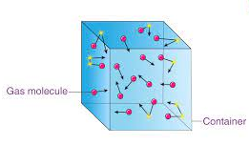
5.7: Kinetic Molecular Theory of Gases
1. Gases are composed of molecules that are very spread out.
3. Gases have low density and can be compressed (Pneumatics).
2. Gases are in constant motion, bouncing around and hitting into one another and the sides of whatever container their in.
4. The amount of K_{E} (speed) the gas molecules have depends/determines temperature.

Slide 63
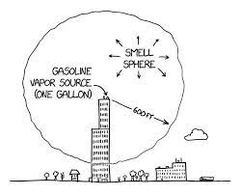
Gas Diffusion and Effusion (BASIC DEFINITION)
Diffusion:
Because gas molecules are always moving and bouncing around, they spread out over time.
Effusion:
Gases slowly leak through a porous barrier…. Gas size affects this.

Slide 64
Key Words
Absoluter Temperature Scale (P.179)
Absolute Zero (P. 179)
Atmospheric pressure (P. 172)
Avagadros Law (P. 180)
Barometer (P. 173)
Boyle’s law (P. 175)
Charle’s and Gay-Lussac’s law (P. 179)
Charles law (P. 179)
Diffusion (P. 203)
Effusion (P. 204)
Gas constant (R) (P. 181)
Ideal gas (P. 181)
Ideal gas equation (P. 181)
Joule (J)
Kelvin temperature
scale (P. 179
Kinetic energy (KE) (P. 179)
Kinetic molecular theory of gases (P. 197)
Mole fraction (P. 193)
Partial pressures (P. 192)
Pascal (Pa) (P. 172)
Pressure (P. 172)
Standard atmospheric pressure
(1 atm) (P. 173)
Standard temperature and pressure (STP) (P. 182)

