Slide 1
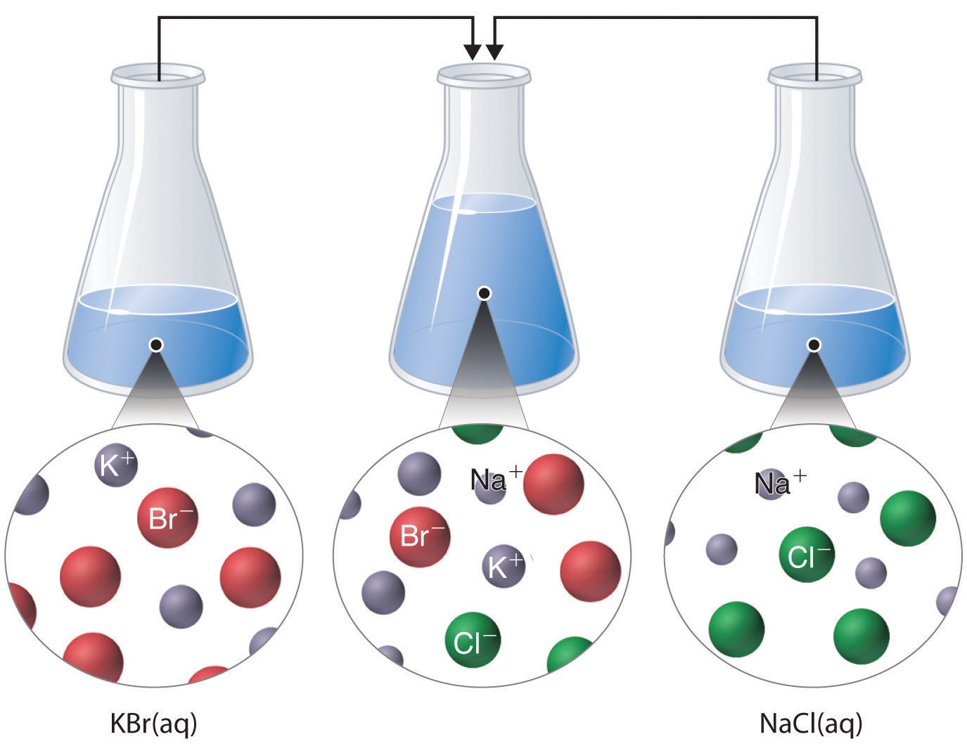
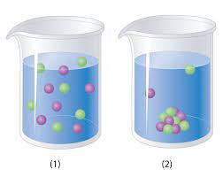
Chapter 4
Reactions in Aqueous Solutions

Slide 2
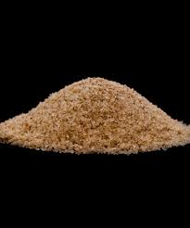
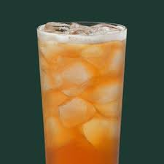
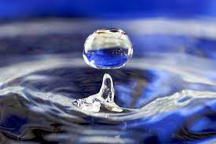
4.1: General Properties of Aqueous Solutions
Solution:
A homogeneous mixture (The solution looks the same throughout….The example is Iced Tea (Properly mixed…no chunks).
Solute:
Is the substance in smaller amounts and gets dissolved.
Iced Tea Powder
Solvent:
The substance in LARGER amounts that does the dissolving.
Water (The UNIVERSAL Solvent)

Slide 3
Electrolyte Properties
When a compound dissolves in a solvent, it can do one of two things:
1. It can break up into ions (Its Metal (+) and Nonmetal (-) pieces)….an Electrolyte
2. It can stay together and NOT form ions…nonelectrolyte.

Slide 4
Electrolyte Properties
1. It can break up into ions (Its Metal (+) and Nonmetal (-) pieces)….an Electrolyte
Electrolyte’s are compounds that break into + and – ions which act as “Islands” allowing electricity to flow between them in a “sea” of solvent.
Na⁺
Na⁺
Cl⁻
Cl⁻
Cl⁻
Na⁺
Dissociation Equation
Salt: NaCl Dissolved in Water

Slide 5
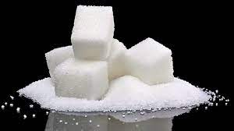
Electrolyte Properties
2. It can stay together and NOT form ions…nonelectrolyte.
When some compounds…like Sucrose (sugar)… are dissolved in coffee they DO NOT separate into ions…they stay joined together.
C₂₂H₂₂O_{11(aq)}
C₂₂H₂₂O_{11(aq)}
C₂₂H₂₂O_{11(s)}
Sucrose

Slide 6
Electrolyte Properties
Hydration is the Scientific Name of the process of dissolving.
When Ionic compound dissolve in water they separate into positive (+) and negative (-) ions_{(aq)}.
H₂O
H₂O
H₂O
H₂O
H₂O
H₂O
+
H₂O
H₂O (Water)
Na⁺
H₂O
Cl⁻
H₂O
H₂O
H₂O
H₂O
H₂O
NaCl (Salt)
H₂O
Hydration

Slide 7
Electrolyte Properties
Hydration is the Scientific Name of the process of dissolving.
When Molecular Acids (Have “H”) dissolve in water they separate into positive (+) and negative (-) ions_{(aq)}.
H₂O
H₂O
H₂O
H₂O
H₂O
H₂O
+
H₂O
H₂O (Water)
H⁺
H₂O
Cl⁻
H₂O
Reversible
H₂O
H₂O
H₂O
H₂O
HCl (Hydrochloric Acid)
H₂O
Hydration

Slide 8
4.2: Precipitation Reactions
Precipitation Reaction:
When TWO AQEUOUS (Li quid) solutions are mixed together and they form a SOLID product that FALLS OUT OF solution.
1 Pb(NO₃)_{2(aq)} + 2 KI_{(aq)} → 1 PbI_{(s)} + 2 KNO_{3(aq)}
What type of reaction is this?
Formation? Decomp? etc.

Slide 9
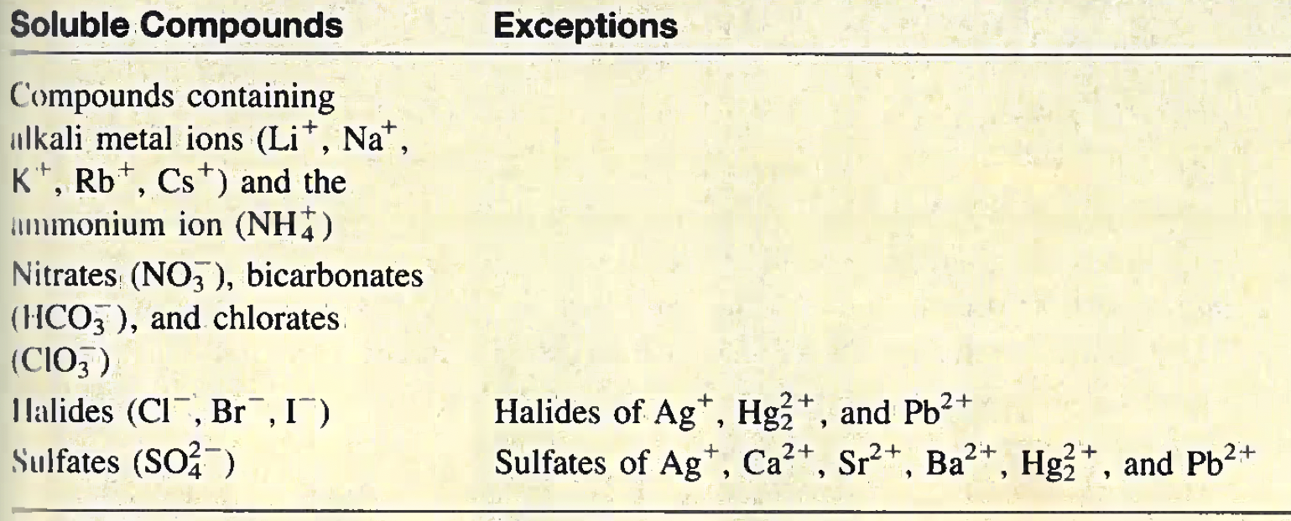
Determining Solubility
So will a randomly chosen compound dissolve? How do we determine it?
Always Soluble. No Exceptions.
(aq)
KCl_{(aq)}
NaI_{(aq)}
Rb₂O_{(aq)}
Always Soluble. No Exceptions. (aq)
KNO_{3(aq)}
NaHCO_{3(aq)}
KClO_{3(aq)}
AgCl_{(s)}
CaSO_{4(s)}

Slide 10
Solubility
Solubility:
The amount of solute (stuff you dissolve) that will dissolve in a given quantity of solvent (thing you does the dissolving) at a given temperature.
The determined solubility relates to the state _{(s or aq)} you assign to an element or compound.

Slide 11
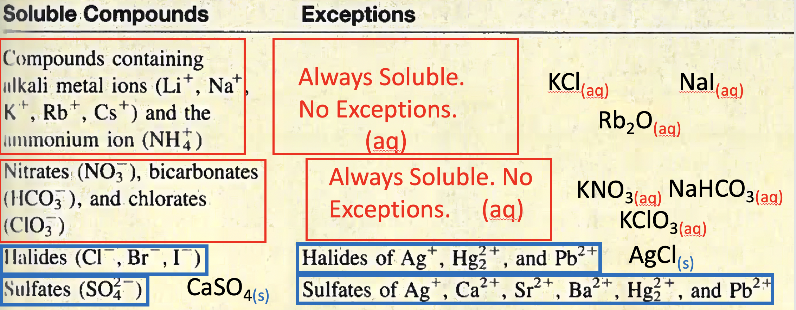
Example 4.1
Classify the following ionic compounds as as soluble or insoluble: (a) silver sulfate (Ag₂SO₄)
(b) calcium carbonate (CaCO₃), (c) sodium phosphate (Na₃PO₄).
No need to use table….just memorize: Only Nitrates, bicarbonates, chlorates, and Group 1 are soluble…. everything else no.
Insoluble.

Slide 12
Example 4.1
Classify the following ionic compounds as as soluble or insoluble: (a) silver sulfate (Ag₂SO₄)
(b) calcium carbonate (CaCO₃), (c) sodium phosphate (Na₃PO₄).
No need to use table….just memorize: Only Nitrates, bicarbonates, chlorates, and Group 1 are soluble…. everything else no.
Insoluble.

Slide 13
Example 4.1
Classify the following ionic compounds as as soluble or insoluble: (a) silver sulfate (Ag₂SO₄)
(b) calcium carbonate (CaCO₃), (c) sodium phosphate (Na₃PO₄).
No need to use table….just memorize: Only Nitrates, bicarbonates, chlorates, and Group 1 are soluble…. everything else no.
Soluble.

Slide 14
Example: Practice Exercise 4.1
Classify the following ionic compounds as soluble or insoluble (a) CuS (b) Ca(OH)₂ (c) Zn(NO₃)₂.

Slide 15
Molecular Equations, Ionic Equations, and Net Ionic Equations
A molecular equation (similar to one below) is an OVERALL (end result) of mixing two compounds together.
1 Pb(NO₃)_{2(aq)} + 2 KI_{(aq)} → 1 PbI_{(s)} + 2 KNO_{3(aq)}
Molecular Equation
Molecular equation DOES NOT describe in detail how ions react to join together. (You can imply it…read into it….but it does NOT tell you directly)

Slide 16
Molecular Equations, Ionic Equations, and Net Ionic Equations
As mentioned previously, soluble ionic compounds break into their ions
(+ Cations and – Anions) when dissolved in water.
1 Pb(NO₃)_{2(aq)} + 2 KI_{(aq)} → 1 PbI_{(s)} + 2 KNO_{3(aq)}
+
+
+
+
+
Pb²⁺_{(aq)}
2 NO₃⁻_{(aq)}
2 K⁺_{(aq)}
2 I⁻_{(aq)}
PbI_{(s)}
2 K⁺_{(aq)}
+
2 NO₃⁻_{(aq)}
Not different, just ran out of room.
This is a TOTAL ionic equation.

Slide 17
Molecular Equations, Ionic Equations, and Net Ionic Equations
The “ions” in the Total Ionic Equation that do NOT interact (the ions resent on both sides) are called SPECTATOR IONS and we cancel them out.
1 Pb(NO₃)_{2(aq)} + 2 KI_{(aq)} → 1 PbI_{(s)} + 2 KNO_{3(aq)}
+
+
+
+
+
Pb²⁺_{(aq)}
2 NO₃⁻_{(aq)}
2 K⁺_{(aq)}
2 I⁻_{(aq)}
PbI_{(s)}
2 K⁺_{(aq)}
+
2 NO₃⁻_{(aq)}
1 Pb²⁺_{(aq)} + 2 I⁻_{(aq)} → 1 PbI_{2(s)}
Not different, just ran out of room.
Net Ionic Equation

Slide 18
Molecular Equations, Ionic Equations, and Net Ionic Equations

Slide 19
Example 4.2
Predict what happens when a potassium phosphate (K₃PO₄) solution is mixed with a calcium nitrate [Ca(NO₃)₂] solution. Write a net ionic equation for the reaction.
In order to write a “Net Ionic Equation” you have to go through all the previous steps.
2 K₃PO_{4(aq)} + 3 Ca(NO₃)_{2(aq)} →6 KNO_{3(aq)}+ Ca₃(PO₄)_{2(s)}
+
+
+
+
+
+
6 K⁺_{(aq)}
2 PO₄³⁻_{(aq)}
3 Ca²⁺_{(aq)}
6 NO₃⁻_{(aq)}
6 K⁺_{(aq)}
6 NO₃⁻_{(aq)}
Ca₃(PO₄)_{2(s)}
Total Ionic Equation
3 Ca²⁺_{(aq)} + 2 PO₄³⁻_{(aq)} → 1 Ca(PO₄)_{2(s)}
Net Ionic Equation
Order doesn’t matter….convention is just cation first…

Slide 20
Example: Practice Exercise 4.2
Predict the precipitate produced by mixing an Al(NO₃)₃ solution with an NaOH solution. Write the net ionic equation for the reaction.

Slide 21
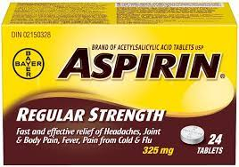
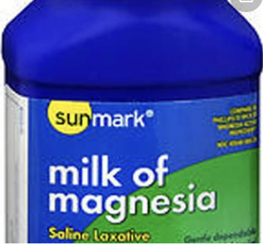
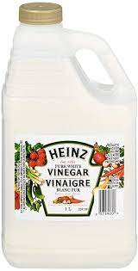
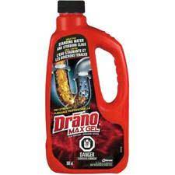
4.2: Acid-Base Reactions
Acids and Bases are all around us, in ,medicine and products we use every day.
Mg(OH)₂
Magnesium Hydroxide
Acetylsalicylic ACID
Vinegar
Acetic Acid (CH₃COOH)
NaOH
Sodium Hydroxide
Acetylsalicylic Acid was first used by indigenous people…made from the bark of a tree and used as a pain reliever.

Slide 22
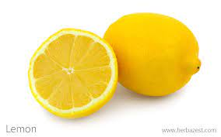
ACIDS
Acids taste sour (Never EVER EVER EVER EVER taste in the lab!)
Acids turned blue litmus paper RED.
Acids turn red litmus paper RED…..if it was already RED then it just gets wet looking.

Slide 23
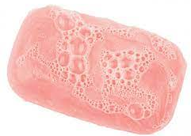
Bases
Bases taste bitter (Never EVER EVER EVER EVER taste in the lab!)
Bases are slippery…like soap.
BLACK Coffee
( No sugar or cream)
Bases turn red litmus paper blue.
Bases turn blue litmus paper blue…..if it was already blue then it just gets wet looking.

Slide 24
General Properties of Acids
When Acids react with water they break up into H⁺ and “The other half”.
Acid-H + H₂O → H⁺ + “Oher Half”
Example:
HCl_{(s)} + H₂O → H⁺_{(aq)} + Cl⁻_{(aq)}
Hydrochloric Acid
(Powder)
Dissolved in water
H⁺_{(aq)} often called a “Proton”.

Slide 25
General Properties of Bases
When Bases react with water they break up into OH⁻ and “The other half”.
Base-OH + H₂O → OH⁻ + “Oher Half”
Example:
NaOH_{(s)} + H₂O → Na⁺_{(aq)} + OH⁻_{(aq)}
Sodium Hydroxide
(Powder)
Dissolved in water
OH⁻_{(aq)} often called a “Hydroxide”.

Slide 26
Types of Redox Reactions
There are 5 Types of Chemical Reactions we deal with:
- Formation/Synthesis Reactions (also called Combination Reactions)
- Decomposition Reactions
- Single Replacement Reactions (also called Displacement Reactions)
- Double Replacement Reactions (also called Displacement Reactions)
- Combustion Reactions

Slide 27
Review Reaction Types: Formation/Synthesis
General Equation:
A + B → AB
TWO Single ELEMENTS form a COMPOUND.
Element
Compound
Element
Example:
H₂ + Cl₂ → HCl
1
1
2

Slide 28
Review Reaction Types: Decomposition
General Equation:
AB → A + B
One COMPOUND BREAKS into its ELEMENTS.
Compound
Element
Element
Example:
HCl → H₂ + Cl₂
2
1
1

Slide 29
Review Reaction Types: Single Replacement
One Element Replaces Its SIMILAR (M or NM) in a COMPOUND.
General Equation:
AB + C → AC + B
Compound
Compound
Element
Element
Example:
NaCl + F₂ → NaF + Cl₂
2
1
2
1

Slide 30
Review Reaction Types: Double Replacement
TWO COMPOUNDS Switch their “Partner” Elements.
General Equation:
AB + CD → AD + CB
Compound
Compound
Compound
Compound
Example:
FeI₃ + Al₂O₃ → Fe₂O₃ + AlI₃
2
1
1
2

Slide 31
Review Reaction Types: Combustion
Carbon and Hydrogen containing COMPOUND BURNS to produce CO₂ and H₂O.
General Equation:
C_{x}H_{2x+2} + O₂ → CO₂ + H₂O
Hydrocarbon W/ Twice as many Cs as Hs
Carbon Dioxide
Oxygen
Water
Example:
C₃H₈ + O₂ → CO₂ + H₂O
1
Propane
3
4
5

Slide 32
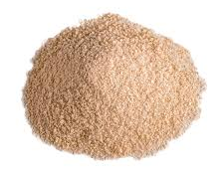
4.5: Concentration of Solutions
The CONCENTRATION of a solution is HOW STRONG it is.
Like the Iced Tea or Juice you made during the summer.
“Stuff”(Solute)
Concentration =
Water (Solvent)
“Stuff”
But water is not the only solvent, “stuff” can be dissolved in all kinds of things.

Slide 33
4.5: Concentration of Solutions
The CONCENTRATION of a solution is:
Mols of Solute (n)
n
C =
V
Volume of Solvent (Needs to be in Liters).
Concentration (mol/L)

Slide 34
4.5: Concentration of Solutions
The CONCENTRATION of a solution also referred to as Molarity:
Mols of Solute (n)
n
M =
V
Volume of Solvent (Needs to be in Liters).
Molarity (mol/L)

Slide 35
4.5: Concentration of Solutions
The CONCENTRATION or Molarity can also be use with a balanced chemical equation (STOICHIOMETRY WITH CONCENTRATION)
1 Ba(OH)_{2(s)} → 1 Ba²⁺_{(aq)} + 2 OH-_{(aq)}
[ ] brackets around ion means concentration/molarity in mol/L
[Ba²⁺] = 0.250 mol/L
[OH⁻] = 0.500 mol/L
1
1
( )
C = 0.250 mol/L
C = 0.250 mol/L
2
1
( )
C = 0.500 mol/L

Slide 36
4.5: Concentration of Solutions
Quite often you will be given grams, so it’s a TWO step calculation to molarity.
First Step
Second Step
m
n
n =
C =
M
V
Take your answer from step 1 and use it in step two
(OR VICE VERSA)
(Make sure to convert volume to liters!!! 1000ml = 1 L)

Slide 37
Example 4.6
How many grams of potassium dichromate (K₂Cr₂O₇) are required to prepare a 250 ml solution whose concentration is 2.16 M?
3 sig figs
Second Step
First Step
n
m
C =
n =
V
M
m ~ 159 g
Or
1.59 x 10² g
CV = n
nM = m
n = CV
m = nM
n = (2.16 mol/L(0.250L)
m = (0.54 mol)(294.2 g/mol)
n = 0.54 mol
m = 158.868 g

Slide 38
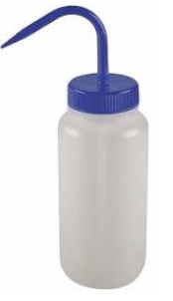
PROPER SOLUTION PREPARATION
Use spray bottle to bring solution up to “meniscus” line

Slide 39
Example: Practice Exercise 4.6
What is the molarity of and 85.0 ml ethanol (C₂H₅OH) solution containing 1.77 g of ethanol?

Slide 40
Example 4.7
3 sig figs
In a biochemical essay (experiment), a chemist needs to add 0.381 g of glucose (C₆H₁₂O₆) to a reaction mixture. Calculate the volume in milliliters of a 2.53 M glucose solution she should use for the addition.
First Step
Second Step
V = 0.00083662714 L
m
n
n =
C =
M
V ~ 8.37 x 10⁻⁴ L
8.37 x 10⁻¹ mL
V
n
0.381 g
n =
V =
180.0 g/mol
C
V =
0.00211666666mol
n = 0.00211666666 mol
2.53 mol/L

Slide 41
Example: Practice Exercise 4.7
What volume (in milliliters) of a 0.315 M NaOH solution contains 6.22 g of NaOH?

Slide 42
Dilution of Solutions
To save room CONCENTRATED (STOCK) solutions are often kept in lab storage and need to be weakened (diluted) to be amounts needed in experiments.
Concentrated Solutions
Reagent | Formula | Concentration (mol/L)
Acetic acid | CH₃COOH | 17.4
Ammonia | NH_{3(aq)} | 14.8
Carbonic acid | H2CO₃ | 0.039
Hydrochloric acid | HCl | 11.6
Nitric acid | HNO₃ | 15.4
Phosphoric acid | H₃PO₄ | 14.6
Sodium hydroxide | NaOH | 19.1
Sulfurous acid | H2SO₃ | 0.73
Sulfuric acid | H₂SO₄ | 17.8

Slide 43
Dilution of Solutions
Concentrated Solutions
Reagent | Formula | Concentration (mol/L)
Acetic acid | CH₃COOH | 17.4
Ammonia | NH_{3(aq)} | 14.8
Carbonic acid | H2CO₃ | 0.039
Hydrochloric acid | HCl | 11.6
Nitric acid | HNO₃ | 15.4
Phosphoric acid | H₃PO₄ | 14.6
Sodium hydroxide | NaOH | 19.1
Sulfurous acid | H2SO₃ | 0.73
Sulfuric acid | H₂SO₄ | 17.8
A solution is created by dissolving # moles in # Volume.
A solution can be changed from one concentration to another by:
Taking a certain volume of concentrated solution and adding more water to it.
Original Concentration
Final Concentration
C₁V₁ = C₂V₂
Original Volume
Final Volume

Slide 44
Dilution of Solutions
Concentrated Solutions
Reagent | Formula | Concentration (mol/L)
Acetic acid | CH₃COOH | 17.4
Ammonia | NH_{3(aq)} | 14.8
Carbonic acid | H2CO₃ | 0.039
Hydrochloric acid | HCl | 11.6
Nitric acid | HNO₃ | 15.4
Phosphoric acid | H₃PO₄ | 14.6
Sodium hydroxide | NaOH | 19.1
Sulfurous acid | H2SO₃ | 0.73
Sulfuric acid | H₂SO₄ | 17.8
A solution can be changed from one concentration to another by:
1. Determining the Volume of Original (usually the final volume YOU WANT) X Concentration of original YOU NEED.
2. Divide by final concentration you WANT
Original Concentration
Final Concentration
OR
C₁V₁ = C₂V₂
2’. Divide by final volume you WANT
Original Volume
Final Volume

Slide 45
Example 4.8
Describe how you prepare 5.00 x 10² mL of a 1.75 M H₂SO₄ solution, starting with 8.61 M stock solution of H₂SO₄.
C₁V₁ = C₂V₂
Steps:
There is no information about this one, so it’s the one to solve for.
C₁=
8.61 mol/L
V₁=
???
C₂=
1.75 mol/L
Volume has to be in Liters…so this needs to be converted.
V₂=
5.00 x 10² mL
0.500 L
1L = 1000 mL

Slide 46
Example 4.8
3 sig figs
Describe how you prepare 5.00 x 10² mL of a 1.75 M H₂SO₄ solution, starting with 8.61 M stock solution of H₂SO₄.
C₁V₁ = C₂V₂
Steps:
V₁ = C₂V₂
Measure 102 mL in graduated cylinder
Transfer 102 ml of stock solution in 500 mL volumetric flask.
Dilute (add water) to the flask to a final volume of 500 mL. (marked)
Invert (Flip Upside down) flask to mix it.
C₁=
8.61 mol/L
C₁
V₁=
???
V₁ = (1.75 mol/L)(0.500 L)
C₂=
1.75 mol/L
(8.61 mol/L)
V₂=
0.500 L
V₁ = 0.1016260163 L
V₁ ~ 1.02 x10⁻¹ L

Slide 47
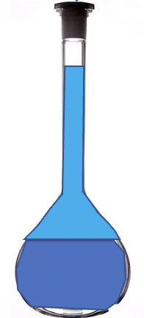
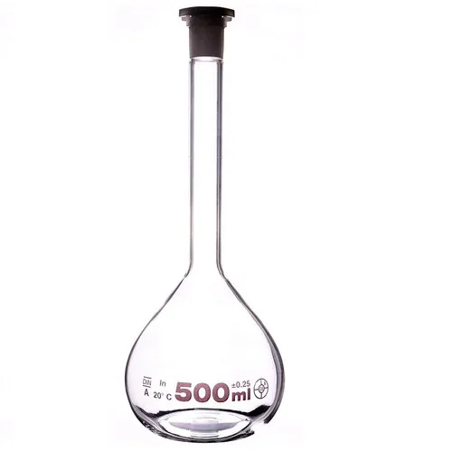
Example 4.8 (Visual)
Describe how you prepare 5.00 x 10² mL of a 1.75 M H₂SO₄ solution, starting with 8.61 M stock solution of H₂SO₄.
Steps:
102 mL
102 mL
Measure 102 mL in graduated cylinder
Transfer 102 ml of stock solution in 500 mL volumetric flask.
Dilute (add water) to the flask to a final volume of 500 mL. (Marked)
Invert (Flip Upside down) flask to mix it.
Stock Solution
(8.61 M)

Slide 48
Example: Practice Exercise 4.8
How would we prepare 2.00 102 mL of a 0.866 M NaOH solution, starting with a 5.07 M stock solution?

Slide 49
4.6: Gravimetric Analysis
In a precipitation reaction TWO aqueous solutions react to form a solid product that falls out of solution. (Cloudy or like a snow globe).
Example:
If you write the Total Ionic equation and then cancel out the spectator ions you get:
1 Ag⁺_{(aq)} + 1 Cl⁻_{(aq)}→ 1 AgCl_{(s)}
If you have balancing numbers you can do stoichiometry with concentrations.

Slide 50
4.7: Acid-Base Titrations
1 H⁺_{(aq)} + 1 OH⁻_{(aq)}→ 1 H₂O_{(l)}
From Acids
From Bases
This process is called neutralization and it has BALANCING NUMBERS…so….Stoichiometry (Again).
The best way to do these questions is just like stoichiometry from before EXCEPT you use C = n/V (n= CV) to get moles instead of
n = m/M OR Unit analysis.

Slide 51
4.7: Acid-Base Titrations
Titration is a technique (experimental method) used in the lab to find another “Unknown” solutions concentration (Very Accurate).
“Known” Concentration
In titration a solution of known concentration is slowly (drop by drop) added to a solution of “unknown” concentration.
“Unknown” Concentration

Slide 52
4.7: Acid-Base Titrations
If you know the CONCENTRATION and the VOLUME you have used, you can calculate mols.
n = CV
“Known” Concentration
How do you know volume?

Slide 53
4.7: Acid-Base Titrations
By measuring how much volume you had in the buret
before and after your titration you can calculate how much you have used.
-
“Known” Concentration
But how do know when to stop adding?

Slide 54
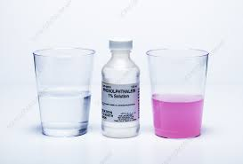
4.7: Acid-Base Titrations
But how do know when to stop adding?
Indicator:
-
“Known” Concentration
Is a substance that changes colour to indicate a change in acid or base environment.
Base
Acid

Slide 55
Example 4.10
In a titration experiment, a student finds that 23.48 mL of an NaOH solution are needed to neutralize 0.5468 g of KHP (Potassium Hydrogen Phthalate…an acid). What is the concentration (in Molarity) of the NaOH solution?
N
m = 0.5468 g
V = 0.02348 L
C = ???
n =0.00241839893 mol
n
m
0.00241839893 mol
n =
= 0.5468 g
C =
=
V
0.02348 L
M
204.2 g/mol
1
1
( )
n =0.0026777669 mol
n =
0.0026777669 mol
C =
0.1140445867 mol/L
~1.140 x10⁻² mol/L

Slide 56
Example: Practice Exercise 4.10
How many grams of KHP are needed to neutralize 18.64 mL of a 0.1004 M NaOH solution?

Slide 57
Example 4.11
3 sig figs
How many milliliters (mL) of a 0.610 M NaOH solution are needed to neutralize 20.0 mL of a 0.245 M H₂SO₄ solution?
2 NaOH + 1 H₂SO₄ → 2 HOH + 1 Na₂SO₄
V = ???
V = 0.020 L
C = 0.610 mol/L
C = 0.245 mol/L
V =
0.0098 mol
n =0.0098 mol
n =CV
0.610 mol/L
V =
n
n = (0.245 mol/L)(0.020L)
0.01606557 L
V =
X 1000 ml/L
C
16.06557 mL
2
1
( )
V = 16.1 mL
n =0.0098 mol
n =
0.0049 mol

Slide 58
Example: Practice Exercise 4.11
How many milliliters (mL) of a 1.28M H₂SO₄ solution are needed to neutralize 60.2 mL of a 0.247 M KOH solution?

Slide 59
Key Words
Aqueous Solution (P. 120)
Combination
reaction (P.138)
Concentration of a
solution (P. 142)
Decomposition
Reaction (P. 137)
Dilution (P. 146)
Electrolyte (P. 120)
Gravimetric analysis (P.148)
Hydration (P. 121)
Indicator (P. 151)
Ionic equation (P. 124)
Molar concentration ( P. 142)
Molarity (M) (P. 142)
Molecular equation (P. 124)
Net ionic equation (P. 125)
Neutralization
reaction (P. 130)
Nonelectrolyte (P. 120)
Oxidation Number (P. 134)
Precipitate (P. 122)
Precipitation
Reaction (P. 122)
Quantitative
analysis (P. 148)
Reversible reaction (P. 122)
Salt (P. 130)
Solubility (P. 123)
Solute (P. 120)
Solvent (P. 120)
Spectator ion (P. 124)
Standard Solution (P. 150)
Titration (P. 150)

