Slide 1
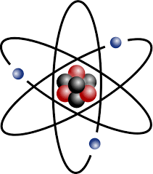
Chapter 3
Mass Relationships in Chemical Reactions

Slide 2
3.1: Atomic Mass
All elements have an atomic mass as show on the periodic table.
The Atomic mass of an element is the sum (add them all up) of PROTONS, NEUTRONS, and electrons.
You can change the # of electrons in an atom (Changes the charge).
REMEMBER:
You can change the # of neutrons in an atom (Changes the Mass).
You can NOT change the # of protons in an atom (Changes what the element is).

Slide 3
3.1: Atomic Mass
The Atomic mass of an element is the sum (add them all up) of PROTONS, NEUTRONS, and electrons.
PROTONS and NEUTRONS have the largest effect on Atomic Mass…electrons are very small and account for small (decimals) of the overall Atomic mass.
Ex. Carbon¹² – Atomic Mass 12.0 g/mol.
6 PROTONS + 6 NEUTRONS = 12
The 6 Electrons has a very small effect.

Slide 4
Average Atomic Mass
Carbon 12? Carbon 14? Carbon 16?
More precisely (complicated)….the weight of individual atoms are determined by Protons + Neutrons + _{Electrons}
BUT, more than one VERSION (Isotope) of each element exists….so the Atomic Mass on the periodic table is an average of all the different “Versions”(Isotopes).
So the mass on the periodic
(12.0 g/mol) table is an AVERAGE of all 3 ISOTOPES.
Ex.
Closer to the first (C-12) because that is the MOST COMMON.

Slide 5
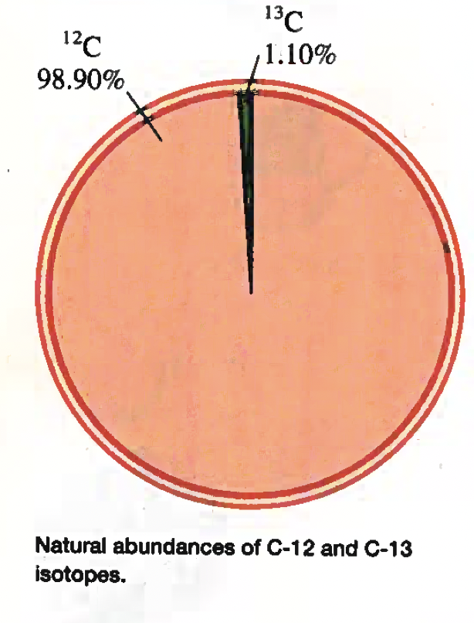

Slide 6
Average Atomic Mass
The Atomic mass of an element is the sum (add them all up) of PROTONS, NEUTRONS, and electrons.
You can change the # of electrons in an atom (Changes the charge).
REMEMBER:
You can change the # of neutrons in an atom (Changes the Mass).
You can NOT change the # of protons in an atom (Changes what the element is).
Isotope:
Is an element with the SAME # OF PROTONS and the SAME # OF ELECTRONS, but a DIFFERENT # OF NEUTRONS.

Slide 7
Example 3.1
Copper, a metal found since ancient times, is used in electrical cables and pennies, among other things. The atomic masses of its two stable isotopes , $\begin{matrix}63 \\ 29\end{matrix}Cu$ (69.09 percent) and $\begin{matrix}65 \\ 29\end{matrix}Cu$ (30.91 percent), are 62.93 amu and 64.9278 amu, respectively. Calculate the average atomic mass of Copper. The relative abundances are given in parenthesis.
Each Isotope contributes to the overall average, each percent abundance has a direct impact on how much its atomic mass affects the average.
$$\begin{matrix}63 \\ 29\end{matrix}Cu$$
= (0.6909) x (62.93 amu)
= 43.478337 amu
+
$$\begin{matrix}65 \\ 29\end{matrix}Cu$$
= (0.3091) x (64.9278 amu)
= 20.069183 amu
= 63.54752$amu$
~
63.55 amu

Slide 8
Example: Practice Exercise 3.1
Then atomic masses of two stable isotopes of boron, $\begin{matrix}10 \\ 5\end{matrix}$B (19.78 percent) and $\begin{matrix}11 \\ 5\end{matrix}B$ (80.22 percent) are 10.0129 amu and 11.0093 amu, respectively. Calculate the average atomic mass of boron.

Slide 9
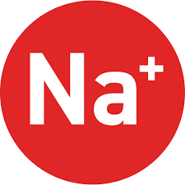
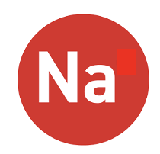
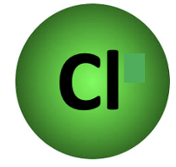
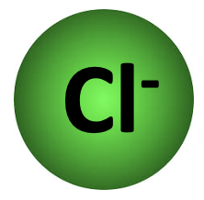
3.2: Avogadro’s Number and the Molar Mass of an Element
In Chemistry because elements and compounds are reacting with each other at the Atomic Level, measuring in grams and pounds doesn’t help.
1 Atom of Na joins with 1 atom of Cl to form NaCl (Salt).

Slide 10
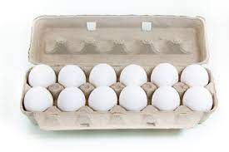
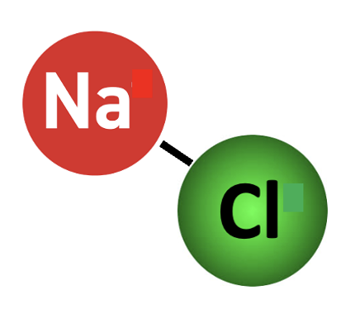
3.2: Avogadro’s Number and the Molar Mass of an Element (The Mole)
Because elements react on the Atomic Level its convenient to measure them on the Atomic Level….hence The Mole (mol is its unit symbol).
A PAIR of shoes.
A DOZEN eggs.
A Mole of NaCl.

Slide 11
3.2: Avogadro’s Number and the Molar Mass of an Element
Because you CANT see a single Particle of NaCl (Its microscopic), we group a whole bunch together and call this quantity A Mole.
1 Mole = 6.0221367 x 10²³ Particles
This amount is Avagadro’s Number

Slide 12
3.2: Avogadro’s Number and the Molar Mass of an Element
With this knowledge we can use the AMU (Molar Mass) given on then periodic table to calculate the mass of one particle.
1 Mole = 6.0221367 x 10²³ Particles
The mass of 1 MOL of Chlorine is 35.5 g/mol.
(35.5 x 1) ➗ (6.022 x10²³)
35.5 g
???
CROSS MULTIPLY
= 0.00942899236
6.022 x 10²³ p
1 p
~ 9.43 x 10⁻³ grams

Slide 13
Example 3.2
Helium (He) is a valuable gas in industry, low temperature research, deep sea diving tanks, and balloons. How many moles of He atoms are in 6.46 g of He?
3 Sig Figs
Molar Mass_{He} = 4.0g / mol
4.0 g
6.46 g
CROSS MULTIPLY
(1 x 6.46) ➗ (4.0)
1 mol
???
= 1.615 mol
~ 1.62 mol
OR A SECOND MORE CHEMISTRY WAY

Slide 14
Example 3.2
Helium (He) is a valuable gas in industry, low temperature research, deep sea diving tanks, and balloons. How many moles of He atoms are in 6.46 g of He?
3 Sig Figs
Molar Mass_{He} = 4.0g / mol
m _{(mass)}
n =
“m” stands for the mass in grams.
M _{(Molar mass)}
“n” stands for the # of Moles.
“M” stands for the Molar Mass in g / mol.

Slide 15
Example 3.2
Helium (He) is a valuable gas in industry, low temperature research, deep sea diving tanks, and balloons. How many moles of He atoms are in 6.46 g of He?
3 Sig Figs
Molar Mass_{He} = 4.0g / mol
m _{(mass)}
Question asks for ”moles” so no need to Rearrange formula.
n =
= 1.615 mol
M _{(Molar mass)}
~ 1.62 mol
=
6.46 g
4.0 g/mol

Slide 16
Example: Practice Exercise 3.2
How many moles of magnesium (Mg) are there in 87.3 g of Mg?

Slide 17
Example 3.3
Zinc (Zn) is a silvery metal that is used in making brass (with copper) and in plating iron to prevent corrosion. How many grams of Zn are in 0.356 mol of Zn?
3 Sig Figs
Molar Mass_{Zn} = 65.4g / mol
65.4 g
???
CROSS MULTIPLY
(65.4 x 0.356) ➗ (1)
1 mol
0.356 mol
= 23.2824 g
~ 23.3 g
m
n =
nM = m
m = nM
= 23.2824 g
M
m = (0.356)(65.4)
~ 23.3 g

Slide 18
Example: Practice Exercise 3.3
Calculate the number of grams of lead (Pb) in 12.4 moles of lead.

Slide 19
Example 3.4
Sulfur (S) is a non-metallic element that is present in coal. When coal is burned, sulfur is converted to sulfur dioxide and eventually to sulfuric acid that gives rise to acid rain phenomenon. How many atoms are there in 16.3 g of Sulfur (S)?
Well we can convert directly (One Step) from grams to atoms.
FIRST we need to convert to moles AND THEN atoms.
m
n =
Molar Mass_{S} = 32.1g / mol
M
=
16.3 g
1 Mole = 6.0221367 x 10²³ Particles
32.1 g/mol
= 0.50778816199 mol

Slide 20
Example 3.4
Sulfur (S) is a non-metallic element that is present in coal. When coal is burned, sulfur is converted to sulfur dioxide and eventually to sulfuric acid that gives rise to acid rain phenomenon. How many atoms are there in 16.3 g of Sulfur (S)?
3 Sig Figs
1 Mole = 6.0221367 x 10²³ Particles
1 mol
0.50778816199 mol
CROSS MULTIPLY
=
6.02 x 10²³ P
???
(6.02 x 10²³)(0.50778816199)
= 3.0568847 x10²³ Atoms
~ 3.06 x10²³ Atoms
= 0.50778816199 mol

Slide 21
Example: Practice Exercise 3.4
Calculate the number of atoms in 0.551 g potassium (K).

Slide 22
3.3: Molecular Mass
Molecular mass (Molar Mass for Ionics) is similar to Atomic Mass but it’s the weight of COMPOUNDS.
For Example:
Molecular Mass =
What is the molecular mass of CO₂?
12.0 amu (Carbon)
+ 2 x16.0 amu (Oxygen)
44.0 amu
1 Carbon (12.0 amu)
2 Oxygen
2 x (16.0 amu)
Concept is best learned through PRACTICE.

Slide 23
Example 3.5
Calculate the molecular masses (In amu) of the following compounds a) sulphur dioxide (SO₂) and b) caffeine (C₈H₁₀N₄O₂)
SO₂
1 Sulphur (32.1 amu)
2 Oxygen
2 x (16.0 amu)
Molecular Mass =
32.1 amu (Suphur)
+ 2 x 16.0 amu (Oxygen)
64.1 amu

Slide 24
Example 3.5
Calculate the molecular masses (In amu) of the following compounds a) sulphur dioxide (SO₂) and b) caffeine (C₈H₁₀N₄O₂)
C₈H₁₀N₄O₂
8 Carbon
8 x (12.0 amu)
4 Nitrogen
4 x (14.0 amu)
2 Oxygen
2 x (16.0 amu)
10 Hydrogen
10 x (1.0 amu)
Molecular Mass =
8 x 12.0 amu (Carbon)
96.0 amu (Carbon)
10 x 1.0 amu (Hydrogen)
10.0 amu (Hydrogen)
4 x 14.0 amu (Nitrogen)
56.0 amu (Nitrogen)
+ 2 x 16.0 amu (Oxygen)
+ 32.0 amu (Oxygen)
194.0 amu

Slide 25
Example: Practice Exercise 3.5
What is the molecular mass of methanol (CH₄OH)?

Slide 26
Molecular Mass and Molar Mass
Molecular mass in AMU is equal to Molar Mass in g/mol.
The ratio between molar mass is 1 : 1……aka, they are the SAME….but different units.
1 Mole = 6.0221367 x 10²³ Particles

Slide 27
Example 3.6
Methane (CH₄) is the principal component of natural gas. How many moles of CH₄ are present in 6.07 g of CH₄?
3 Sig Figs
CH₄
m
Know this.
n =
M
Don’t know this.
1 Carbon
(12.0 g/mol)
4 Hydrogen
4 x (1.0 g/mol)
But we can calculate it!
Molecular Mass =
1 x 12.0 amu (Carbon)
+ 4 x 1.0 amu (Hydrogen)
n =
= 0.379375 mol
6.07 g
16.0 g/mol
16.0 g/mol
~ 3.79 x10⁻¹ mol

Slide 28
Example: Practice Exercise 3.6
Calculate the number of moles of chloroform (CHCl₃) in 198 g of chloroform.

Slide 29
Example 3.7
How many hydrogen atoms are present in 25.6 g of urea [(NH₂)₂CO)], which is used as fertilizer in animal feed and in the manufacture of polymers. The molar mass of urea is 60.06 g/mol.
FIRST we have to calculate the number of moles of Urea.
m
n =
1 Mole = 6.0221367 x 10²³ Particles
M
(0.42624042624 mol)(6.022 x 10²³ Atoms/mol
=
25.6 g
= 2.5668198 x 1024 Atoms_{[[NH2)2CO]}
60.06 g/mol
= 0.42624042624 mol

Slide 30
Example 3.7
How many hydrogen atoms are present in 25.6 g of urea [(NH₂)₂CO)], which is used as fertilizer in animal feed and in the manufacture of polymers. The molar mass of urea is 60.06 g/mol.
SECOND we have to calculate the number of atoms of Urea.
1 Mole = 6.0221367 x 10²³ Particles
(0.42624042624 mol)(6.022 x 10²³ Atoms/mol
= 2.5668198 x 10²⁴ Atoms_{[[NH2)2CO]}
= 0.42624042624 mol

Slide 31
Example 3.7
3 Sig Figs
How many hydrogen atoms are present in 25.6 g of urea [(NH₂)₂CO)], which is used as fertilizer in animal feed and in the manufacture of polymers. The molar mass of urea is 60.06 g/mol.
THIRD we have to calculate the number of atoms of Hydrogen.
= 2.5668198 x 10²⁴ Atoms_{[[NH2)2CO]} x 4 H in each urea
= 1.0267279 x 10²⁵ Atoms_{H}
= 1.03 x 10²⁵ Atoms_{H}
= 2.5668198 x 10²⁴ Atoms_{[[NH2)2CO]}

Slide 32
Example: Practice Exercise 3.7
How many H atoms are in 72.5 g of isopropanol (rubbing alcohol), C₃H₈O

Slide 33
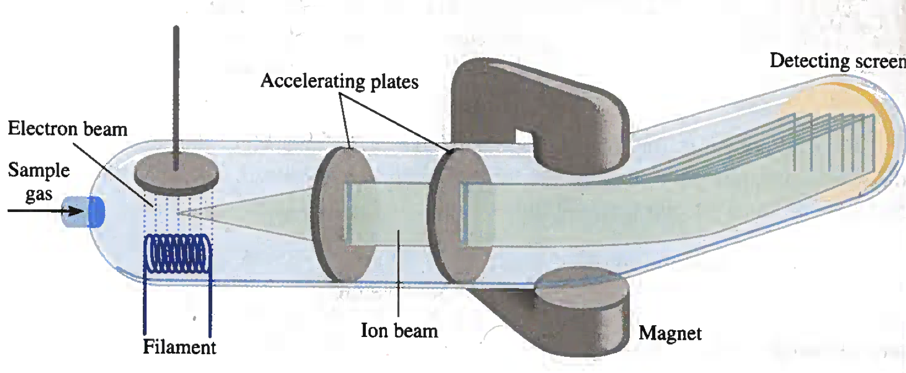
3.4: The Mass Spectrometer
Mass spectroscopy is the most accurate way of determining atomic and molar mass.
The sensitivity of mass spectroscopy lead to the discovery (definitive proof) of isotopes (same element, different mass).
As technology improved more RARE (Really small %) isotopes were discovered.

Slide 34
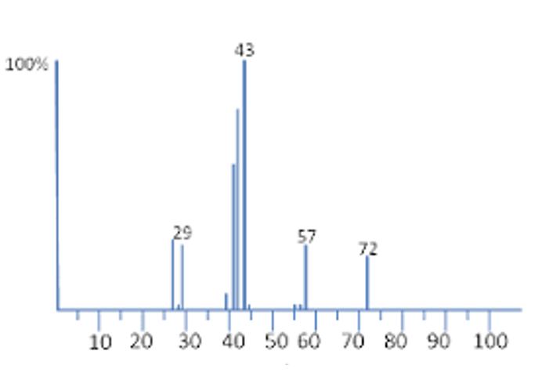
3.5: Percent Composition of Compounds
When studying a compound in the lab its important to know the composition of the compound (What is it made of?)
Each ”Spike” on the graph indicates the presence of a different weighted element.
(A different Element or Isotope)

Slide 35
3.5: Percent Composition of Compounds
After determining the weight of the different elements that make up a compound we can determine its % by:
Elemental Molar Mass
Percent Composition =
Compounds Molar Mass
= Decimal
X 100%

Slide 36
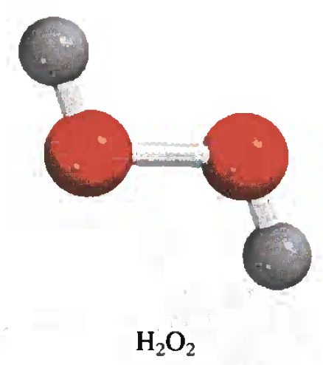
3.5: Percent Composition of Compounds
Hydrogen Peroxide
+
99.99%
Just Rounding.

Slide 37
Example 3.8
Phosphoric acid (H₃PO₄) is a colourless, syrupy liquid in detergents, fertilizers, toothpastes, and in carbonated beverages for a “tangy” flavour. Calculate the percent composition by mass of H, P, and O in this compound.
H₃PO₄
%H =
3 x (1.0 g/mol H)
X 100% =
3.06 %
1
98.0g/mol H₃PO₄)
1 x (31.0 g/mol P)
%P =
Molar Mass =
X 100% =
31.6 %
98.0g/mol H₃PO₄)
3 x 1.0 g/mol (Hydrogen)
%O =
4 x (16.0 g/mol O)
1 x 31.0 g/mol (Phosphorus)
X 100% =
+ 4 x 16.0 amu (Oxygen)
98.0g/mol H₃PO₄)
65.3 %
98.0 g/mol

Slide 38
Example: Practice Exercise 3.8
Calculate the percent composition by mass of each of the elements in Sulfuric Acid (H₂SO₄).

Slide 39
3.5: Percent Composition of Compounds (Backwards)
If we know the % composition we can work back and find the Empirical Formula (Lowest Terms) for the compound.
And once we have the Empirical Formula, we can compare it to a compounds Molar Mass to find its
Molecular Formula (Actual Chemical Formula)

Slide 40
Example 3.9
Ascorbic acid (Vitamin C) cures scurvy. It is composed of 40.92 percent carbon (C), 4.58 percent hydrogen (H), and 54.50 percent oxygen (O) by mass. Determine its empirical formula.
For easy calculation we just assume the entire sample of Vitamin C is 100g…that way we can convert each percent to grams.
m
n =
n_{C} =
40.92 g
= 3.41 mol
M
12.0 g/mol
n_{H} =
4.58 g
= 4.58 mol
If we divide each mass by its molar mass it will give us the moles of each.
1.0 g/mol
n_{O} =
54.50 g
= 3.41 mol
16.0 g/mol

Slide 41
Example 3.9
Ascorbic acid (Vitamin C) cures scurvy. It is composed of 40.92 percent carbon (C), 4.58 percent hydrogen (H), and 54.50 percent oxygen (O) by mass. Determine its empirical formula.
Now if we divide all three amounts and the smallest amount we can get a ratio.
n_{C} =
40.92 g
To be empirical formula it has to be lowest terms…(All whole numbers)..
= 3.41 mol
= 1
12.0 g/mol
3.41
n_{H} =
4.58 g
= 4.58 mol
= 1.34
1.0 g/mol
3.41
n_{O} =
54.50 g
= 3.41 mol
= 1
16.0 g/mol
3.41

Slide 42
Example 3.9
x
Ascorbic acid (Vitamin C) cures scurvy. It is composed of 40.92 percent carbon (C), 4.58 percent hydrogen (H), and 54.50 percent oxygen (O) by mass. Determine its empirical formula.
How do we make them all whole numbers?
We have to use multiplication
And what we do to one we have to do to ALL.
n_{C} =
1
x1
= 1
To be empirical formula it has to be lowest terms…(All whole numbers)..
1.34
x1
n_{H} =
= 1.34
n_{O} =
1
x1

Slide 43
Example 3.9
x
Ascorbic acid (Vitamin C) cures scurvy. It is composed of 40.92 percent carbon (C), 4.58 percent hydrogen (H), and 54.50 percent oxygen (O) by mass. Determine its empirical formula.
How do we make them all whole numbers?
We have to use multiplication
And what we do to one we have to do to ALL.
n_{C} =
1
x2
= 2
To be empirical formula it has to be lowest terms…(All whole numbers)..
1.34
x2
n_{H} =
= 2.68
n_{O} =
1
x2

Slide 44
Example 3.9
Ascorbic acid (Vitamin C) cures scurvy. It is composed of 40.92 percent carbon (C), 4.58 percent hydrogen (H), and 54.50 percent oxygen (O) by mass. Determine its empirical formula.
How do we make them all whole numbers?
We have to use multiplication
And what we do to one we have to do to ALL.
n_{C} =
1
x3
= 3
To be empirical formula it has to be lowest terms…(All whole numbers)..
1.34
x3
n_{H} =
= 4.02
Really close to 4…just rounding.
n_{O} =
1
x3
= 3

Slide 45
Example 3.9
Ascorbic acid (Vitamin C) cures scurvy. It is composed of 40.92 percent carbon (C), 4.58 percent hydrogen (H), and 54.50 percent oxygen (O) by mass. Determine its empirical formula.
So the Empirical Formula = C₃H₄O₃
n_{C} =
1
x3
= 3
1.34
x3
n_{H} =
= 4.02
Really close to 4…just rounding.
n_{O} =
1
x3
= 3

Slide 46
Example: Practice Exercise 3.9
Determine the empirical formula of a compound having the following percent composition by mass: K: 24.75 percent; Mn: 34.77 percent; O: 40.51 percent.

Slide 47
Example 3.10
Chalcopyrite (CuFeS₂) is a principal mineral (main raw form) of copper. Calculate the number of kilograms of Cu in 3.71 x 10³ kg of chalcopyrite
If you know the molar mass of copper AND the fully compound you can find percentage.
CuFeS₂
63.5 g/mol (Copper)
% =
183.5 g/mol (Chalcopyrite)
Molar Mass_{CuFeS2} =
1 x 63.5 g/mol (Copper)
% = 0.34604904632
1 x 55.8 g/mol (Iron)
+ 2 x 32.1 g/mol (Sulfur)
Now that we have percent its an easy multiplication to find kg of Cu.
183.5 g/mol

Slide 48
Example 3.10
Chalcopyrite (CuFeS₂) is a principal mineral (main raw form) of copper. Calculate the number of kilograms of Cu in 3.71 x 10³ kg of chalcopyrite
3 Sig Figs
If you know the molar mass of copper AND the fully compound you can find percentage.
CuFeS₂
63.5 g/mol (Copper)
% =
183.5 g/mol (Chalcopyrite)
% = 0.34604904632
X (3.71 x 10³ kg)
= 1283.84196185 kg
Now that we have percent its an easy multiplication to find kg of Cu.
~ 1.28 x 10³ kg

Slide 49
Example: Practice Exercise 3.10
Calculate the number of grams of Al in 371 g of Al₂O₃.

Slide 50
3.6: Experimental Determination of Empirical Formulas (Beginning of Stoichiometry)
In an experiment you may be measuring the products or reactants.
A beginning compound (REACTANT) CANNOT produce more final product (PRODUCT..go figure) than it had to begin with.
This relationship between reactants and products is on the MOLE level.

Slide 51
3.6: Experimental Determination of Empirical Formulas (Beginning of Stoichiometry)
For Example:
When you burn ethanol (C₂H₆O), the moles of reactants and products which are H₂O and CO₂ are related by a ratio.
C₂H₆O
+ O₂
H₂O
+ CO₂
Ethanol
What do you need to burn something?

Slide 52
3.6: Experimental Determination of Empirical Formulas (Beginning of Stoichiometry)
For Example:
When you burn ethanol (C₂H₆O), the moles of reactants and products which are H₂O and CO₂ are related by a ratio.
C₂H₆O
+ O₂
H₂O
+ CO₂
Mass = 13.5 g
Mass = 22.0g
From measuring the difference (Weight before and after) of the H₂O and CO₂ scrubbers you determine the weights.

Slide 53
3.6: Experimental Determination of Empirical Formulas (Beginning of Stoichiometry)
For Example:
When you burn ethanol (C₂H₆O), the moles of reactants and products which are H₂O and CO₂ are related by a ratio.
C₂H₆O
+ O₂
H₂O
+ CO₂
Mass = 13.5 g
Mass = 22.0g
m
n = 0.75 mol
n = 0.50 mol
n =
n =
13.5 g
n =
22.0 g
M
18.0 g/mol
44.0 g/mol
The amounts of Reactants and Products is related on the MOLE LEVEL…..so we should convert to moles.

Slide 54
3.6: Experimental Determination of Empirical Formulas (Beginning of Stoichiometry)
For Example:
When you burn ethanol (C₂H₆O), the moles of reactants and products which are H₂O and CO₂ are related by a ratio.
C₂H₆O
+ O₂
H₂O
+ CO₂
Mass = 13.5 g
Mass = 22.0g
n = 0.75 mol
n = 0.50 mol
X 2
X 1
n_{H} =
1.5 mol
n_{C} =
0.50 mol
You can even calculate the number of mole of specific elements.

Slide 55
3.6: Experimental Determination of Empirical Formulas (Beginning of Stoichiometry)
For Example:
When you burn ethanol (C₂H₆O), the moles of reactants and products which are H₂O and CO₂ are related by a ratio.
C₂H₆O
+ O₂
H₂O
+ CO₂
Mass = 13.5 g
Mass = 22.0g
m
n = 0.75 mol
n = 0.50 mol
n =
M
n =
m
n_{H} =
1.5 mol
n_{C} =
0.50 mol
M
Then you can calculate the mass of specific elements.

Slide 56
Determination of Molecular Formulas
When you use the percent composition of an element in a compound to determine its Empirical Formula its always in LOWEST TERMS.
If you know the actual Molar Mass of a compound you can multiply the lowest terms (Empirical Formula) until it has the SAME molar mass (Molecular Formula).

Slide 57
Determination of Molecular Formulas
When you use the percent composition of an element in a compound to determine its Empirical Formula its always in LOWEST TERMS.
If your given the ACTUAL molar mass you can WHOLE NUMBER COEFFICIENTS to MULTIPLY your Empirical to Molecular.

Slide 58
Determination of Molecular Formulas
Ascorbic acid (Vitamin C) cures scurvy. It is composed of 40.92 percent carbon (C), 4.58 percent hydrogen (H), and 54.50 percent oxygen (O) by mass. Determine its empirical formula.
So the Empirical Formula = C₃H₄O₃
Actual Molar Mass is 264.0 g/mol
n_{C} =
1
x3
= 3
Molar Mass_{C3H4O3} =
1.34
x3
3 x 12.0 g/mol (Carbon)
n_{H} =
= 4.02
4 x 1.0 g/mol (Hydrogen)
Really close to 4…just rounding.
+ 3 x 16.0 g/mol (Oxygen)
n_{O} =
1
x3
88.0 g/mol
= 3

Slide 59
Determination of Molecular Formulas
Ascorbic acid (Vitamin C) cures scurvy. It is composed of 40.92 percent carbon (C), 4.58 percent hydrogen (H), and 54.50 percent oxygen (O) by mass. Determine its empirical formula.
So the Empirical Formula = C₃H₄O₃
Molecular Formula = C₉H₁₂O₉
Actual Molar Mass is 264.0 g/mol
Molar Mass_{C3H4O3} =
_{ACTUAL Molar Mass}
Coefficient =
3 x 12.0 g/mol (Carbon)
_{Empirical Molar Mass}
4 x 1.0 g/mol (Hydrogen)
_{264.0 g/mol}
+ 3 x 16.0 g/mol (Oxygen)
Coefficient =
_{88.0 g/mol}
88.0 g/mol
Coefficient = 3

Slide 60
Example 3.11
A sample of a compound contains 1.52 g of nitrogen (N) and 3.47 g of oxygen (O). The total molar mass of this compound is between 90 g/mol and 95 g/mol. Determine the molecular formula and the accurate molar mass of the compound.
m
n =
So the Empirical Formula = N₁O₂ Just NO₂
M
1.52 g
= 0.1085714 mol
n_{N} =
= 1
14.0 g/mol
0.108 mol
3.47 g
= 0.216875 mol
= 2.008
n_{O} =
16.0 g/mol
0.108 mol
To find the lowest terms ratio we divide both amounts by the smallest amount.

Slide 61
Example 3.11
A sample of a compound contains 1.52 g of nitrogen (N) and 3.47 g of oxygen (O). The total molar mass of this compound is between 90 g/mol and 95 g/mol. Determine the molecular formula and the accurate molar mass of the compound.
Empirical Formula = NO₂
Molecular Formula = N₂O₄
NO₂
Well we calculate this.
NO₂ heavy enough?
Molar Mass_{CNO2} =
x2
= 92.0 g/mol
1 x 14.0 g/mol (Nitrogen)
x3
= 138.0 g/mol
Accurate Molar Mass
+ 2 x 16.0 g/mol (Oxygen)
x4
= 184.0 g/mol
46.0 g/mol
NO₂ is NOT heavy enough.

Slide 62
Example: Practice Exercise 3.11
A sample of a compound containing boron (B) and hydrogen (H) contains 6.444 g of B and 1.803 g of H. The molar mass of the compound is about 30 g. What is the molecular formula?
So far we have converted amounts in grams to amount in moles.
The amounts of elements in a compound are related by a ratio at the MOLE LEVEL.
In order to use this ratio we need to CORRECTLY write a chemical equation represent a reaction.

Slide 63
Example: Practice Exercise 3.11
A sample of a compound containing boron (B) and hydrogen (H) contains 6.444 g of B and 1.803 g of H. The molar mass of the compound is about 30 g. What is the molecular formula?

Slide 64
3.7: Chemical Reactions and Chemical Equations
Chemists from around the world use the SAME symbols to represent a chemical equation.
This designates a chemical reaction has taken place.
Example:
Reactant + Reactant → Product + Product
This designates that TWO reactants that reacted together.
This designates that MULTIPLE products have been produced.
Its NOT always the case where you have TWO reactants and TWO products. Could be 2:1 or 1:2 or 1:3 or 3:1 etc. etc.

Slide 65
Writing Chemical Equations
UNBALANCED
Consider the following reaction where Chlorine gas and Hydrogen gas react together to form HCl (hydrochloric acid).
Chlorine is DIATOMIC…it naturally exists as 2.
Hydrogen is ALSO DIATOMIC…it naturally exists as 2.
Cl₂
+
H₂
HCl
Cl₂ and H₂ react to form HCl.
(g)
(g)
(aq)
The formula for HCl is determined by charge neutrality as HCl is IONIC.
As Chlorine is on the LEFT/REACTANT SIDE of the equation, the “+” means it REACTS with something else.
The “Arrow” means the Reactants are REACTING to YIELD the products.

Slide 66
Balancing Chemical Equations
BALANCED
1:1:2
The Law of Conservation of Matter (Matter is not created or destroyed) states that Reactant (Left side) and Products (Right Side) should be EQUAL ON THE MOLE LEVEL.(Balanced)
Easiest way to balance a chemical equation is a “T” Chart that list all ELEMENTS in the equation.
Easiest way to balance a chemical equation is a “T” Chart that list all ELEMENTS in the equation.
1
Cl₂
+
1
H₂
2
HCl
(g)
(g)
(aq)
$$≠$$
2
Cl
2
1
H
2
2

Slide 67
Example 3.12
When aluminium metal is exposed to air, a protective layer of aluminium oxide (Al₂O₃) forms on its surface. This layer prevents further reaction between aluminum and oxygen, and it is the reason why aluminium beverage cans do not corrode. [In the case of iron, the rust, or iron (III) oxide, that forms is too porous to protect the iron metal underneath, so rusting continues.] Write a balanced chemical equation for the formation of Al₂O₃.
DONE
4
2
Al _{(S)}
+
3
O_{2(g)}
2
Al₂O₃
$$≠$$
4
2
2
1
Al
4
2, 4, 6, 8, 10, 12
Now this one is harder to fix.
$$≠$$
3
2
O
6
6
3, 6, 9, 12, 15, 18

Slide 68
Balancing Chemical Equations (Steps)

Slide 69
Example: Practice Exercise 3.12
Balance the equation representing the reaction between iron (III) oxide, Fe₂O₃, and carbon monoxide (CO) to yield iron (Fe) and carbon dioxide (CO₂).

Slide 70
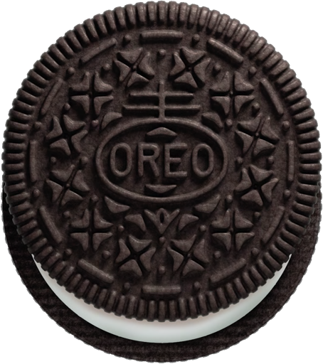
3.8: Amounts of Reactants and Products
When doing a chemical reaction you are joining together or taking apart a compound at the MOLE level.
Its like making Oreos…..2 crackers to
1 filling. (2:1)

Slide 71
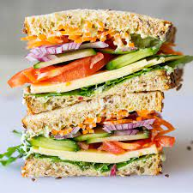
3.8: Amounts of Reactants and Products
Or (More complicated), its like making sandwiches: 2 Pieces of Bread, 1 Piece of meat, 1 piece of cheese, 1 piece of lettuce, 1 pickle, 1 piece of tomato (2:1:1:1:1:1)
Its like Pizza, Layer cake, Lasagna, Sheppard’s Pie, Cake…pretty much anything with proportions.
Can you tell I like food…?

Slide 72
3.8: Amounts of Reactants and Products
Anyway……when you do this, eventually you run out of one of the ingredients (pieces) and have to stop making the ”thing” until you get more.
Chemical reactions are the same, but on the MOLE level.
Amounts (in mol) of reactants and products are related by a RATIO.

Slide 73
3.8: Amounts of Reactants and Products
The RATIO (the numbers) are the balancing coefficients from a balanced chemical equation.
SO….MAKE SURE THE EQUATION IF BALANCED BEFORE YOU DO ANY STOICHIOMETRY!

Slide 74
3.8: Amounts of Reactants and Products
10.60 g of Hydrogen and excess(more than you need) Iodine combine to form Hydrogen iodide (How much?).
H₂ + I₂ → HI
1
1
2
Great…but not really helpful….Chemical Equations are related at the MOLE level….not gram level…
m = 10.60 g
m = ???
How do we convert grams to mol?
n= 5.3 mol
m
=
10.60 g
n =
2.0 g/mol
M
= 5.3 mol

Slide 75
3.8: Amounts of Reactants and Products
10.60 g of Hydrogen and excess(more than you need) Iodine combine to form Hydrogen iodide (How much?).
G
N
H₂ + I₂ → HI
1
1
2
Now that we are the MOL level we can use the balancing numbers to calculate using a RATIO (Fraction)
N is what you NEED to find out about.
m = 10.60 g
m = ???
N
G
2
1
G is the information you were GIVEN in question.
( )
n=
n= 5.3 mol
n= 10.6 mol
n= 5.3 mol x (2/1)

Slide 76
3.8: Amounts of Reactants and Products
10.60 g of Hydrogen and excess(more than you need) Iodine combine to form Hydrogen iodide (How much?).
G
N
Remember: ALL amounts are related at MOLE level by Ratio.
So I₂ is 1:1.
Nice. So how do we convert back to mass?
H₂ + I₂ → HI
1
1
2
m = ???
m = 10.60 g
m = 1355.74 g
m
n =
M
2
1
( )
n=
n= 5.3 mol
n= 10.6 mol
nM = m
= (10.6 mol)(127.9 g/mol)
= 1355.74 g

Slide 77
3.8: Amounts of Reactants and Products
10.60 g of Hydrogen and excess(more than you need) Iodine combine to form Hydrogen iodide (How much?).
G
N
Remember: ALL amounts are related at MOLE level by Ratio.
So I₂ is 1:1.
Nice. So how do we convert back to mass?
H₂ + I₂ → HI
1
1
2
m = ???
m = 10.60 g
m = 1355.74 g
m
n =
M
2
1
( )
n=
n= 5.3 mol
n= 10.6 mol
10.60_{H2} g
1 mol _{H2}
2 mol HI
127.9 g/ mol HI
X
X
X
2.0 g/mol
1 mol H₂
1 mol HI

Slide 78
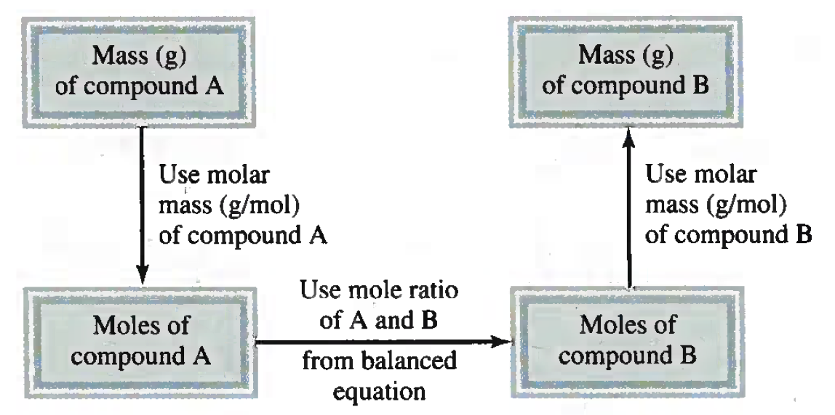
3.8: Amounts of Reactants and Products
m
n =
nM = m
M
N
G
( )

Slide 79
3.8: Amounts of Reactants and Products
Step by Step General Approach for Solving Stoichiometry Problems

Slide 80
Example 3.13
The food we eat is degraded, or broken down, in our bodies to provide energy for growth and function. A general overall equation for this very complex process represents the degradation of glucose (C₆H₁₂O₆) to carbon dioxide (CO₂) and water (H₂O):
1 C₆H₁₂O₆ + 6 O₂ → 6 CO₂ + 6 H₂O
If 856 g of C₆H₁₂O₆ is consumed by a person over a certain period of time, what is the mass of the CO₂ produced?

Slide 81
Example 3.13
3 Sig Figs
If 856 g of C₆H₁₂O₆ is consumed by a person over a certain period of time, what is the mass of the CO₂ produced?
G
N
C₆H₁₂O₆ + 6 O₂ → 6 CO₂ + 6 H₂O
m = 1245.2…. g
m = 856 g
m = ??? g
~1.25 x 10³ g
m
n =
856 g
m =
nM
(28.3 mol)(44.0 g/mol)
M
180.0 g/mol
N
G
6
1
( )
n = 4.7555555555555555 mol
n = 28.5333333333333333 mol
856 g_{C6H12O6}
1 mol _{C6H12O6}
6 mol HI
44.0 g/ mol CO₂
X
X
X
180.0 g/mol
1 mol H₂
1 mol CO₂

Slide 82
Example: Practice Exercise 3.13
If 209 g of methanol (CH₃OH)are used up in a combustion process, what is the mass of H₂O produced?
2 CH₃OH + 3 O₂ → 2 CO₂ + 4 H₂O

Slide 83
Example 3.14
All Alkali metals react with water to produce hydrogen gas and the corresponding alkali metal hydroxide. A typical reaction is that between lithium and water.
2 Li_{(s)} + 2 H₂O_{(l)} → 2 LiOH _{(aq)} + H_{2(g)}
How many grams of Li are needed to produce 9.89 g of H₂?

Slide 84
Example 3.14
3 Sig Figs
How many grams of Li are needed to produce 9.89 g of H₂?
N
G
2 Li_{(s)} + 2 H₂O_{(l)} → 2 LiOH _{(aq)} + H_{2(g)}
m = ??? g
m = 9.89 g
m = 68.241 g
~6.82 x 10¹ g
No need to put a “¹”….just x 10
n =
m =(9.89 mol)(6.9 g/mol)
9.89g
2.0g/mol
2
1
( )
n = 9.89 mol
n = 4.95 mol
9.89 g_{H2}
1 mol _{H2}
2 mol Li
X
6.9 g/ mol Li
X
X
2.0 g/mol
1 mol H₂
1 mol Li

Slide 85
Example: Practice Exercise 3.14
The reaction between nitric oxide (NO) and oxygen (O₂) x to form nitrogen dioxide (NO₂) is a key step in photochemical fog formation:
2 NO_{(g)} + O_{2(g)} → 2 NO_{2(g)}

Slide 86
3.9: Limiting Reagents
When a reaction occurs there are limitations to how much of the product you make.
Similar to the Oreo or Sandwich analogies earlier.
One of the ingredients will run out and thus you CANT make any product (Oreos/Sandwiches).
The ingredient that runs out is called the LIMITING REAGENT.
The ingredient you have lots of and have left over is called the EXCESS (Extra) REAGENT.

Slide 87
Example:
n = 8.0 mol
n = 7.0 mol
Which one would run out first? Nitrogen monoxide or Oxygen?

Slide 88
Example:
L
E
BE CAREFUL! You might get mass (g) which requires an extra step.
Because of NO would make less product than the NO it’s the LIMITING REAGENT
2
2
( )
n = 8.0 mol
2
1
( )
n = 8.0 mol
n = 7.0 mol
n = 14.0 mol

Slide 89
Example 3.15
Urea [(NH₂)₂CO] is prepared by reacting ammonia with carbon dioxide.
2 NH_{3(g)} + CO_{2(g)} → (NH₂)₂CO_{(aq)} + H₂O_{(l)}
In one process, 637.2 g NH₃ are treated with 1142 g CO₂. (a) Which of the two reactants is the limiting reagent? (b) Calculate the mass of (NH₂)₂CO formed. (c) How much excess reagent
(in grams) is left at the end of the reaction?

Slide 90
Example 3.15
4 Sig Figs
In one process, 637.2 g NH₃ are treated with 1142 g CO₂. (a) Which of the two reactants is the limiting reagent? (b) Calculate the mass of (NH₂)₂CO formed. (c) How much excess reagent
(in grams) is left at the end of the reaction?
L
E
2 NH_{3(g)} + CO_{2(g)} → (NH₂)₂CO_{(aq)} + H₂O_{(l)}
m = 637.2 g
m = 1142 g
m
n =
M
1
1
( )
n = 25.9545454545 mol
n = 25.9545454545 mol
1
2
( )
n = 37.4823529412 mol
n = 18.7411764706 mol
n ~ 18.74 mol

Slide 91
Example 3.15
In one process, 637.2 g NH₃ are treated with 1142 g CO₂. (a) Which of the two reactants is the limiting reagent? (b) Calculate the mass of (NH₂)₂CO formed. (c) How much excess reagent
(in grams) is left at the end of the reaction?
L
E
2 NH_{3(g)} + CO_{2(g)} → (NH₂)₂CO_{(aq)} + H₂O_{(l)}
m = 637.2 g
m = 1142 g
m = ??? (g)
You only make this many mols and then you run out of an ingredient and CANT make anymore (NH₂)₂CO
1
1
( )
n = 25.9545454545 mol
n = 25.9545454545 mol
1
2
( )
n = 37.4823529412 mol
n = 18.7411764706 mol

Slide 92
Example 3.15
In one process, 637.2 g NH₃ are treated with 1142 g CO₂. (a) Which of the two reactants is the limiting reagent? (b) Calculate the mass of (NH₂)₂CO formed. (c) How much excess reagent
(in grams) is left at the end of the reaction?
L
E
2 NH_{3(g)} + CO_{2(g)} → (NH₂)₂CO_{(aq)} + H₂O_{(l)}
m = 637.2 g
m = 1142 g
m = ??? (g)
You only make this many mols and then you run out of an ingredient and CANT make anymore (NH₂)₂CO
n = 18.7411764706 mol

Slide 93
Example 3.15
4 Sig Figs
In one process, 637.2 g NH₃ are treated with 1142 g CO₂. (a) Which of the two reactants is the limiting reagent? (b) Calculate the mass of (NH₂)₂CO formed. (c) How much excess reagent
(in grams) is left at the end of the reaction?
L
E
2 NH_{3(g)} + CO_{2(g)} → (NH₂)₂CO_{(aq)} + H₂O_{(l)}
m = 637.2 g
m = 1142 g
m = 1124 g
OR
1.124 x 10³ g
m = ??? (g)
m = nM
= (18.7…mol)(60.0 g/mol)
= 1124.47058 g
n = 18.7411764706 mol

Slide 94
Example 3.15
In one process, 637.2 g NH₃ are treated with 1142 g CO₂. (a) Which of the two reactants is the limiting reagent? (b) Calculate the mass of (NH₂)₂CO formed. (c) How much excess reagent
(in grams) is left at the end of the reaction?
L
E
2 NH_{3(g)} + CO_{2(g)} → (NH₂)₂CO_{(aq)} + H₂O_{(l)}
m = 637.2 g
m = 1142 g
m = 1162 g
OR
1.162 x 10³ g
n = 25.9545454545 mol (E.R)
1
1
( )
n = 18.741… mol (E.R) USED
n = 18.7411764706 mol (LR)

Slide 95
Example 3.15
4 Sig Figs
In one process, 637.2 g NH₃ are treated with 1142 g CO₂. (a) Which of the two reactants is the limiting reagent? (b) Calculate the mass of (NH₂)₂CO formed. (c) How much excess reagent
(in grams) is left at the end of the reaction?
L
E
2 NH_{3(g)} + CO_{2(g)} → (NH₂)₂CO_{(aq)} + H₂O_{(l)}
m = 637.2 g
m = 1142 g
m_{Left Over} ~ 317.4 g
The books answer of 319 g is WORNG…they rounded at each step..
-
n = 25.9545454545 mol
n_{used up} = 18.7411764706 mol
X 44.0 g/mol
n_{Left} _{Over}= 7.2133689839 mol
n = 18.741… mol (E.R) USED
m_{Left Over} = 317.388235292 g

Slide 96
Example: Practice Exercise 3.15
The reaction between aluminium and iron(III) oxide can generate temperatures approaching 3000∘C and is used in welding metals:
2 Al + Fe₂O₃ → Al₂O₃ + 2 Fe
In one process, 124 g of Al are reacted with 601 g of Fe₂O3. (a) Calculate the mass (in grams) of Al₂O₃, formed. (b) How much of the excess reagent is left at the end of the reaction?

Slide 97
3.10: Reaction Yield
When we do an experiment we DO NOT always get as much as we Calculate that we should.
We make:
Measuring mistakes
Spills
These are called SOURCES OF ERROR.
Little drops left in beakers and tubes
Calculation mistakes
SOURCES OF ERROR all affect the Reaction Yield (a %).

Slide 98
3.10: Reaction Yield
The Reaction Yield is a Percentage similar to how to calculate percentage on a test.
Amount you actually got (Usually give to you in question)
Actual Yield
Reaction Yield is =
X 100%
Theoretical Yield
Amount you CALCULATED using stoichiometry).

Slide 99
Example 3.16
Titanium is a strong, light weight, corrosion-resistant metal that is used in rockets, aircraft, jet engines, and bicycle frames. It is prepared by the reaction of titanium (IV) chloride with molten magnesium between 950∘ C and 1150∘ C :
In a certain industrial operation 3.54 x 10⁷ g of TiCl₄ are reacted with 1.13 x 10⁷ g of Mg. (a) Calculate the theoretical yield of Ti in grams. (b) Calculate the percent yield if 7.91 x 10⁶ g of Ti are actually obtained.

Slide 100
Example 3.16
In a certain industrial operation 3.54 x 10⁷ g of TiCl₄ are reacted with 1.13 x 10⁷ g of Mg. (a) Calculate the theoretical yield of Ti in grams. (b) Calculate the percent yield if 7.91 x 10⁶ g of Ti are actually obtained.
N
L
E
m = 3.54 x 10⁷ g
m = 1.13 x 10⁷ g
M = 189.9 g/mol
M = 24.3 g/mol
m
n =
M
1
2
( )
n =465020.5761 mol
n = 232510.2881mol
1
1
( )
n =186413.9021 mol
n = 186413.9021 mol

Slide 101
Example 3.16
3 Sig Figs
In a certain industrial operation 3.54 x 10⁷ g of TiCl₄ are reacted with 1.13 x 10⁷ g of Mg. (a) Calculate the theoretical yield of Ti in grams. (b) Calculate the percent yield if 7.91 x 10⁶ g of Ti are actually obtained.
N
L
E
m = ??? (g)
m = 3.54 x 10⁷ g
m = 1.13 x 10⁷ g
m = 8.93 x 10⁶ g
M = 346.4 g/mol
M = 48.6 g/mol
m
m = nM
n =
= (186413…mol)(47.9 g/mol)
M
= 8929225.911 g
1
2
( )
n = 465020.5761 mol
n =232510.2881 mol
1
1
( )
n = 186413.9021 mol
n = 186413.9021 mol

Slide 102
Example 3.16
In a certain industrial operation 3.54 x 10⁷ g of TiCl₄ are reacted with 1.13 x 10⁷ g of Mg. (a) Calculate the theoretical yield of Ti in grams. (b) Calculate the percent yield if 7.91 x 10⁶ g of Ti are actually obtained.
3 Sig Figs
N
L
E
m = 3.54 x 10⁷ g
m = 1.13 x 10⁷ g
m = 8.93 x 10⁶ g
Actual Yield
Reaction Yield is =
X 100%
Theoretical Yield
7.91 x 10⁶ g
Reaction Yield is =
X 100%
8929225.911g
~ 88.6 %
Reaction Yield is = 88.5855065 %

Slide 103
Example: Practice Exercise 3.16
Industrially, vanadium metal, which is used in steel alloys, can be obtained by reacting
vanadium (V) oxide with calcium at high temperatures:
5 Ca + V₂O₅ → 5 CaO + 2 V
In one process, 1.54 x 10³ g of V₂O₅ reacts with 1.96 x 10³ g of Ca. (a) Calculate the theoretical yield of V. (b) Calculate the percent yield if 803 g of V are obtained.

Slide 104
Key Words
Actual Yield (P. 103)
Atomic Mass (P. 78)
Atomic Mass Unit (amu) (P. 78)
Avogadro’s Number (N_{A}) (P. 79)
Chemical Equations (P. 92)
Chemical Reaction (P. 92)
Excess Reagent (P. 101)
Limiting Reagent (P. 101)
Molar Mass (P. 80)
Mole (mol) (P. 79)
Mole Method (P. 97)
Molecular Mass (P. 83)
Percentage Composition by Mass (P. 87)
Percent Yield (P. 103)
Product (P. 93)
Reactant (P. 93)
Stoichiometric Amount (P. 101)
Stoichiometry (P. 97)
Theoretical Yield (P. 103)

