Slide 1
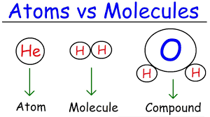
Chapter 2
Atoms, Molecules, and Ions (Ionic Compounds)

Slide 2
2.1: The Atomic Theory
In the 5th century Democritus formulated that all matter was composed of small indivisible particles (atomos) (Not widely accepted)
Then in 1802 John Dalton refined the idea of discoveries since and devised the Atomic Theory.
It States:

Slide 3
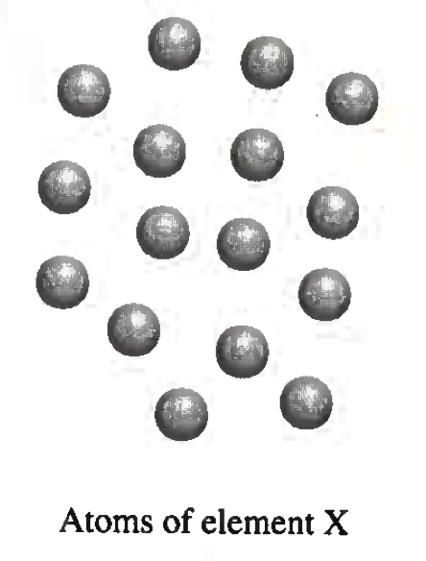
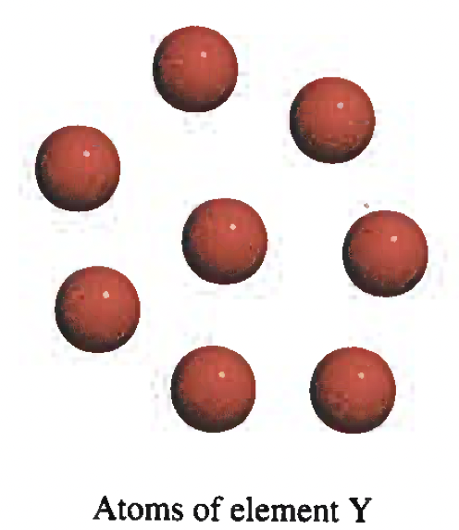
John Dalton’s Hypothesis
Dalton did not have any technology to actually see an atom, he had no idea about the structure (Nucleus with P + N, rings of electrons around it like satellites.
Dalton did not know why, he just noticed that different elements had different characteristics….hence they must be different from one another.

Slide 4
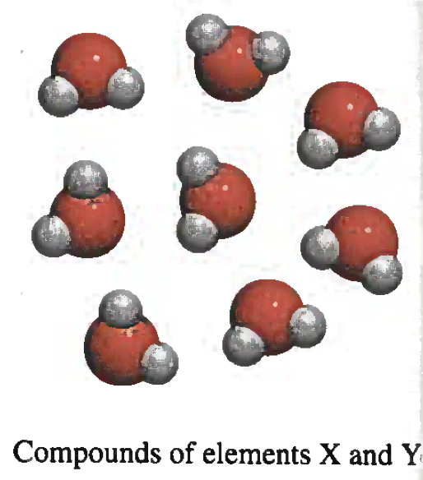
John Dalton’s Hypothesis
2 : 1 Ratio
X : Y
Law of Definite proportions:
Compounds ALWAYS join together in a specific ratio ---- H₂0 ALWAYS has 2Hs and1 O.
Law of Multiple proportions:
Different compounds using the same elements (CO and CO₂) have different ratios.

Slide 5
John Dalton’s Hypothesis
Dalton’s fourth hypothesis is very similar to the Law of Conservation of Mass…..(mass cannot be created or destroyed).
Really important concept later in Chemistry….applies to many things we do
Chemical equations should ALWAYS have the same number on either side of the “→”.

Slide 6
2.2: The Structure of the Atom
Through many experiments during the 1900’s, the internal structure of an atom was discovered.
ALL elements are made up of “Subatomic Particles” (smaller than atom) Protons, Neutrons, and Electrons.
Scientist found that each “Subatomic Particle” had a certain charge.
Protons | +
Neutrons | Neutral
Electrons | -

Slide 7
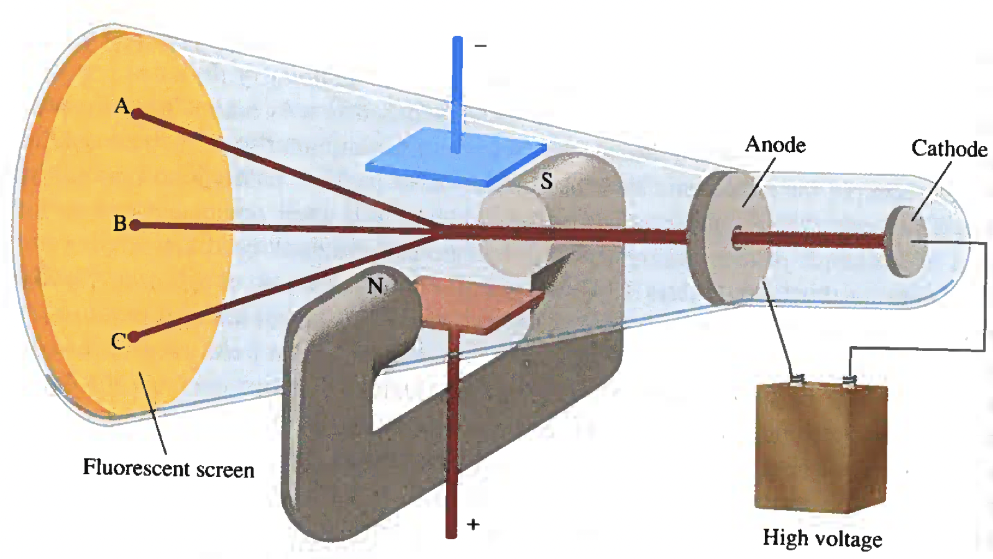
The Electron
In the 1890’s scientists the “Cathode Ray Tube” to experiment on Subatomic Particles and learn that electrons are “Negatively Charged”.
Picture is deceptive.
The main idea is Electrons are fired down the tube towards “B”.
(Straight ahead)
If turn on the electricity (+ and – plates)…the electron goes closer to the positive and hence hits at C.
If turn on the magnets (+ and – poles)…the electron goes closer to the positive and hence hits at C.
A “Cathode Ray Tube”

Slide 8
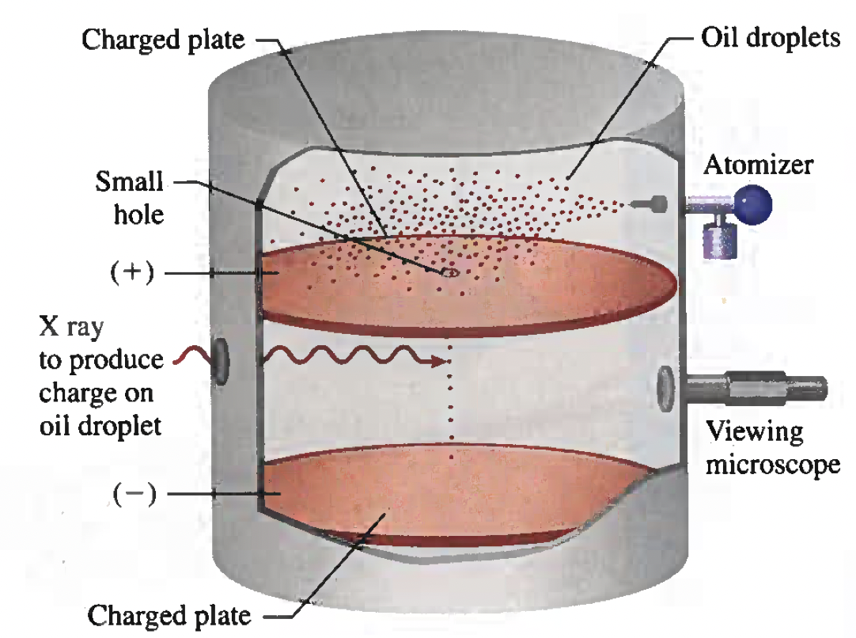
The Electron
Through calculations and experiments you can actually calculate the weight of an electron.
Long story short…spoiler alert…the weight of an electron is really small.
9.10 x 10⁻²⁸ grams.
So
0.000000000000000000000000000910 g

Slide 9
Radioactivity
Elements want to be stable….aka…not too many protons, neutrons, electrons.
Elements in the first 4 or 5 rows (periods) of the periodic table.
When elements naturally (elements in Rows 6 and above) or artificially….we use science to add neutrons to them. They BREAK down.
When elements break down they eject (kick out) energetic (high energy) protons and or electrons……or just the energy ejection.

Slide 10
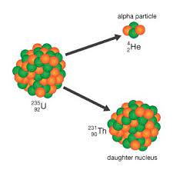
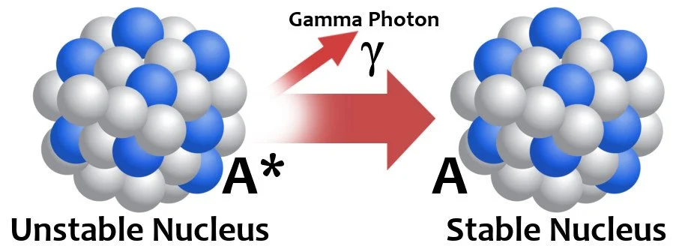
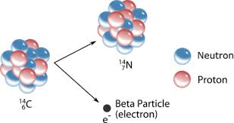
Radioactivity
Through experiments they discovered the CHARGE of the different types of radiation.
Alpla ($α$) Radiation
Gamma ($γ$) Radiation
Beta ($β$) Radiation

Slide 11
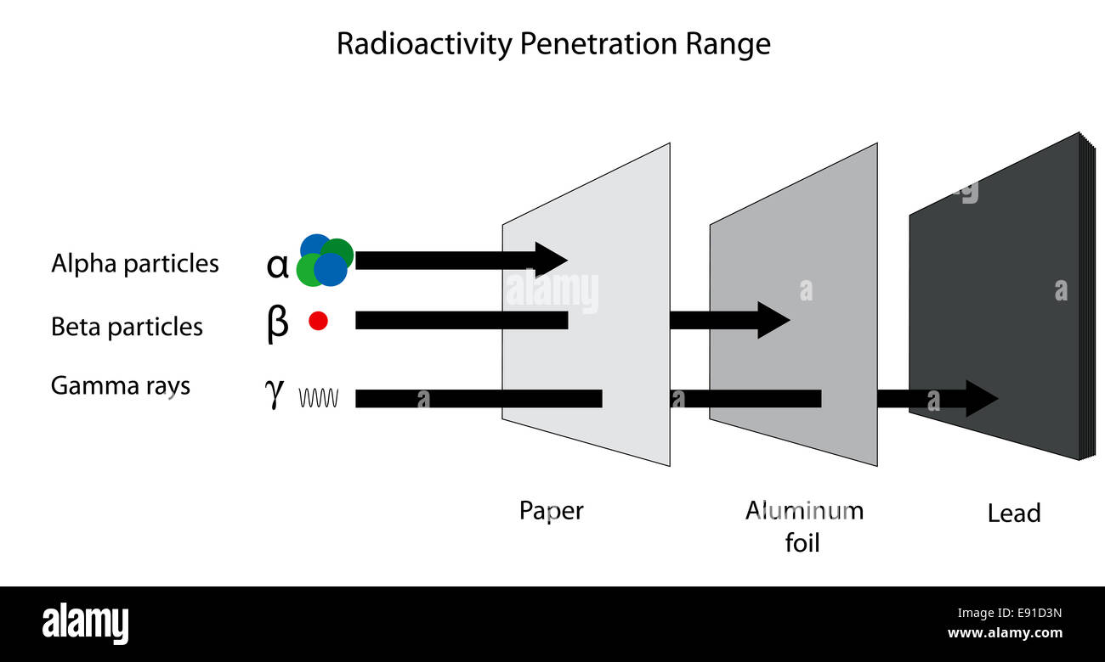
Radioactivity
Alpha radiation ejects an alpha particle (Helium Atom)
Beta radiation ejects an beta particle (Electron)
Gamma radiation ejects PURE ENERGY.
Out all THREE types of radiation, Gamma ($γ$) radiation is the WORST.
It can goes through a lot….including you!

Slide 12
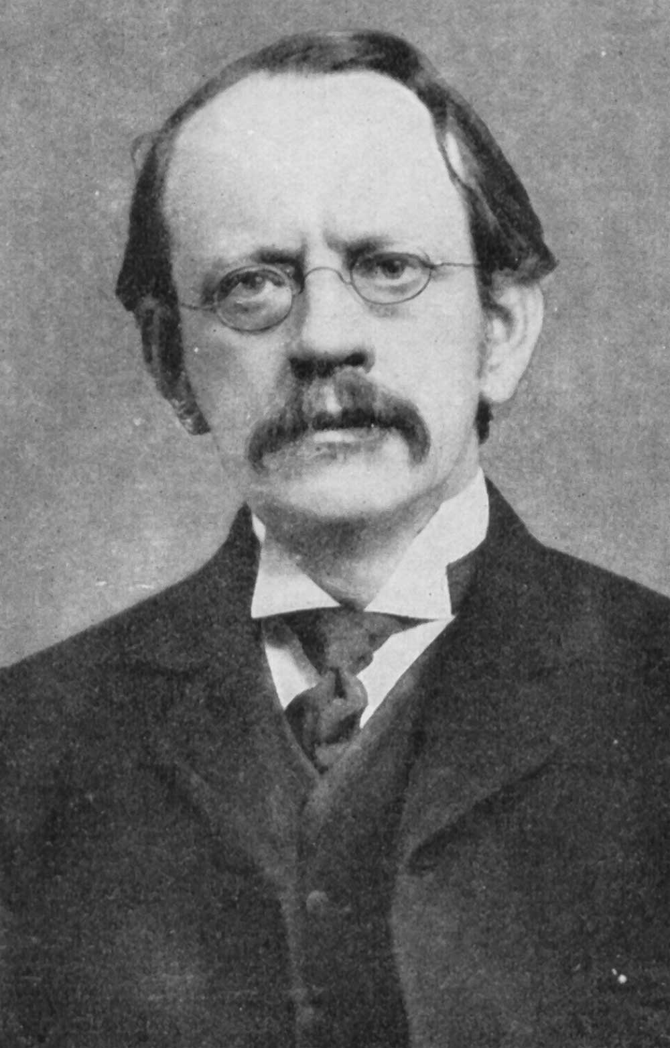
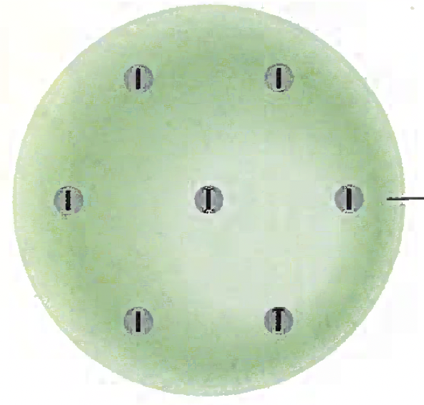
The Proton and the Nucleus
Early scientist that knew that atoms had electrons.
Also knew that atoms were neutral….same number of positives and negatives.
J. J. Thompson
(1856 – 1940)
WE NOW KNOW it as Protons = Electrons in Neutral Atom.
Thompson had no idea what the positives were or what to call them.
X
Good first try
X
X
X
X
X
He just thought the electrons and “positives” were squished together in a ball. (Cookie/Plum Pudding)
X
“Positive” Cookie with “Electrons” stuck in it like raisin’s.
X
But wrong…

Slide 13
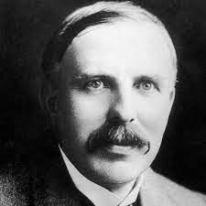
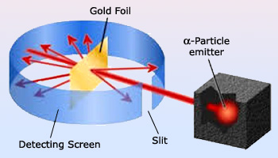
The Proton and the Nucleus
Rutherford assumed this model…..at first…..
Rutherford tested this theory by firing Alpha Particles (Postively Charged) at a Gold Foil (Like Tin Foil, but gold)
Ernest Rutherford
(1871 – 1937)
Rutherford expected all the alpha particles to hit the “Plum Pudding” and stop………this didn’t happen…..
Most Alpha Particles went straight through the foil!
Some even bounced back!

Slide 14
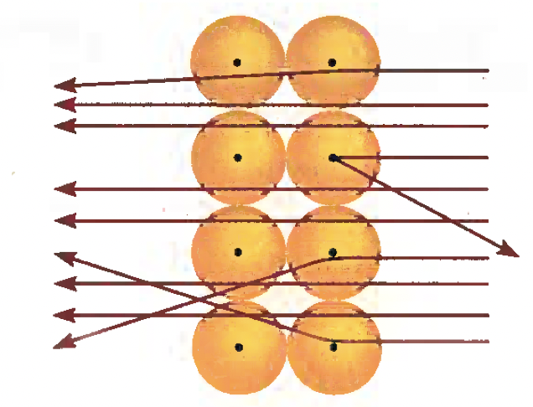
The Proton and the Nucleus
Rutherford explained this by saying most of the atom was empty space.
Ernest Rutherford
(1871 – 1937)
Alpha Particles $(α$) that were ”Deflected”…aka not straight/bent were repulsed by the small positively charged nucleus.

Slide 15
The Proton and the Nucleus
So if this Christmas ornament represented an atom.
The small dot would represent the NUCLEUS.
In reality its way way way smaller.

Slide 16
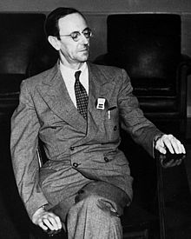
The Neutron
When Rutherford was doing his research (Gold Foil Experiment), He had no idea about NEUTRONS.
This screwed up Atomic Mass since:
Atomic Mass = Protons + Neutrons
James Chadwick
(1891 – 1972)
Sir James Chadwick to the rescue!
Chadwick discovered the NEUTRON (Neutral….hence the name)…..don’t need to know how he did it.

Slide 17
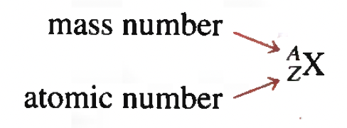
2.3: Atomic Number, Mass Number, and Isotopes
If you look on the periodic table there’s decimals in most atomic masses…
Atomic Mass = Protons + Neutrons
Protons
This because atomic mass is an average of all common Isotopes.

Slide 18
2.3: Atomic Number, Mass Number, and Isotopes
What is an isotope?
An isotope is a change in NEUTRONS.
Common isotopes of Carbon.
Can’t change the bottom (6) cause it’s a protons, but you can change NEUTRONS that have WEIGHT.

Slide 19
Example 2.1
Give the number of protons, neutrons, and electrons in each of following species.
$\begin{matrix}17 \\ 8\end{matrix}O$
$\begin{matrix}199 \\ 80\end{matrix}Hg$
$\begin{matrix}200 \\ 80\end{matrix}Hg$

Slide 20
Example 2.1
Give the number of protons, neutrons, and electrons in each of following species.
$\begin{matrix}17 \\ 8\end{matrix}O$
No Formal charge indicated so…..P_{ROTONS} = E_{LECTRONS}
Atomic Number = # of Protons
Protons:
Neutrons:
Electrons:
8 Protons
Mass # = Protons + Neutrons
9 Neutrons
17 = 8 + Neutrons
8 Electrons
17 - 8 = Neutrons
9 = Neutrons

Slide 21
Example 2.1
Give the number of protons, neutrons, and electrons in each of following species.
$\begin{matrix}17 \\ 8\end{matrix}O$
$\begin{matrix}199 \\ 80\end{matrix}Hg$
$\begin{matrix}200 \\ 80\end{matrix}Hg$

Slide 22
Example 2.1
Give the number of protons, neutrons, and electrons in each of following species.
b) $\begin{matrix}199 \\ 80\end{matrix}Hg$
Protons:
Neutrons:
Electrons:
80 Protons
Mass # = Protons + Neutrons
119 Neutrons
199 = 80 + Neutrons
80 Electrons
199 - 80 = Neutrons
119 = Neutrons

Slide 23
Example 2.1
Give the number of protons, neutrons, and electrons in each of following species.
$\begin{matrix}17 \\ 8\end{matrix}O$
$\begin{matrix}199 \\ 80\end{matrix}Hg$
$\begin{matrix}200 \\ 80\end{matrix}Hg$

Slide 24
Example 2.1
Give the number of protons, neutrons, and electrons in each of following species.
c) $\begin{matrix}200 \\ 80\end{matrix}Hg$
Protons:
Neutrons:
Electrons:
80 Protons
Mass # = Protons + Neutrons
120 Neutrons
200 = 80 + Neutrons
80 Electrons
200 - 80 = Neutrons
120 = Neutrons

Slide 25
Example: Practice Exercise 2.1
How many protons, neutrons, and electrons are in the following isotope
of copper: $\begin{matrix}63 \\ 29\end{matrix}$Cu?

Slide 26
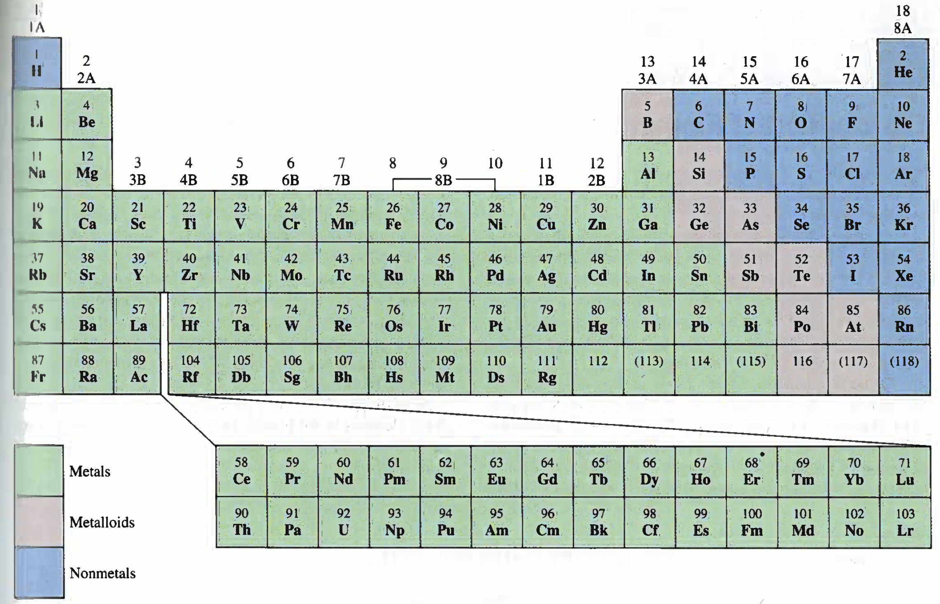
2.4: The Periodic Table
Periods:
Also called families.
VERTICAL Groups
Grouped according to certain properties.
Rows:
HORIZONTAL Rows.
Arranged according to periodic number (number of protons).
??

Slide 27
2.4: The Periodic Table
Bottom Rows:
Called Actinides and Lanthinides
Actually go in periodic table in Rows 6 & 7
Bottom Rows:
So Technically, the periodic table is super long and awkward.
Why? Fits on page…
??

Slide 28
2.4: The Periodic Table: Metals, Non-Metals, and Mettaloids

Slide 29
2.4: The Periodic Table: Family Names
Alkaline Earth Metals
Halogens
Alkali Metals
Noble Gases
Family Names:
The most common groups have names:

Slide 30
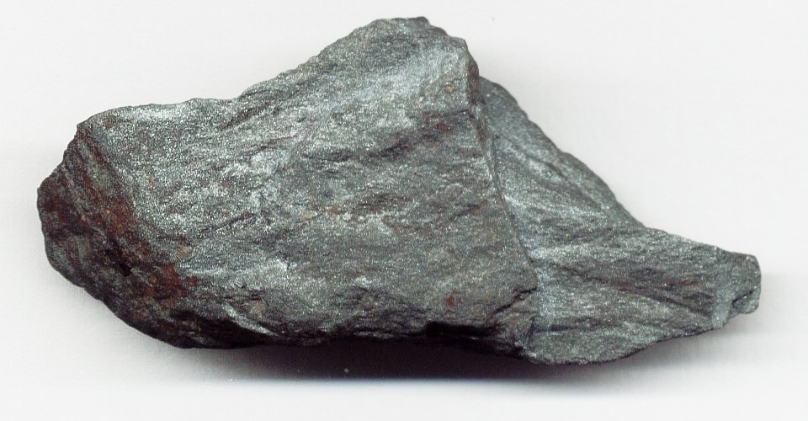
2.5: Molecules and Ions
Most matter DOES NOT exist on their own in nature.
You can’t dig up a pure element, most are mixed with other elements..
Only the “Noble Gases” exist as a pure single element. (Monatomic)
He, Ne, Ar, Kr, Xe, and Rn
Iron Ore: Mix of Iron and oxygen.

Slide 31
Molecules
Most matter exists either joined to Itself (H₂) or another element (Fe₃O₄) (Diatomic).
Many molecule exists joined to 2 or more other elements and are referred to as “Polyatomic”.

Slide 32
Molecules: The ”Power” 7….and Hydrogen
₂
₂
₂
₂
₄
₂
A couple of ”Odd Balls” to remember.
₈
₂
₂

Slide 33
Ions: ⁺ or ⁻?
Ions are formed when elements gain (Non-Metals)
or lose (Metals) electrons.
For example:
Li + loses 1 e- → Li⁺
Na + loses 1 e- → Na⁺
Positive Ions called CATIONS.
Cl + gains 1 e- → Cl⁻
Negative Ions called ANIONS.

Slide 34
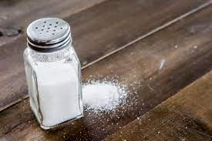
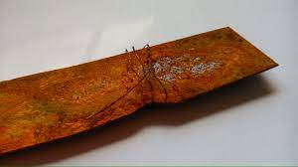
Ionic Compounds
One class of compound we will learn about later is called Ionic Compounds.
These compounds are formed from Ions:
Ionic Compound = Cation + Anion
Either in a simple 1:1 ratio like NaCl or some other more complex ratio like Fe₂O₃ (Iron Oxide……Rust). DUE TO CHARGE

Slide 35
2.6: Chemical Formulas
At the MINIMUM LEVEL chemical formulas tell you the elements involved in a chemical reaction.
UNBALANCED….Does not show how many of each element.
Mg + Cl --> MgCl
BALANCED chemical formulas tell you a lot more information.
By consulting a periodic table and with limited knowledge of chemistry you can determine A lot.
+2
-1
Mg + Cl --> MgCl₂
Metal
Non-metal
(+2) + 2(-1) = 0

Slide 36
Molecular Formulas
Molecular formulas give the exact number of atoms in a single unit of a substance. NOT NECESSARILY IN LOWEST TERMS.
Glucose
Methane
Water
Ammonia
Hydrogen
Molecular formulas are MOLECULAR…they have NOTHING to do with Charge!

Slide 37
Molecular Formulas

Slide 38
Empirical Formulas
Empirical formulas give information about the elements that make up a compound, BUT IN LOWEST TERMS AND NOT NECESSARILY THE CHEMICAL FORMULA.
That is it’s Empirical Formula
H₂O₂
That is it’s Chemical Formula
Hydrogen Peroxide
HO
The Empirical Formula is the LOWEST TERM RATIO of H to O is:
1 : 1

Slide 39
Empirical Formulas
Empirical formulas give information about the elements that make up a compound, BUT IN LOWEST TERMS AND NOT NECESSARILY THE CHEMICAL FORMULA.
That is it’s Empirical Formula
N₂H₄
That is it’s Chemical Formula
Hydrazine
NH₂
The Empirical Formula is the LOWEST TERM RATIO of H to O is:
1 : 2

Slide 40
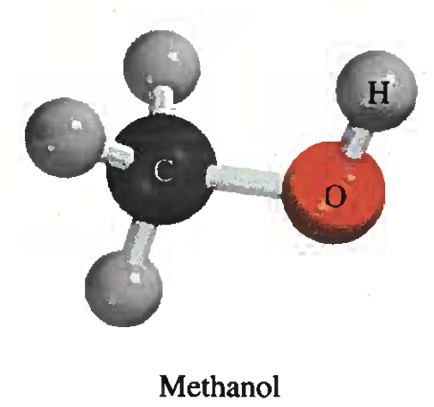
Example 2.2
Write the molecular formula of methanol, an organic solvent and antifreeze, from its ball-stick model, shown below.
4
Empirical Formula: CH4O
H =
1
C =
Already in lowest terms.
1
O =
CH4O is usually written as CH3OH by convention to show the molecule’s shape.

Slide 41
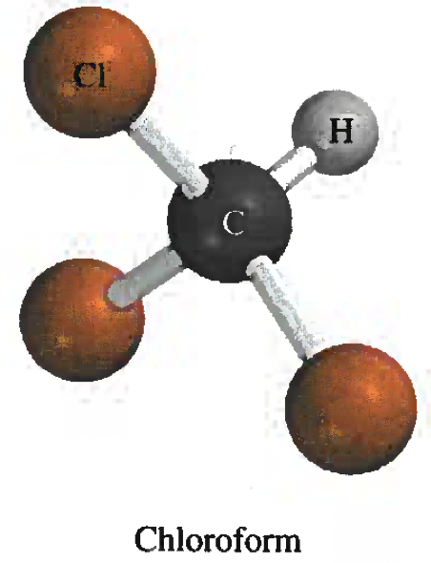
Example: Practice Exercise 2.2
Write the molecular formula for chloroform , which is used as a solvent and a cleansing agent. The ball-and-stick model of chloroform is shown below.

Slide 42
Example 2.3
Write the empirical formulas for the following molecules: a) acetylene (C₂H₂) which is used for welding torches; b) glucose (C₆H₁₂O₆), a substance known as blood sugar and c) nitrous oxide (N₂O), a gas used as an anesthetic gas (“laughing gas”) and as an aerosol propellant for whipped cream.
That is it’s Chemical Formula
a) Acetylene (C₂H₂)
That is it’s Empirical Formula
2
H =
➗2
CH
2
C =
The Empirical Formula is the LOWEST TERM RATIO of H to C is:

Slide 43
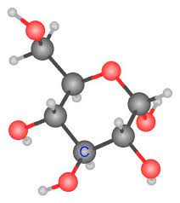
Example 2.3
Write the empirical formulas for the following molecules: a) acetylene (C₂H₂) which is used for welding torches; b) glucose (C₆H₁₂O₆), a substance known as blood sugar and c) nitrous oxide (N₂O), a gas used as an anesthetic gas (“laughing gas”) and as an aerosol propellant for whipped cream.
That is it’s Chemical Formula
b) Glucose (C₆H₁₂O₆)
That is it’s Empirical Formula
12
H =
➗6
CH₂O
6
C =
The Empirical Formula is the LOWEST TERM RATIO of H to C is:
6
O =

Slide 44
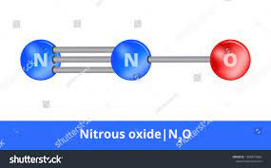
Example 2.3
Write the empirical formulas for the following molecules: a) acetylene (C₂H₂) which is used for welding torches; b) glucose (C₆H₁₂O₆), a substance known as blood sugar and c) nitrous oxide (N₂O), a gas used as an anesthetic gas (“laughing gas”) and as an aerosol propellant for whipped cream.
That is it’s Chemical Formula
c) Nitrous (N₂O)
Oxide
That is it’s Empirical Formula
2
N =
The Empirical Formula is the LOWEST TERM RATIO of H to C is:
N₂O
1
O =
Already in lowest terms.

Slide 45
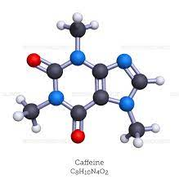
Example: Practice Exercise 2.3
Write the empirical formula for caffeine (C₈H₁₀N₄O₂), a stimulant found in tea and coffee.

Slide 46
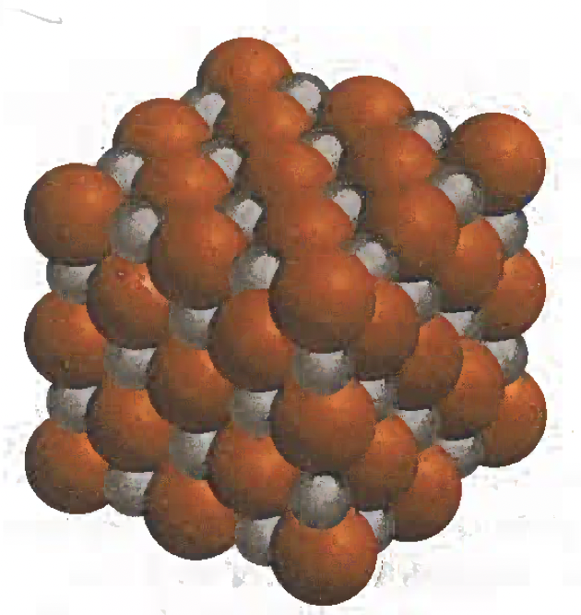
Formulas of Ionic Compounds (Basic 1 : 1)
Ionic Formulas are usually the same as their empirical versions as Ionic Compounds are formed from Positive (Cations) and Negative (Anion) Ions.
Na⁺
Cl⁻
Sodium Cation
Chlorine Anion
NaCl
Sodium Chloride
Atom
NEUTRAL ATOM

Slide 47
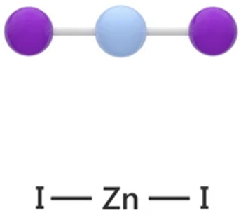
Formulas of Ionic Compounds (Medium 1 : 2)
In more complex ionic compounds its NOT a simple 1+ to 1-….But you still work to make a NEUTRAL PAIR.
Zn²⁺
l⁻
Sodium Cation
Ioine Anion
Znl₂
Zinc Ioide
Atom
NEUTRAL ATOM

Slide 48
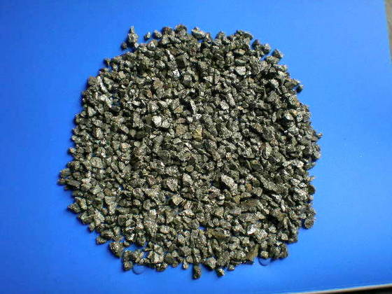
Formulas of Ionic Compounds (Hard 3 : 2)
In more complex ionic compounds, with higher charges, You still make a NEUTRAL PAIR.
3, 6, 9, 12, 15
2, 4, 6, 8, 10, 12
(Fe)³⁺
(S)²⁻
Iron (III) Cation
Sulfur Anion
Fe₂S₃
2 X 3+ = 6⁺
Iron Sulfide
Atom
3 X 2- = 6⁻
NEUTRAL ATOM

Slide 49
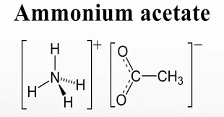
Formulas of Ionic Compounds (Hard: Polyatomics)
In more complex ionic compounds, like polyatomics (more than 1 atom joined together), You still make a NEUTRAL PAIR.
(NH₄)⁺
(CH₃COO)⁻
Ammonium Cation
Acetate Anion
(NH₄)(CH₃COO)
Ammonium Acetate
Atom
NEUTRAL ATOM

Slide 50
Example 2.4
Write the formula for Magnesium nitride, Mg²⁺ and N³⁻ ions.
2, 4,6, 8, 10, 12
3, 6, 9, 12, 15
Mg²⁺
N³⁻
Magnesium Cation
Nitrogen Anion
Mg₃N₂
NEUTRAL ATOM
Magnesium Nitride
Atom
3 X 2+ = 6⁺
2 X 3- = 6⁻

Slide 51
Example: Practice Exercise 2.4
Write the formulas for the following ionic compounds: a) Chromium Sulfate (Containing Cr³⁺ and SO₄²⁻ ions) and b) titanium oxide (containing Ti⁴⁺ and O²⁻ ions).

Slide 52
2.7: Naming Compounds
The rules for naming compounds are universal (Everybody uses the same rules).
First Question is: Is it Organic or Inorganic?
Compound X
Organic Compounds are:
Compounds
containing Carbon with Hydrogen, Oxygen, Nitrogen, and sulfur.
Organic
Inorganic
Inorganic Compounds are:
Talk more about these later.
Everything else….and CO, CO², CS², CN₋, CO³, and HCO₃⁻

Slide 53
2.7: Naming Compounds
Compound X
Organic
Inorganic
Ionic
Molecular
Acids
Bases
Hydrates

Slide 54
Ionic Compounds
As mentioned previously, ionic compounds are formed from positive cations and negative anions.
The majority of Ionic Compounds are Binary……..meaning composed of two parts (Metal and Non-metal)
For example:
Lithium chloride

Slide 55
Ionic Compounds
For example:
Lithium chloride
The metal keeps its full name when forming an ionic compound.
The non-metal changes it name and gets an -ide ending.

Slide 56
Ionic Compounds
Some Ionic compounds are formed from multiple elements joined together (Ternary Compounds….Polyatomic ions).
***But their still considered binary and get named the same***
KCN
NEUTRAL
Potassium cyanide atom
K⁺ + CN⁻ →
POSITIVE Potassium
Ion
NEGATIVECyanide
Ion

Slide 57
Ionic Compounds
When Read or Writing Ionic Compounds the Roman Numerals (I II III IV) refer to the CHARGE of the multi-valent (Multiple Charges) metal.
For example:
Fe(III) chloride
This is the Fe³⁺ version of Fe.
(There’s Fe²⁺/Fe³⁺)

Slide 58
Example 2.5
Name the following compounds: a) Cu(NO₃)₂ b) KH₂PO₄ c) NH₄ClO₃.
Cu(NO₃)₂
Not –ide because its NO₃ (polyatomic) NOT Nitrogen (non-metal).
Copper
Nitrate
Copper Nitrate

Slide 59
Example 2.5
Name the following compounds: a) Cu(NO₃)₂ b) KH₂PO₄ c) NH₄ClO₃.
KH₂PO₄
Potassium
Hydrogen
Phosphate
Potassium
dihydrogen
Phosphate

Slide 60
Example 2.5
Name the following compounds: a) Cu(NO₃)₂ b) KH₂PO₄ c) NH₄ClO₃.
NH₄ClO₃
Two Polyatomic ions…so no changes in names or ending.
Ammonium
Chlorate
Ammonium Chlorate

Slide 61
Example: Practice Exercise 2.5
Name the following compounds: a) PbO b) Li₂SO₃

Slide 62
Example 2.6
Write the chemical formulas for the following compounds: a) mercury (I) nitrate b) cesium sulfide, and c) calcium phosphate.
Nitrate is a polyatomic ion with a charge of -1.
Mercury (I)
Nitrate
The “(I)” next to mercury tells me it has a +1 charge.
Hg⁺¹
NO₃⁻
HgNO₃

Slide 63
Example 2.6
Write the chemical formulas for the following compounds: a) mercury (I) nitrate b) cesium sulfide, and c) calcium phosphate.
Sulfide is ACTUALLY sulfur with an –ide ending. Its charge is -2.
Cesium
Sulfide
Cesium is in Group 1…so its charge is +1.
Cs⁺¹
S²⁻
So Sulfur is TWICE as strongly charged as Cesium….So you need two cesiums to mke the compound NEUTRAL.
Cs₂S

Slide 64
Example 2.6
Write the chemical formulas for the following compounds: a) mercury (I) nitrate b) cesium sulfide, and c) calcium phosphate.
Phosphate is a polyatomic ion with a charge of -3.
Calcium
Phosphate
Calcium is in Group 2…so its charge is +2.
Ca⁺²
PO₄³⁻
Phosphate is 3 and Calcium is 2 so we need to list all their multiples and look for the LCM.
Ca₃(PO₄)₂
2, 4, 6, 8, 10, 12
3, 6, 9, 12, 15

Slide 65
Example: Practice Exercise 2.6
Write the formulas for the following ionic compounds:
a) Rubidium Sulfate,
b) barium hydride

Slide 66
Molecular Compounds
Molecular compounds are formed from TWO or more Non-metals.
The BONDS formed in a molecular compound are called COVALENT BONDS.

Slide 67
Molecular Compounds
Molecular compounds are named quite similarly to Ionic compounds (First element gets FULL name and second ends in –ide.
A big difference is that Molecular names and formula have NOTHING TO DO WITH CHARGE.
The name has “Prefixes” to indicate the number/amount of each element in the compound.

Slide 68
Molecular Compounds
When using the prefixes to name a molecular compound its important to note that:
You omit (do not write) Mono prefix if it is the amount of the FIRST element.
On compounds with Oxygen you don’t put the “a” on the prefix….just sounds odd.

Slide 69
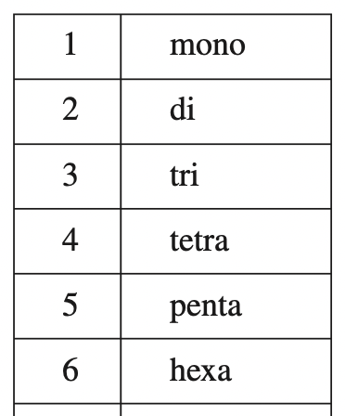
Example 2.7
Name of following molecular compounds. a) SiCl₄ b) P₄O₁₀.
FIRST element gets whole name OMIT Mono if applicable.
SiCl₄
SECOND element ends in –ide AND gets Prefix for 4.
Silicon
Tetrachloride

Slide 70
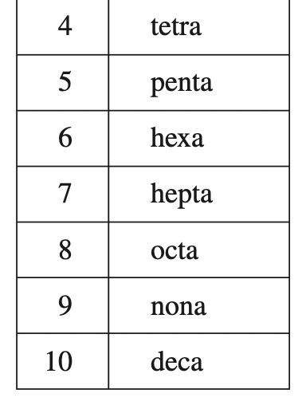
Example 2.7
Name of following molecular compounds. a) SiCl₄ b) P₄O₁₀.
FIRST element gets whole name OMIT Mono if applicable.
P₄O₁₀
SECOND element ends in –ide AND gets Prefix for 10….its Oxygen so…
a
Dec oxide
Tetra Phosphorous

Slide 71
Example: Practice Exercise 2.7
Name the following molecular compounds: a) NF₃ b) Cl₂O₇

Slide 72
Example 2.8
Write the chemical formulas for the following molecular compounds?: a) Carbon disulfide and b) disilicon hexabromide.
”Disulfide” …”Di” means 2. So…
Carbon
Sulfur
Only “Carbon” with no prefix so we assume “Mono” (1)
C
S₂

Slide 73
Example 2.8
Write the chemical formulas for the following molecular compounds?: a) Carbon disulfide and b) disilicon hexabromide.
”Hexabromide” …”Hexa” means 6. So…
Silicon
Bromine
”Disilicon” …”Di” means 2. So…
Br₆
Si₂

Slide 74
Example: Practice Exercise 2.8
Write the chemical formulas for the following molecular compounds:
sulfur tetrachloride
dinitrogen pentoxide

Slide 75
Acids and Bases
An acid is a molecular compound that gives off H⁺(Also called A Proton) when it dissolves in water.
A “DRY” acid does absolutely nothing…..until it dissolves in water…or skin oils…
Acid + Water → H⁺ + “Left Overs”
Chemical formulas for acids contain one OR MORE Hs (hydrogen) atoms.
HCl (Hydrochloric acid)
H₂SO₄ (Sulfuric acid)

Slide 76
Acids and Bases
Acid named come from REGULAR naming. Here are the “Rules”:
1. If the molecular compound name ends in –ide it turns into –Hydro…..ic Acid.
Ex. Hydrogen chloride
Hydrochloric acid
(HCl)
Ex. Hydrogen bromide
Hydrobromic acid
(HBr)
Ex. Hydrogen Iodide
Hydroiodic acid
(HI)

Slide 77
Acids and Bases
Acid named come from REGULAR naming. Here are the “Rules”:
2. If the molecular compound name ends in –ate it turns into –ic Acid.
Ex. Hydrogen nitrate
Nitric acid
(HNO₃)
Ex. Hydrogen chlorate
Chloric acid
(HClO₃)
Ex. Hydrogen Phosphate
Phosphoric acid
(H₃PO₄)

Slide 78
Acids and Bases
Acid named come from REGULAR naming. Here are the “Rules”:
3. If the molecular compound name ends in per………..–ate it turns into –per…………ic Acid. (Add 1 “O” to polyatomic)
Ex. Hydrogen pernitrate
pernitric acid
(HNO₄)
Ex. Hydrogen perchlorate
perchloric acid
(HClO₄)
Ex. Hydrogen perphosphate
perphosphoric acid
(H₃PO₅)

Slide 79
Acids and Bases
Acid named come from REGULAR naming. Here are the “Rules”:
4. If the molecular compound name ends in -ite it turns into –ous Acid. (Remove 1 “O” to polyatomic)
Ex. Hydrogen nitrite
nitrous acid
(HNO₂)
Ex. Hydrogen perchlorite
chlorous acid
(HClO₂)
Ex. Hydrogen phosphite
phosphorous acid
(H₃PO₃)

Slide 80
Acids and Bases
Acid named come from REGULAR naming. Here are the “Rules”:
5. If the molecular compound name ends in hypo……ate it turns into –hypo…………ous Acid. (Remove 2 “O” to polyatomic)
Ex. Hydrogen hyponitrate
hyponitrous acid
(HNO)
Ex. Hydrogen hypochlorate
hypochlorous acid
(HClO)
Ex. Hydrogen hypophosphate
hypophosphorous acid
(H₃PO₂)

Slide 81
Example 2.9
Name the following Oxoacid and oxoanion:
H₃PO₃
IO₄⁻
PO₃
Phosphite
(H₃)
3 Hydrogens
Phosphorous Acid
4. If the molecular compound name ends in -ite it turns into –ous Acid. (Remove 1 “O” to polyatomic)

Slide 82
Example 2.9
Name the following Oxoacid and oxoanion:
H₃PO₃
IO₄⁻
Either this acid name will be given to you or IO3²⁻ must be given to you.
HIO₄
Periodous Acid
Periodate
3. If the molecular compound name ends in per………..–ate it turns into –per…………ic Acid. (Add 1 “O” to polyatomic)

Slide 83
Example: Practice Exercise 2.9
Name the following oxoacid and oxoanion:
HBrO
HSO₄⁻

Slide 84
Acids and Bases
A base is a compound that produces OH- (hydroxide) ions when dissolved in water.
Ex. NaOH
Na⁺ + OH⁻
Sodium hydroxide
Ex. KOH
K⁺ + OH⁻
Potassium hydroxide
Ex. Ba(OH)₂
Ba⁺ + 2 OH⁻
Barium hydroxide

Slide 85
Acids and Bases
Ammonia (NH₃) is also a common base.
What? How? Its got no OH⁻ in it…
A base is a compound that produces OH- (hydroxide) ions when dissolved in water.
Water
Ex. NH3 + H₂O
NH₄⁺ + OH⁻
Ammonia
Weird how that’s red(acid) now….learn that later…
H

Slide 86
Hydrates
MOST compounds naturally have water stuck to them….pretty hard to get rid of at least some humidity.
CuSO₄
∙ 5 H₂O
Name: Copper(II) sulfate pentahydrate
Copper (II) sulfate is naturally has some water molecule stuck to it…..5 of them to be exact.

Slide 87
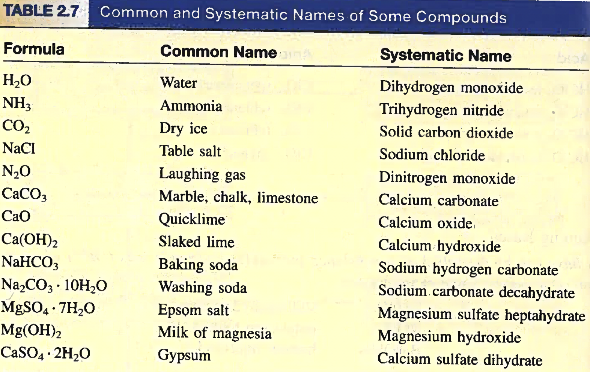
Familiar Inorganic Compounds

Slide 88
2.8: Introduction to Organic Compounds (Very Basic)
The simplest type of organic compound is the hydrocarbon.
As the name implies HYDROcarbon, all are made of different numbers of hydrogen and carbon arranged in different ways.
Hydrocarbons can be more complex and contain Oxygen and Nitrogen as well, organized in Functional Groups.

Slide 89
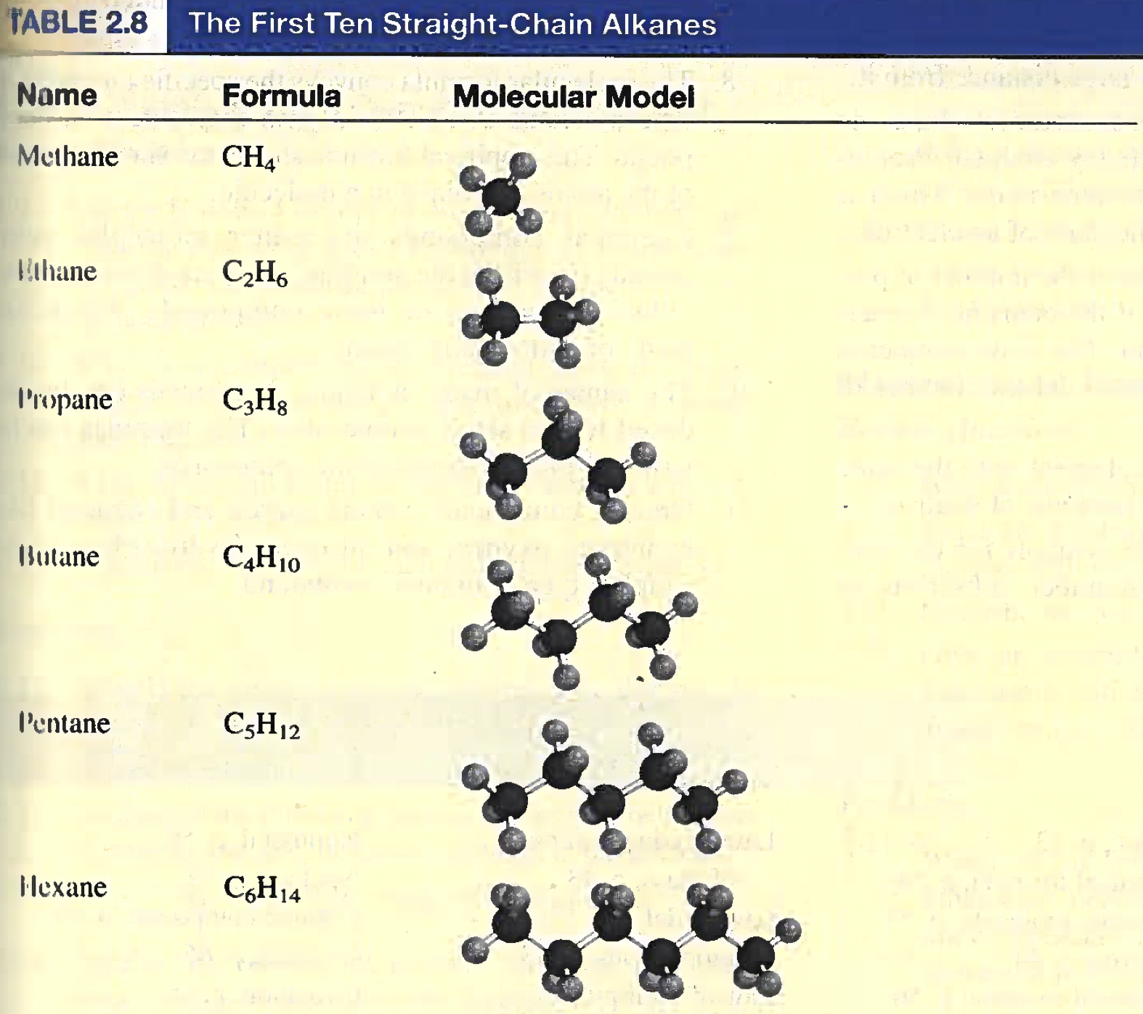
H
-C-
H
H
H
H
H
H
-C-C-
H
H
H
H
H
H
-C-C-C-
H
H
H
H
H
H
H
H
H
H
-C-C-C-C-
H
H
H
H
H
H
H
H
H
H
H
-C-C-C-C-C-
H
H
H
H
H
H

Slide 90
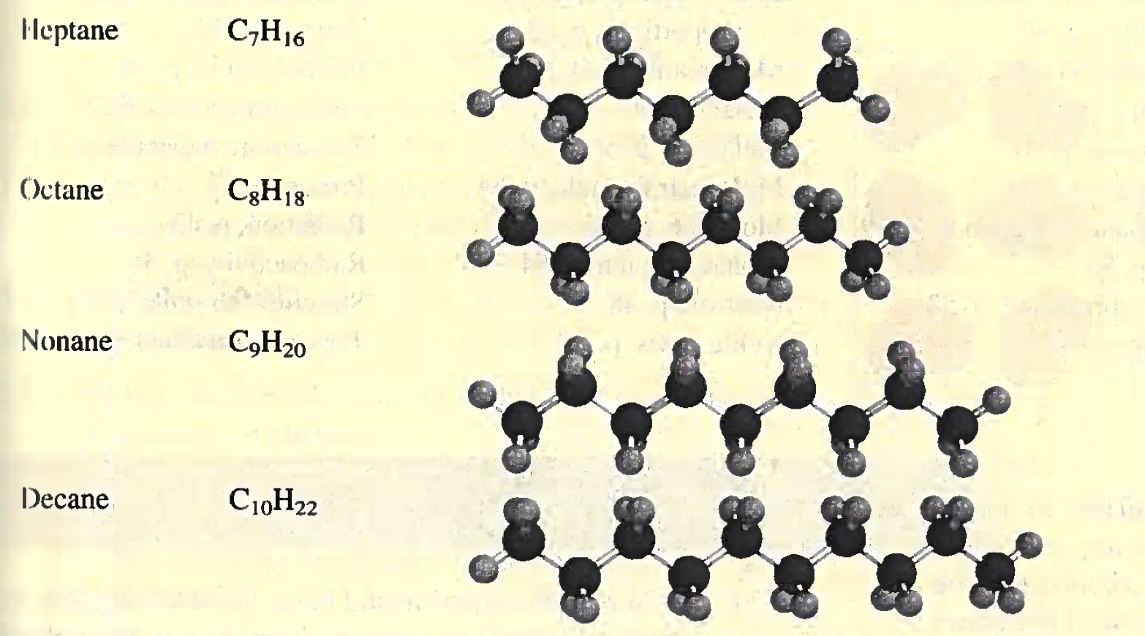
-C-C-C-C-C-C-
-C-C-C-C-C-C-C-
-C-C-C-C-C-C-C-C-
-C-C-C-C-C-C-C-C-C-
-C-C-C-C-C-C-C-C-C-C-

Slide 91
Key Words
Cation (P. 53)
Chemical Formula (P. 54)
Diatomic Molecule (P. 53)
Electron (P. 44)
Empirical Formula (P. 56)
Families (P. 50)
Gamma ($γ$) Rays (P. 46)
Groups (P. 50)
Halogens (P. 51)
Hydrate (P. 67)
Inorganic Compounds (P. 59)
Ion (P. 53)
Ionic Compound (P. 53)
Isotope (P. 49)
Nonmetal (P. 50)
Nucleus (P. 47)
Organic Compounds (P. 59)
Oxoacids (P. 65)
Oxoanion (P. 65)
Periods (P. 50)
Periodic Table ( P. 50)
Polyatomic Ion (P. 54)
Polyatomic Molecule ( P. 53)
Proton (P. 47)
Radiation (P. 43)
Radioactivity (P. 46)
Structural Formula (P. 55)
Ternary Compound (P. 59)
Acid (P. 64)
Alkali Metals (P. 51)
Alkaline Earth Metals (P. 51)
Allotrope (P. 54)
Alpha ($α)$ Particles (P. 46)
Alpha ($α)$ Rays (P. 46)
Anion (P. 53)
Atom (P. 43)
Atomic Number (Z) (P. 49)
Base (P. 67)
Beta ($β)$ Particles (P. 46)
Beta ($β)$ Rays (P. 46)
Binary Compound (P. 59)
Law of Conservation
of Mass (P. 43)
Law of Definite Proportions (P. 43)
Law of Multiple Proportions (P. 43)
Mass Number (A) (P. 49)
Metals (P. 50)
Metalloid (P. 50)
Molecular Formula (P. 54)
Molecule (P. 53)
Monatomic Ion (P. 54)
Neutron (P. 48)
Noble Gas (P. 51)

