Slide 1
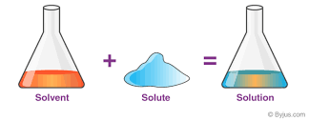
Chapter 12
Physical Properties of Solutions

Slide 2
12.1: Types of Solutions
Depending on the amount of solute (stuff) dissolved in the solvent (usually liquid...water) you have three (3) different types of solutions:
1. Un-Saturated.
2. Saturated.
1. Super-Saturated.

Slide 3
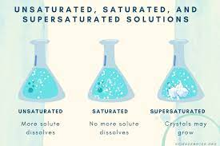
Unsaturated Solution
Definition:
A solution that has LESS solute dissolved in it at a certain temperature.
Have you ever tried to dissolve sugar in cold coffee?
Have you ever tried to dissolve sugar in hot coffee?
Temperature has a direct relationship to solubility.

Slide 4
Saturated Solution
Definition:
A solution in which the maximum amount of solute has been dissolved in a certain volume of solvent at a certain temperature.
Any more solute added to the solution would NOT dissolve….it would just sink to the bottom.
Dissolving
NaCl_{(s)}
Na⁺_{(aq) +} Cl⁻_{(aq)}
Crystallization
Dissolving and Crystalizing (crystals that are at bottom of the container NOT dissolved) is an EQUILIBRIUM.

Slide 5
Supersaturated Solution
Definition:
A solution in which the more than the maximum amount of solute has been dissolved in a certain volume of solvent at a certain temperature.
This solution is made by heating up a solution to allow more to dissolving than cooling it slowly.
This solution is really unstable. A light tap or scratch on the container and it all (all above the normal dissolved (saturated amount) falls to the bottom like a snow globe.

Slide 6
Crystallization
Definition:
The process of turning into (back into in some cases) a solid….forming crystals.
This can be caused by things such as a temperature decrease.
Crystallization IS NOT the same as Precipitation.
Dissolving
NaCl_{(s)}
Na⁺_{(aq) +} Cl⁻_{(aq)}
Crystallization

Slide 7
12.2: Molecular View of Solution Process
A solution behaves because of how it reacts with parts of the solution.
1. Solvent - Solvent Interactions.
2. Solute – Solute Interactions.
1. Solvent – Solute Interactions.

Slide 8
Solvent-Solvent Interaction
Does the solvent polar or non-polar?
Polar Solvents:
A good way to tell if a solvent will be polar is if the molecules that make it up have lone pairs?
Non-Polar Solvents:
A good way to tell if a solvent will be polar is if the molecules that make it up DOES NOT have lone pairs?

Slide 9
Solute-Solute Interaction
Solute-solute interactions are the intermolecular attractions between solute particles.
Is the solute polar nor non-polar?
Is the solute made of multiple of the SAME element?
or
Is the solute a compound made of different elements??

Slide 10
Solvent-Solute Interaction
Like dissolves Like.
Which means that if the solute and solvent are similar they will interact favorably with each other.
If the solute and solvent are BOTH Polar.
Or
If the solute and solvent are BOTH Non-polar.

Slide 11
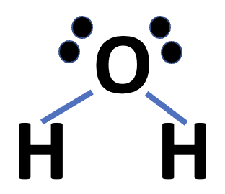
Solvation (Process of Dissolving)
Dissolving in a solvent is called Solvation….also known as Dissolving.
Solvation is when a solute gets surrounded by solvent molecules.
C₁₂H₂₂O_{11(s)}
Sugar

Slide 12
Example 12.1
Predict the relative solubilities in the following cases: a) Bromine (Br₂) in benzene
(C₆H₆ 𝜇 = 0 D) and in water (𝜇 = 1.87 D), b) KCl in carbon tetrachloride (CCl₄, 𝜇 = 0 D) and in liquid ammonia (NH3 𝜇 = 1.46 D), c) formaldehyde (CH₂O) in carbon disulfide (CS , 𝜇 = 0) and in water.
H
H
Br
Br
C
C
O
H
C
C
H
Bromine is nonpolar.
C
C
H
H
H₂O (Water).
H
H
Benzene.
Benzene is nonpolar.
LIKE dissolve LIKE
So I predict Br₂ is soluble in benzene NOT Water..

Slide 13
Example 12.1
Predict the relative solubilities in the following cases: a) Bromine (Br₂) in benzene
(C₆H₆ 𝜇 = 0 D) and in water (𝜇 = 1.87 D), b) KCl in carbon tetrachloride (CCl₄, 𝜇 = 0 D) and in liquid ammonia (NH3 𝜇 = 1.46 D), c) formaldehyde (CH₂O) in carbon disulfide (CS , 𝜇 = 0) and in water.
Cl
N
Cl
C
Cl
K
Cl
H
KCl is polar.
Cl
H
Carbon Tetrachloride is non-polar.
H
Liquid ammonia is polar.
So I predict KCl is soluble in ammonia NOT Carbon Tetrachloride.
LIKE dissolve LIKE

Slide 14
Example 12.1
Predict the relative solubilities in the following cases: a) Bromine (Br₂) in benzene
(C₆H₆ 𝜇 = 0 D) and in water (𝜇 = 1.87 D), b) KCl in carbon tetrachloride (CCl₄, 𝜇 = 0 D) and in liquid ammonia (NH3 𝜇 = 1.46 D), c) formaldehyde (CH₂O) in carbon disulfide (CS , 𝜇 = 0) and in water.
O
H
C
O
S
C
S
H
H
Carbon Disulfide is NOT polar.
H₂O (Water).
H
CH₂O is polar.
LIKE dissolve LIKE
So I predict CH₂0 is soluble in water NOT Carbon Disulfide.

Slide 15
Example: Practice Exercise 12.1
Is iodine (I₂) more soluble in water or in carbon disulfide (CS₂)?

Slide 16
12.3: Concentration Units
There are many types of concentration that are used by society. We are going to focus on TWO.
Percent by Mass:
Also called percent by weight.
Percent by volume has no units other than %
as the units both cancel out.
Molarity:
The concentration unit used in CHEMSITRY. The units of Molarity (as youv already seen) is mol/L.

Slide 17
Percent by Mass
Mass of Solute (g)
Percent by mass =
X 100%
Total Mass of Solution (g)
Percent by mass has no units….Just % as the grams on top and the bottom cancel out.

Slide 18
Molarity
Mols of Solute (n)
n
C =
V
Volume of Solvent (Needs to be in Liters).
Molarity (mol/L)
Concentration most commonly used in Chemistry.

Slide 19
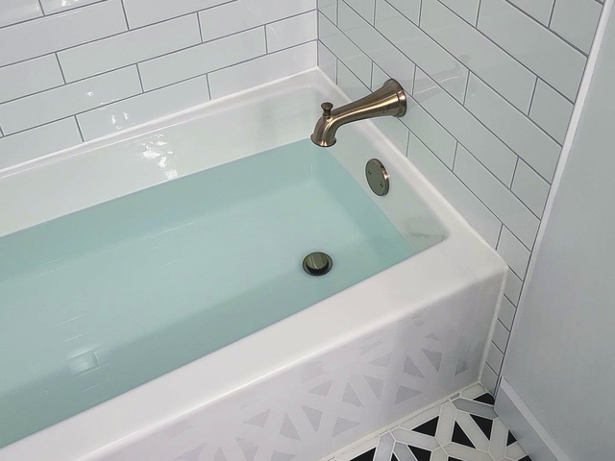
Molality
Molality exists, but its not as accurate. Its final volume is NOT per 1000g….its 1000 g solvent + whatever you put into it.
We all know from our fun time taking a bath that when we put stuff in water (us) the water level goes up.
Or putting ice cubes in a glass of water…the water level goes up.
When googling tubs, it was all girls and/or babies…there was only 1 or 2 guys. SEXIST!

Slide 20
Example 12.2
3 Sig Figs
A sample of 0.892 g potassium chloride (KCl) is dissolved in 54.6 g of water. What is the percent by mass of KCl in the solution?

Slide 21
Example: Practice Exercise 12.2
A sample of of 6.44 g of naphthalene (C₁₀H₈) is dissolved in 80.1 g of benzene (C₆H₆). Calculate the percent by mass of naphthalene in this solution.

Slide 22
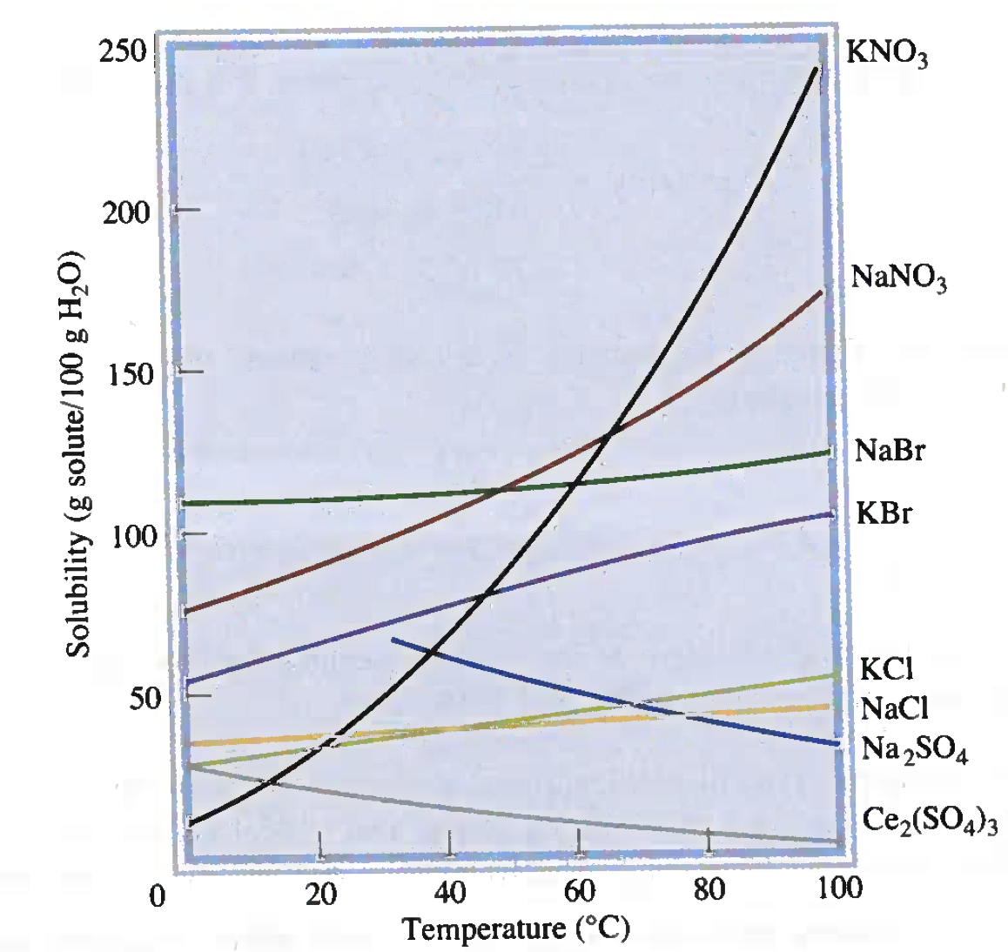
12.4: The Effect of Temperature on Solubility
As you increase temperature you increase the solubility of a solid.
So if you look at the exact number (amount) of ”stuff” you can dissolve (solubility) you always see “at a specific temperature”.
SO₄ is odd, not an exception to this temperature increase solubility, its equilibrium….its Chemistry 12 stuff (Explanation of the reason why)

Slide 23
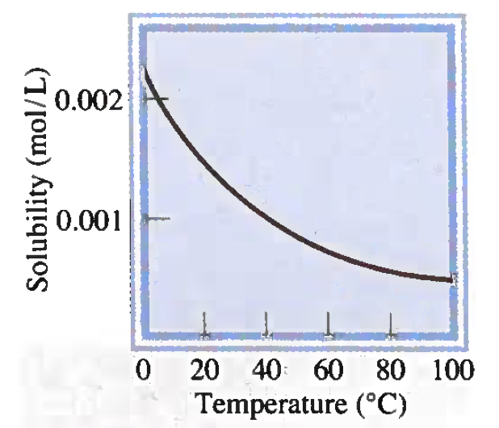
Gas Solubility and Temperature
The opposite is true for gases.
As you increase temperature you decrease the solubility of a gas.
This is the reason why cold water holds more oxygen than hot water. Hot water pollution suffocates fish (less oxygen).

Slide 24
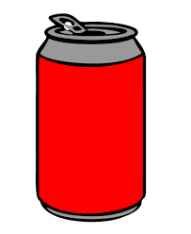
12.5: The Effect of Pressure on The Solubility of Gases
When you increase pressure you increase solubility of a gas.
The CO₂ (Carbonation) in a pop can is under pressure until you open it.
When you open the can and break the seal, the CO2 comes out of the solution (the pop) and “Fizzes”.

Slide 25
12.6: Colligative Properties of Nonelectrolyte Solutions Overall Properties
Non-electrolyte solutions do NOT contain ions (positively and negatively charged pieces) and thus overall do NOT conduct electricity.
Non-electrolyte solutions do not separate into cations (positive) and anions (negative).
X
AB
A⁺ + B⁻
As no Cations or Anions are created it does not conduct electricity.

Slide 26
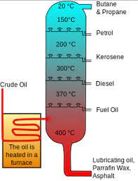
Fractional Distillation**
Fractional Distillation is the separation of a mix of compounds according to its boiling point.
The principle of Fractional Distillation (how it works) is when things heat up and boil, they rise up to the top and are separated off.

Slide 27
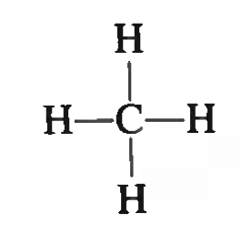
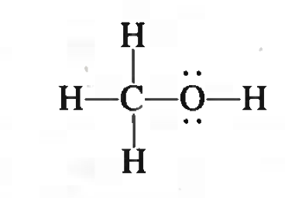
Using Colligative Properties to Determine Molar Mass
The larger the molecule…the more “central” molecules in it.
H
H
C
C
H
C
C
H
C
C
CH₄
(Methane)
Methanol
H
H
Benzene (C₆H₆)
ALSO, as the molecule gets longer, the less chance of a positive and negative end……(less chance its polar).

Slide 28
12.7: Colligative Properties of Electrolyte Solutions
Electrolyte solutions contain ions (positively and negatively charged pieces) and thus overall conduct electricity.
Electrolyte solutions do separate into cations (positive) and anions (negative) when dissolved in a solvent.
AB
A⁺ + B⁻
As Cations or Anions are created it does conduct electricity.

Slide 29
Key Words
Boiling Point
(𝚫T_{b}) (P. 520)
Colligative Properties (P. 512)
Crystallization (P. 504)
Fractional Distillation (P. 519)
Freezing Point
(𝚫T_{f}) (P. 521)
Hydrophilic (P. 532)
Hydrophobic (P. 532)
Miscible (P. 506)
Percent by mass (P. 507)
Saturated solution (P. 504)
Solvation (P. 506)
Supersaturated
solution (P. 504)
Unsaturated solution (P. 504)
Volatile (P. 518)
Non-Volatile

