Slide 1
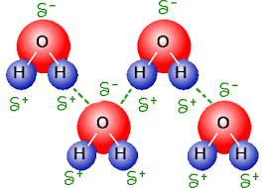
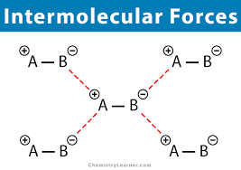
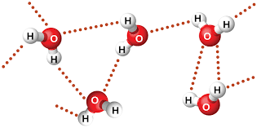
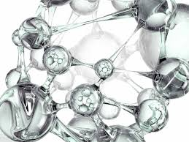
Chapter 11
Intermolecular Forces

Slide 2
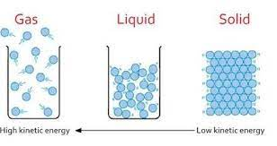
11.1: The Kinetic Molecular Theory of Liquids and Solids
ALL mater is composed of particles and the distance between particles is less and less as you change states from gases to liquids to solids.
The ability to compress mater depends on the maters state.

Slide 3
11.1: The Kinetic Molecular Theory of Liquids and Solids
The space between particles of the mater determine if a sate can be compressed.
Gases can be compressed…its called pneumatics.
Liquids can be sort of (medium) be compressed…its called hydraulics.
Solids cannot be compressed.

Slide 4
11.2: Intermolecular Forces
Intermolecular Forces:
Weak Forces.
Forces between elements.
Intramolecular Forces:
STRONG Forces.
Forces within an element. (Protons – Electrons, etc.)

Slide 5
11.2: Intermolecular Forces
There are 5 Types of Intermolecular Forces we will review:
1. Dipole-Dipole Interactions.
2. Dipole Induced Dipole.
Van der Waals Forces
3. Dispersion Forces.
4. Ion-Dipole Forces (weak electrostatic attraction).
5. Hydrogen Bonding (Unique and especially strong type of Dipole-Dipole).

Slide 6
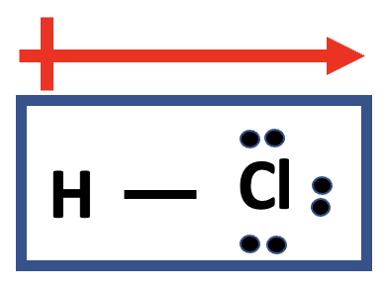
Dipole-Dipole Forces
Attractions (+ to -) between multiple polar molecules that arrange themselves so that the positive side of a molecule is close to the negative side of the next.
H
Cl

Slide 7
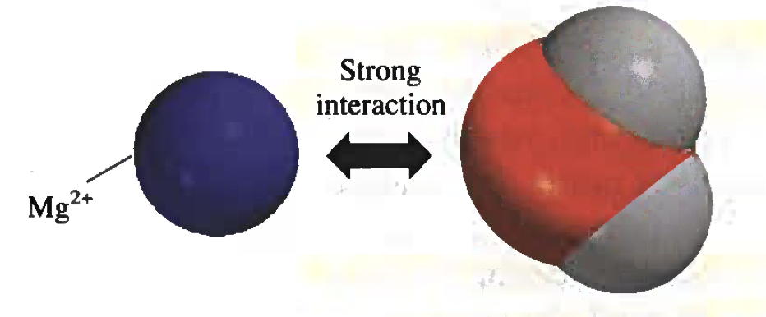
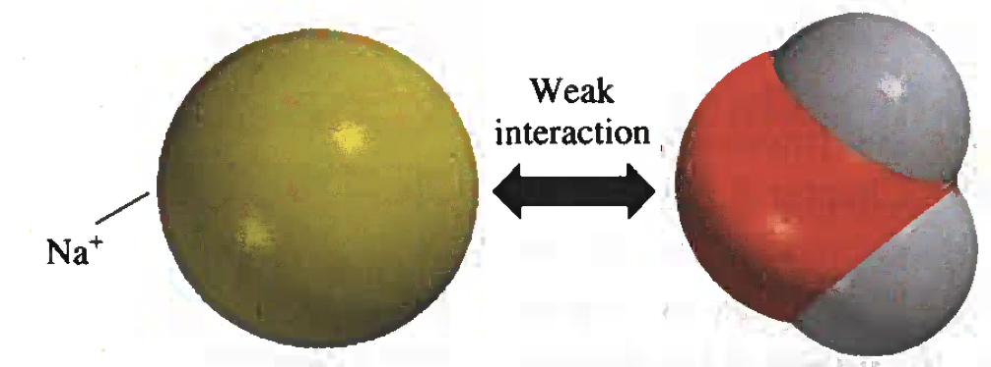
Ion-Dipole Forces (Dissolving)
The Positive charge of Cations (Metals) are attracted to the negative end of a dipole (water in dissolving).
When a cation get dissolved in water its positive charge (higher the charge the better) is attracted to the negative end of the water.

Slide 8
Dispersion Forces (Temporary Dipole)
Dispersion Forces:
Is the TEMPORARY dipole created by the constant moving of electrons.
Electron (e⁻)
No Dipole
No Dipole
At 1.0 Seconds
At 1.5 Seconds
At 2.0 Seconds

Slide 9
Dispersion Forces (Temporary Dipole)
The chances of more electrons randomly being on one side is increased by the number of electrons an elements has.
A.K.A…..Higher atomic number (more protons and electrons) have a higher chance of a temporary dipole.
Ions have more e⁻ and also have a higher chance of a temporary dipole.

Slide 10
Example 11.1
CORRECTION: Draw (Lewis Structures) each molecule and EXPLAIN the forces that exist in each:
a) HBr and H₂S b) Cl₂ and CBr₄, c) I₂ and NO₃⁻, d) NH₃ and C₆H₆?
H
Br
H
S
HBr
(Hydrogen Bromide)
H
Sulfur is more electronegative than Hydrogen so it gets a negative charge. (dipole formed)
Bromine is more electronegative than Hydrogen so it gets a negative charge. (dipole formed)
H₂S has electrons so it also has dispersion forces.
HBr has electrons so it also has dispersion forces.

Slide 11
Example 11.1
CORRECTION: Draw (Lewis Structures) each molecule and EXPLAIN the forces that exist in each:
a) HBr and H₂S b) Cl₂ and CBr₄, c) I₂ and NO₃⁻, d) NH₃ and C₆H₆?
Br
Cl
Cl
Br
C
Br
Br
The two Chlorine molecules have the same electronegativity, so neither is (+) or (-)…no dipole.
The four Bromine molecules make dipoles in 4 different directions, so they cancel each other out…no dipole.
Cl₂ has electrons so it also has dispersion forces.
Br₂ has electrons so it also has dispersion forces.

Slide 12
Example 11.1
CORRECTION: Draw (Lewis Structures) each molecule and EXPLAIN the forces that exist in each:
a) HBr and H₂S b) Cl₂ and CBr₄, c) I₂ and NO₃⁻, d) NH₃ and C₆H₆?
[ ]⁻
O
N
O
I
I
O
The two Iodine molecules have the same electronegativity, so neither is (+) or (-)…no dipole.
The three Oxygen molecules have the same electronegativity, so none are (+) or (-)…no dipole.
I₂ has electrons so it also has dispersion forces.
NO₃⁻ has electrons so it also has dispersion forces.

Slide 13
Example 11.1
CORRECTION: Draw (Lewis Structures) each molecule and EXPLAIN the forces that exist in each:
a) HBr and H₂S b) Cl₂ and CBr₄, c) I₂ and NO₃⁻, d) NH₃ and C₆H₆?
WRONG
H
N
C
C
C
C
C
C
H
The three Hydrogen molecules have the same electronegativity (less than the N), AND the lone pair up top make it very polar.
H
NH₃ has electrons so it also has dispersion forces.

Slide 14
Example 11.1
CORRECTION: Draw (Lewis Structures) each molecule and EXPLAIN the forces that exist in each:
a) HBr and H₂S b) Cl₂ and CBr₄, c) I₂ and NO₃⁻, d) NH₃ and C₆H₆?
Triple bonds?
N
STILL WRONG
H
C
C
C
C
C
C
H
The three Hydrogen molecules have the same electronegativity (less than the N), AND the lone pair up top make it very polar.
H
NH₃ has electrons so it also has dispersion forces.

Slide 15
Example 11.1
CORRECTION: Draw (Lewis Structures) each molecule and EXPLAIN the forces that exist in each:
a) HBr and H₂S b) Cl₂ and CBr₄, c) I₂ and NO₃⁻, d) NH₃ and C₆H₆?
Ring?
H
N
C
C
C
C
C
C
H
The three Hydrogen molecules have the same electronegativity (less than the N), AND the lone pair up top make it very polar.
H
NH₃ has electrons so it also has dispersion forces.

Slide 16
Example 11.1
CORRECTION: Draw (Lewis Structures) each molecule and EXPLAIN the forces that exist in each:
a) HBr and H₂S b) Cl₂ and CBr₄, c) I₂ and NO₃⁻, d) NH₃ and C₆H₆?
Double bonded ring?
Ring?
H
N
C
C
C
C
H
C
C
The three Hydrogen molecules have the same electronegativity (less than the N), AND the lone pair up top make it very polar.
STILL WRONG
H
NH₃ has electrons so it also has dispersion forces.

Slide 17
Example 11.1
CORRECTION: Draw (Lewis Structures) each molecule and EXPLAIN the forces that exist in each:
a) HBr and H₂S b) Cl₂ and CBr₄, c) I₂ and NO₃⁻, d) NH₃ and C₆H₆?
Double bonded ring?
H
H
H
N
C
C
H
C
C
H
H
C
C
The three Hydrogen molecules have the same electronegativity (less than the N), AND the lone pair up top make it very polar.
H
H
RIGHT…finally
H
Also called Benzene.
NH₃ has electrons so it also has dispersion forces.

Slide 18
Example 11.1
CORRECTION: Draw (Lewis Structures) each molecule and EXPLAIN the forces that exist in each:
a) HBr and H₂S b) Cl₂ and CBr₄, c) I₂ and NO₃⁻, d) NH₃ and C₆H₆?
H
H
C
C
H
C
C
H
C
C
The six Hydrogen molecules have the same electronegativity (less than the C), Cancel each other out...NON POLAR
H
H
RIGHT…finally
Also called Benzene.
C₆H₆ has electrons so it also has dispersion forces.

Slide 19
Example: Practice Exercise 11.1
Name the type(s) of intermolecular forces that exist between molecules (or basic units) in each of the following species: a) LiF, b) CH₄, c) SO₂.

Slide 20
The Hydrogen Bond
H
Hydrogen is very unique as it can EITHER a metal or nonmetal.
It can either gain an e- to fill its “S” orbital and thus become negative anion OR…
It can lose the one electron it has and become positive cation.
[ ]⁺
[ ]⁻
H
H
+ 1e⁻
H
+ 1e⁻
H

Slide 21
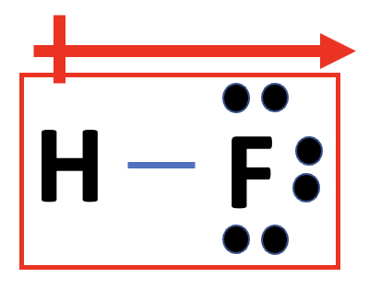
The Hydrogen Bond
A hydrogen bond is NOT an actual bond, but a special type of dipole-dipole attraction.
When hydrogen bonds to another element that is very electronegative this dipole is created.
H
H
F
F
(2.1)
(4.0)
Electronegativities.
(Just FYI, no need to memorize)

Slide 22
The Hydrogen Bond
This situation occurs when hydrogen is bonded to Fluorine, Oxygen, or Nitrogen.
(Chemistry is FON!)
(No one is laughing out loud, but you all secretly think its funny….secretly)
H
O
H
O
(2.1)
(3.5)
Electronegativities.
(Just FYI, no need to memorize)

Slide 23
The Hydrogen Bond
This situation occurs when hydrogen is bonded to Fluorine, Oxygen, or Nitrogen.
(Chemistry is FON!)
(No one is laughing out loud, but you all secretly think its funny….secretly)
H
N
H
N
(2.1)
(3.0)
Electronegativities.
(Just FYI, no need to memorize)

Slide 24
Example 11.2
Which of the following can form hydrogen bonds with water? CH₃OCH₃, CH4, F⁻, HCOOH, Na⁺.
H
H
C
O
O
H
H
H
C
C
H
C
H
H
H
H
H
H
Has Oxygen so. Hydrogen bonding.

Slide 25
Example 11.2
Which of the following can form hydrogen bonds with water? CH₃OCH₃, CH4, F⁻, HCOOH, Na⁺.
H
H
C
H
H
Does not have Fluorine, Oxygen, or Nitrogen. So NO Hydrogen bonding.

Slide 26
Example 11.2
Which of the following can form hydrogen bonds with water? CH₃OCH₃, CH4, F⁻, HCOOH, Na⁺.
[ ]⁻
F
Has Fluorine so it has Hydrogen bonding.

Slide 27
Example 11.2
Which of the following can form hydrogen bonds with water? CH₃OCH₃, CH4, F⁻, HCOOH, Na⁺.
O
H
C
O
H
Has two Oxygen so. Hydrogen bonding.

Slide 28
Example 11.2
Which of the following can form hydrogen bonds with water? CH₃OCH₃, CH4, F⁻, HCOOH, Na⁺.
[ ]⁺
Na
Does not have Fluorine, Oxygen, or Nitrogen. So NO Hydrogen bonding.

Slide 29
Example: Practice Exercise 11.2
Which of the following species are capable of hydrogen bonding among themselves?
a) H₂S b) C₆H₆ c) CH₃OH

Slide 30
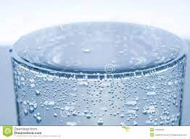
11.3: Properties of Liquids
The properties of a liquid are determined by the intermolecular forces that it has.
Properties such as Viscosity.
Properties such as Surface Tension.
Properties such as Cohesion.
Properties such as Adhesion.

Slide 31
Surface Tension
Surface Tension is a result of intermolecular forces being strong enough to want to stay together and not separate.
In the case of the water in the glass, the water forms a “bubble/dome” when the glass is over filled because the water molecules want to stay together and not separate.
O
Water has dispersion.
H
H
Water has dipole-dipole.
Water has Hydrogen Bonding.
(FON)
Water molecule forms a bent shape.

Slide 32
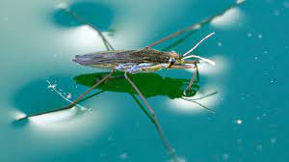
Cohesion
Cohesion is the intermolecular forces that hold a molecule together.
Water molecules have strong intermolecular forces (cohesion is high) and want to stay together.
Thus water molecules stay together and DO NOT allow the insect to split them apart and fall into them.

Slide 33
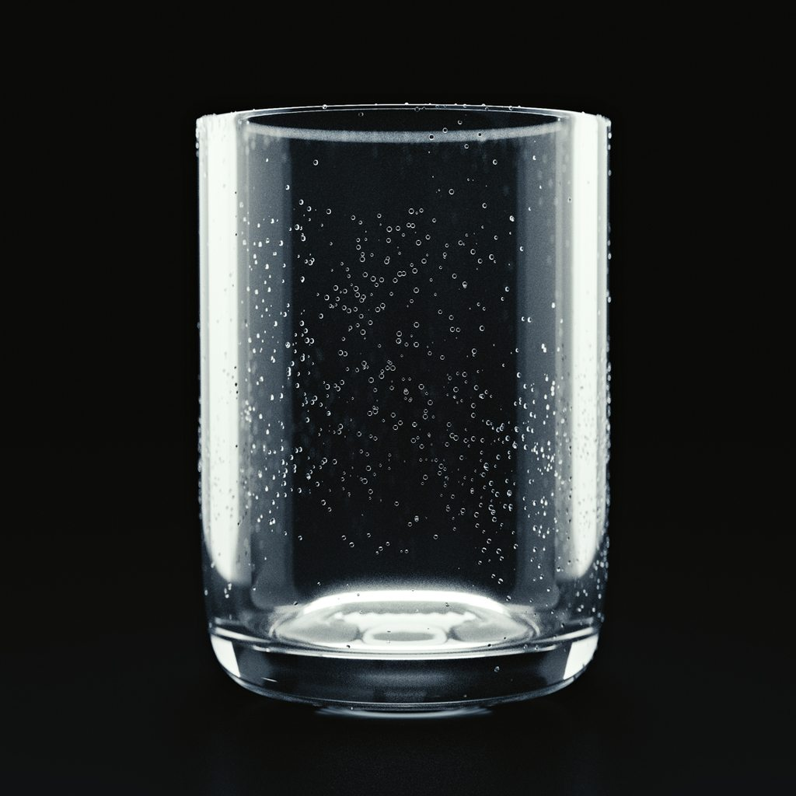
Adhesion
Adhesion is the attraction to molecule OUTSIDE the molecule
(Not intermolecular).
Liquids want to ”stick” onto surfaces.
Adhesion is the reason you can never get ALL the liquid out of a beaker or test tube.

Slide 34
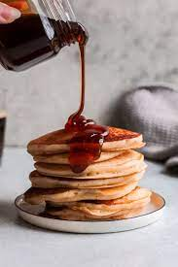
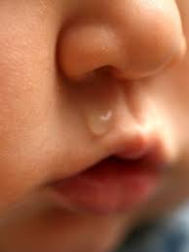
Viscosity
Viscosity is a measure of the resistance to much/quickly a liquid flows.
High Viscosity
Low Viscosity
Viscosity is affected by temperature.
The hotter a liquid, the faster it flows.

Slide 35
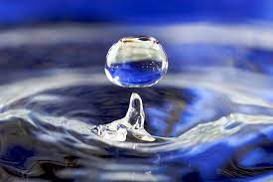
The Structure and Properties of Water
Water is very unique, it has all three types of intermolecular bonds.
When you change the state (s, l g) of a substance you must first break its intermolecular bonds.
Water has a lot of bonds, so breaking all of them requires A LOT of energy.
Because of this water has really high heat capacity (Energy required to break its bonds and increase its temperature). (Q = mc𝚫T)

Slide 36
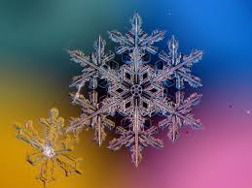
The Structure and Properties of Water
Water can form many intermolecular bonds that allow it form networks (crystal lattices….3d networks of bonds).
O
H
H

Slide 37
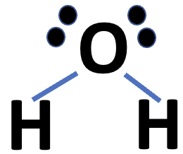
The Structure and Properties of Water
When water forms these “Crystal Lattice” structures they have a lot of air spaces between them.
O
H
H

Slide 38
The Structure and Properties of Water
All these air spaces make partially frozen water the less dense.
O
H
H
That’s why ice floats!
And why lakes don’t free solid and kill all life in it. (The floating ice insulates the more dense liquid below)

Slide 39
11.8: Phase Changes (Diagrams)
A “Phase” change is a change in the ”State” of a compound.
If we record the temperature of a compound as we add more energy to it (heat it up) we notice:
Phase Change Diagram
- The temperature of the compound increases as we had energy to it.
100∘C
- The temperature of the compound DOES NOT change…sometimes (Why?)
Temperature (∘C)
0∘C
Time (minutes)

Slide 40
11.8: Phase Changes (Diagrams)
Phase Change Diagram
100∘C
Phase Change
Temperature (∘C)
Phase Change
Temperature DOES NOT CHANGE during a “Phase” change.
Phase Change
0∘C
Time (minutes)

Slide 41
States Pyramid!
Plasma
(p)
Gases (g)
Increase Energy
(Temperature)
Liquids (l)
Solids (s)

Slide 42
11.8: Phase Changes (Diagrams)
Phase Change Diagram
Plasma (p)
100∘C
Evaporation/Boiling
Gas (g)
Temperature (∘C)
Melting
Liquid (l)
Condensation
Sublimation
Solid (s)
Solidification
0∘C
Time (minutes)

Slide 43
Key Words
Adhesion (P. 459)
Amorphous solid (P. 476)
Boiling Point (P. 483)
Cohesion (P. 459)
Condensation (P. 480)
Evaporation (p. 479)
Freezing point (P. 484)
Glass (P. 476)
Hydrogen Bonding (P. 457)
Induced dipole (P. 454)
Intermolecular forces (P. 453)
Intramolecular
forces (P. 453)
Ion-Dipole forces (P. 453)
Melting point (P. 484)
Molar heat of fusion
(𝚫H_{fus}) (P. 487)
Crystalline Structure (p. 463)
Dipole-Dipole
forces (P. 453)
Dispersion Forces (P. 455)

