Slide 1
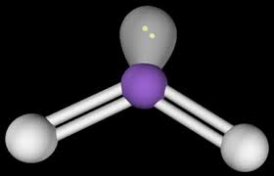
Chapter 10
Chemical Bonding II: Molecular Geometry and Dipoles

Slide 2
10.1: Molecular Geometry
Molecular geometry is the 3D shape of a molecule or compound.
Molecular geometry is the result of the electrons around the CENTRAL ATOM.
Molecular geometry is determined by:
- The number of bonding electrons (Single dots) around the central atom.
- The number of Lone Pair (Pairs of dots) around the central atom.

Slide 3
Molecules in Which Central Atom has No Lone Pairs
If the molecule/compound has no lone pairs its shape is determine solely by how many bonds it can form (aka how many things are connected to it).
Bonds are…two electrons sharing (Covalent) or transferring (Ionic)….so bonds are very negative.
So a molecule orients (arranges its shape) to keep electrons as far from each other as possible.
My analogy is little kids fighting….keep them as far away from each other as possible.

Slide 4
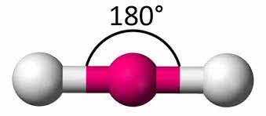
AB₂ (Linear) (2 Bonding and 0 Lone Pairs)
The electrons in the bonds repulse each other (same charge)….so you keep them as far from each other as possible.
The central atom can form two bonds and has no lone pairs.
All Group 2
Be
Mg
Like:
What do you notice about these?
Ca
Sr
Ba
Ra

Slide 5
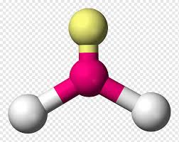
AB₃ (Trigonal Planar) (3 Bonding and 0 Lone Pairs)
The electrons in the bonds repulse each other (same charge)….so you keep them as far from each other as possible.
The central atom can form three bonds and has no lone pairs.
Group 3 also has 3+ charges, but we try not to look at transition metal as they act strangely.
All Group 13
120 ∘
B
Al
Like:
Ga
What do you notice about these?
In
Tl
Uut

Slide 6
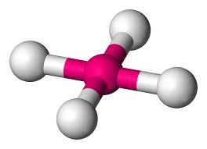
AB₄ (Tetrahedral) (4 Bonding and 0 Lone Pairs)
The electrons in the bonds repulse each other (same charge)….so you keep them as far from each other as possible.
The central atom can form four bonds and has no lone pairs.
109.5 ∘
All Group 14
C
Si
Like:
Ge
What do you notice about these?
Sn*
Pb*
Uuq*

Slide 7
Molecules in Which Central Atom has One or More Lone Pairs
Elements with a pair of electrons (A lone pair) make shapes so that the lone pair of e- are as far away from the bonding e- as possible.
Elements with a single lone pair are elements with 5 dots around them…Group 15.
Single Lone Pair
This makes a “Negative” end and a “Positive” end (less negative)…like a magnet.
The ”Lone Pair” is very negative so it pushes the bonds down.
P

Slide 8
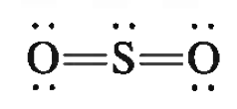
AB₂E (BENT) (2 Bonding and 1 Lone Pair)
Example does NOT follow ”Octet” (dot rules) and the Lewis Dot diagram will be provided to you.
SO₂
Sulphur Dioxide
Central atom (S) has 2 things (0xygens) bonded to it and 1 Lone Pair.
(Double or triple bonds count as 1)
X
The Lone Pair has a big impact, pushes two bonds away (down).
Linear
Bent

Slide 9
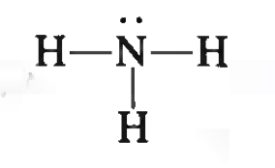
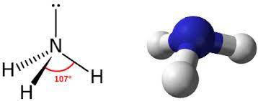
AB₃E (Trigonal Pyramidal) (3 Bonding and 1 Lone Pair)
NH₃
Ammonia
X
Central atom (N) has 3 things (Hydrogens) bonded to it and 1 Lone Pair.
The Lone Pair has a big impact, pushes three bonds away (down).
Assume Tetrahedral

Slide 10
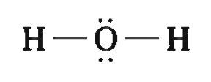
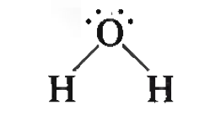
AB₂E₂ (BENT)
H₂O
Water
X
Central atom (O) has 2 things (Hydrogens) bonded to it and 2 Lone Pairs.
The Lone Pairs have a big impact, pushes two bonds away (down).
Assume Linear

Slide 11
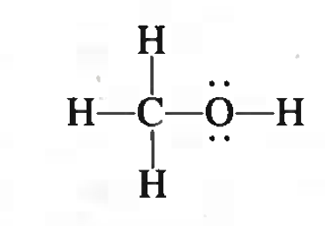
Geometry of Molecules With More than One Central Atom
Molecules with multiple central atoms have a complex geometry that is is a combination of determining central atom individually.
The first central atom ”C” is AB₄.
AB₄ = Tetrahedral
The second central atom ”O” is AB₂E₂.
Methanol
AB₂E₂ = Bent

Slide 12
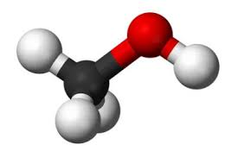
Geometry of Molecules With More than One Central Atom
Molecules with multiple central atoms have a complex geometry that is is a combination of determining central atom individually.
Methanol
Methanol actually looks like.

Slide 13
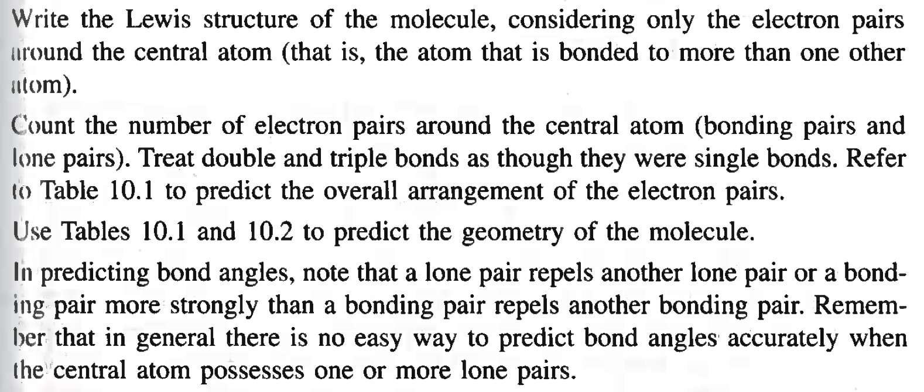
Guidelines for Applying the VSEPR Model (Not sure why this is last...little late no?)
1.
2.
3.
4.

Slide 14
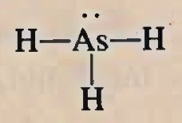
Example 10.1
Use VSEPR model to predict the geometry of the following molecules and ions. a) AsH₃, b) OF₂
c) AlCl₄⁻, d) I₃⁻, e) C₂H₄
Central atom (As) has 3 things (Hydrogens) bonded to it and 1 Lone Pairs.
AB₃E₁ = Trigonal Pyramidal
AB₃E₁ = ???
Another way I remember it is AB₃E₁ is like nitrogen…nitrogen is trigonal pyramidal.

Slide 15
Example 10.1
Use VSEPR model to predict the geometry of the following molecules and ions. a) AsH₃, b) OF₂
c) AlCl₄⁻, d) I₃⁻, e) C₂H₄
Central atom (O) has 2 things (Fluorines) bonded to it and 2 Lone Pairs.
AB₂E₂ = Bent
AB₂E₂ = ???
Another way I remember it is AB₂E₂ is like water (H₂O)…water is ”bent”.

Slide 16
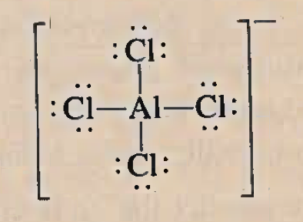
Example 10.1
Use VSEPR model to predict the geometry of the following molecules and ions. a) AsH₃, b) OF₂
c) AlCl₄⁻, d) I₃⁻, e) C₂H₄
Extra dot (electron) added.
How do I know? Well how many dots is Al suppose to have?
Dot from Al and a dot from Cl form a bond.

Slide 17
Example 10.1
Use VSEPR model to predict the geometry of the following molecules and ions. a) AsH₃, b) OF₂
c) AlCl₄⁻, d) I₃⁻, e) C₂H₄
Central atom (Al) has 4 things (Chlorines) bonded to it.
AB₄ = ???
AB₄ = Tetrahedral
Another way I remember it is AB₄ is like Carbon (methane) …methane is tetrahedral.

Slide 18
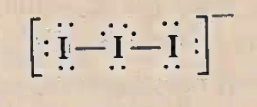
Example 10.1
Use VSEPR model to predict the geometry of the following molecules and ions. a) AsH₃, b) OF₂
c) AlCl₄⁻, d) I₃⁻, e) C₂H₄
Don’t do. Did not learn 3 lone pairs.
Central atom (I) has 2 things (Iodines) bonded to it and 3 lone pairs.

Slide 19
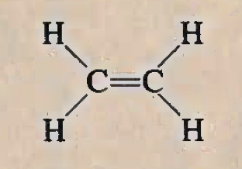
Example 10.1
Use VSEPR model to predict the geometry of the following molecules and ions. a) AsH₃, b) OF₂
c) AlCl₄⁻, d) I₃⁻, e) C₂H₄
There are 2 central atoms.
So the overall shape of the molecule is a combination of shape around each central atom.
1 Central atom (C) has 3 things (Hydrogens & other Carbon) bonded to it.
1 Central atom (C) has 3 things (Hydrogens & other Carbon) bonded to it.
AB₃ =
Trigonal Planar
Trigonal Planar
AB₃ =

Slide 20
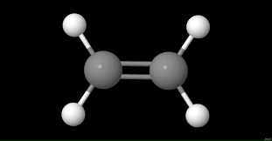
Example 10.1
Use VSEPR model to predict the geometry of the following molecules and ions. a) AsH₃, b) OF₂
c) AlCl₄⁻, d) I₃⁻, e) C₂H₄
Overall Shape:
1 Central atom (C) has 3 things (Hydrogens & other Carbon) bonded to it.
1 Central atom (C) has 3 things (Hydrogens & other Carbon) bonded to it.
AB₃ =
Trigonal Planar
Trigonal Planar
AB₃ =

Slide 21
Example: Practice Exercise 10.1
Use the VSEPR model to predict the geometry of a) SiBr₄, b) CS₂, and c) NO₃⁻

Slide 22
10.2: Dipole Moment (Polar Bond)
In every chemical bond (Except when two of the SAME element are bonded together) there is a difference in electronegativity.
Electronegativity:
The ability of an atom to draw electrons towards itself.
Dipole Moment
A dipole moment shows the difference between elements with an arrow.

Slide 23
10.2: Dipole Moment (Polar Bond – Single Dipole)
The + end is drawn from the LESS electronegative (Positive) end pointing to the more electronegative (negatively charge) end.
For Example:
Cl
H
Cl
H
HCl
(Hydrochloric Acid)
H is in group 1.
Cl is in group 17.

Slide 24
10.2: Dipole Moment (Polar MOLECULE – Multiple Bonds)
The + end is drawn from the LESS electronegative (Positive) end pointing to the more electronegative (negatively charge) end.
For Example:
H
H
N
H
H
N
H
NH₃
(Ammonium)
N is in group 15.
H is in group 1.
H

Slide 25
10.2: Dipole Moment (Polar MOLECULE – Multiple Bonds)
The + end is drawn from the LESS electronegative (Positive) end pointing to the more electronegative (negatively charge) end.
Actual Shape:
For Example:
N
H
N
H
H
H
H
H
Overall Dipole

Slide 26
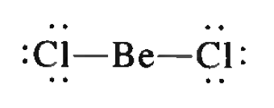
10.2: Dipole Moment (Polar Bond Affected by 3d shape: Linear)
If the Individual dipoles for each bond are in opposite directions in its 3d shape they cancel each other out.
For Example:
The two OPPOSITE and EQUAL dipoles on a LINEAR molecule cancel each other out!
So molecule has NO OVERAL POLARITY.
BeCl₂
(Beryllium Chloride)

Slide 27
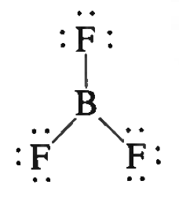
10.2: Dipole Moment (Polar Bond Affected by 3d shape: Trigonal Planar)
If the Individual dipoles for each bond are in opposite directions in its 3d shape they cancel each other out.
For Example:
The three OPPOSITE and EQUAL dipoles on a TRIGONAL PLANAR molecule cancel each other out!
So molecule has NO OVERAL POLARITY.
BF₃
(Boron Tetra Fluoride)

Slide 28
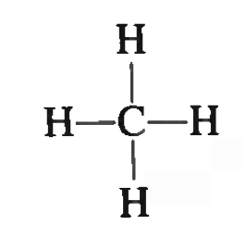
10.2: Dipole Moment (Polar Bond Affected by 3d shape: Tetrahedral)
If the Individual dipoles for each bond are in opposite directions in its 3d shape they cancel each other out.
For Example:
The four OPPOSITE and EQUAL dipoles on a TETRAHEDRAL molecule cancel each other out!
So molecule has NO OVERAL POLARITY.
CH₄
(Methane)

Slide 29
Example 10.2
Predict whether each of the following molecules has a dipole moment: a) Ibr (linear),
b) BF₃, (trigonal planar), c) CH₂Cl₂ (tetrahedral)
“I” and “Br” are right next to each other, but “I” is below “Br” and slightly more electronegative.
I
Br
“I” is in group 17.
Br is in group 17.

Slide 30
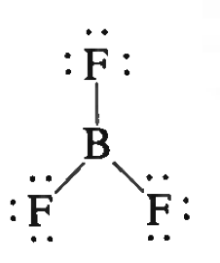
Example 10.2
Predict whether each of the following molecules has a dipole moment: a) Ibr (linear),
b) BF₃, (trigonal planar), c) CH₂Cl₂ (tetrahedral)
If the Individual dipoles for each bond are in opposite directions in its 3d shape they cancel each other out.
The three OPPOSITE and EQUAL dipoles on a Trigonal Planar molecule cancel each other out!
“B” is in group 13.
So molecule has NO OVERAL POLARITY.
“F” is in group 17.

Slide 31
Example 10.2
Predict whether each of the following molecules has a dipole moment: a) Ibr (linear),
b) BF₃, (trigonal planar), c) CH₂Cl₂ (tetrahedral)
If the Individual dipoles for each bond are in opposite directions in its 3d shape they cancel each other out.
The three OPPOSITE and EQUAL dipoles on a TETRAHEDRAL molecule cancel each other out!
H
Cl
C
Cl
So molecule has NO OVERAL POLARITY.
H

Slide 32
Example 10.2
Predict whether each of the following molecules has a dipole moment: a) Ibr (linear),
b) BF₃, (trigonal planar), c) CH₂Cl₂ (tetrahedral)
But hey, why not this version…its polar…
H
92 %
H
Cl
C
Cl
Cl
C
H
H
Cl
8 %
Different versions is called…..resonance.

Slide 33
Example: Practice Exercise 10.2
Does the AlCl₃ molecule have a dipole moment? EXPLAIN.

Slide 34
Key Words
Bond order (P. 433)
Boding molecular
Orbital (P. 430)
Delocalized molecular orbital (P. 438)
Dipole moment ($μ)$(P. 409)
Hybrid orbital (P. 418)
Hybridization (P. 418)
Molecular orbital (P. 429)
Nonpolar molecule (P. 410)
Pi Bond ($π bond)$(P. 426)
Pi molecular orbital (P. 432)
Polar molecule (P. 410)
Sigma bond ($ℴ bond)$ (P. 426)
Sigma molecular
orbital (P. 430)
Valence Shell (P. 400)
Valence Shell Electron Pair Repulsion (VSEPR) model (P.400)

