Slide 1
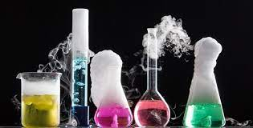
Chapter 1
Chemistry: The Study of Change

Slide 2
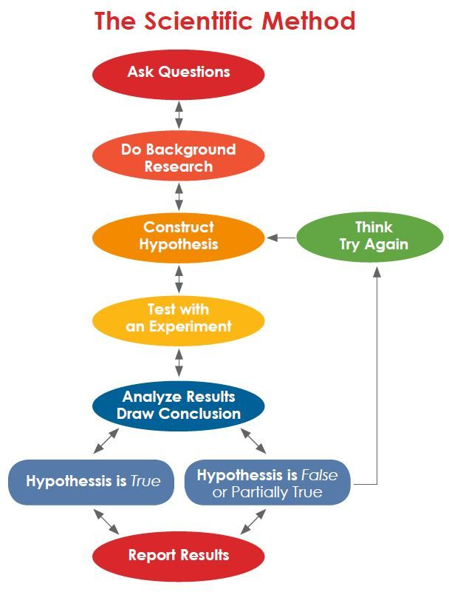
1.3: Scientific Method
Scientific Method:
A Systematic (Has steps to follow) approach to answering research questions.
“What is the hardest material on earth?”
Example
Geology Magazine says: “Diamond is the hardest material on earth”.
Diamond is the hardest material on earth so it will cut/scratch all other materials.
Data…numbers, etc. to record
This is the Lab Experiment: Test the diamond on lots of random things.
Quantitative
Qualitative

Slide 3
1.3: Scientific Method
Geology Magazine says: “Diamond is the hardest material on earth”.
Diamond is the hardest material on earth so it will cut/scratch all other materials
Data…numbers, etc. to record
This is the Lab Experiment: Test the diamond on lots of random things.
Quantitative
Qualitative
Qualitative:
Observations…Qualities of data, characteristics.
Quantitative:
Numbers and measurements. Amounts, Quantities.

Slide 4
1.3: Scientific Method
Analysis Section of Lab Report…looking at data;
“Diamon scratches/cut all material tested”
Experimental data supports (proves, agrees with)
Working Theory
Lots of Evidence
Law
Experimental data disproves hypothesis
Back to the Drawing Board…”Sorry, try again…”

Slide 5
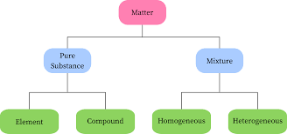
1.4: Classification of Matter
Substances and Mixtures
Matter:
Catchall umbrella for “anything that has mass and occupies space”.
Pure Substances:
2 or more elements joined together with a distinct (constant).
Mixture:
2 or more substances joined together with a distinct (constant).

Slide 6
1.4: Classification of Matter
Elements and Compounds
Element:
Single square from periodic table.
Compound:
Multiple squares from periodic table bonded together.
Homogeneous:
Mixture all looks the same…like icedtea.
Heterogeneous:
Mixture all looks different…like stew.

Slide 7
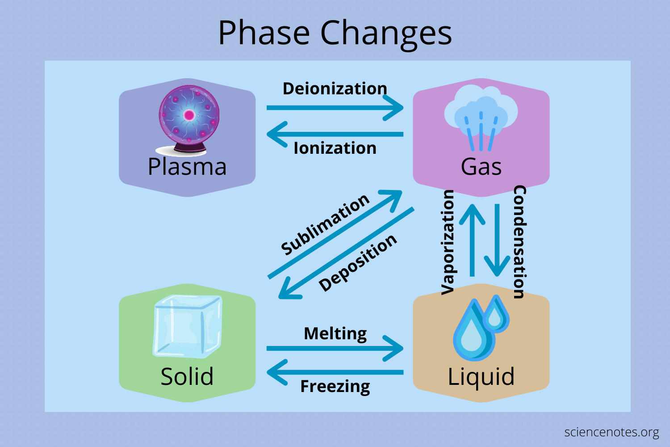
1.5: The Three States of Matter
Plasma is actually a super heated gas so it should be at the top.
HOTTER and the molecules that make it spread FARTHER APART.

Slide 8
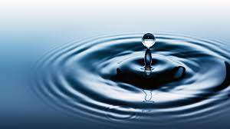
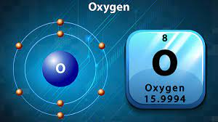
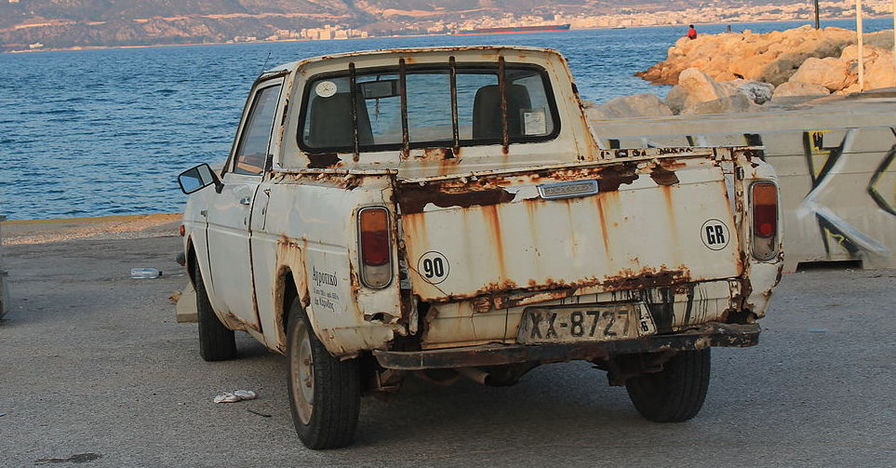
1.6: Physical and Chemical Properties of Matter
NO CHANGE by observing.
Physical Property:
A physical property is something you OBSERVE.
Water is clear.
Water can conduct electricity.
Water is q liquid at room temperature (23 ∘C)
H₂O
Dissolves quite a few things.
Chemical Property:
A Chemical property is something how something Reacts.
Oxygen burns/flammable.
Oxygen is involved in rusting.
CHANGES in reaction.

Slide 9
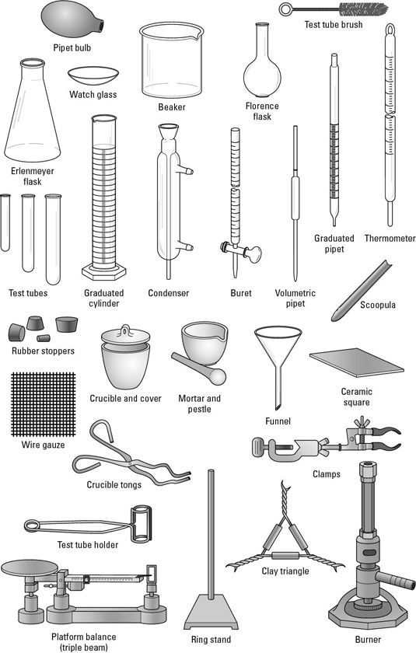
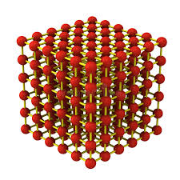
1.7: Measurement
Microscopic Properties:
A microscopic properties NEED TO BE CALCULATED or viewed using a MICROscope.
Bond Energy
Enthalpy
Q = mc𝚫t
Ionization Energy
Crystal Lattice Structure
Atomic Radius
MACROSSCOPIC Properties:

Slide 10
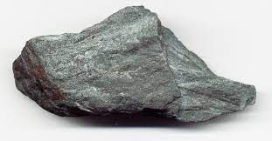
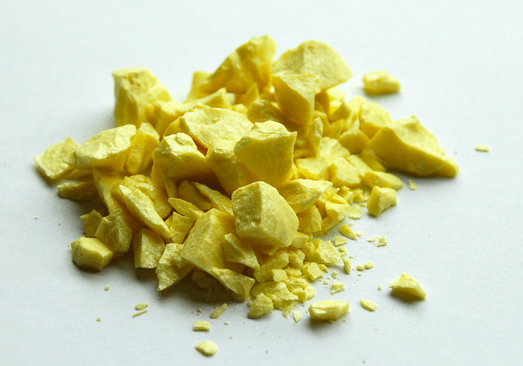
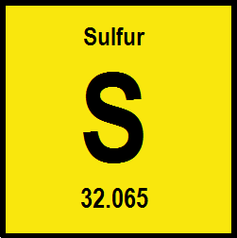
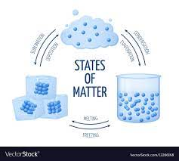
Macroscopic Properties
Things that you can observe directly....very similar to physical properties.
Texture
Colour
State

Slide 11
SI Units
The problem was that scientists all over the world were doing research (often the same research) but all using different units…so it was really confusing!
So in 1960 there was a general conference of scientists from around the world.
All the scientists agree on a SINGLE global unit they would ALL use, it was called the International System of Units or SI for short.
SI units are very similar to the METRIC units that your used to using….a few minor differences.

Slide 12
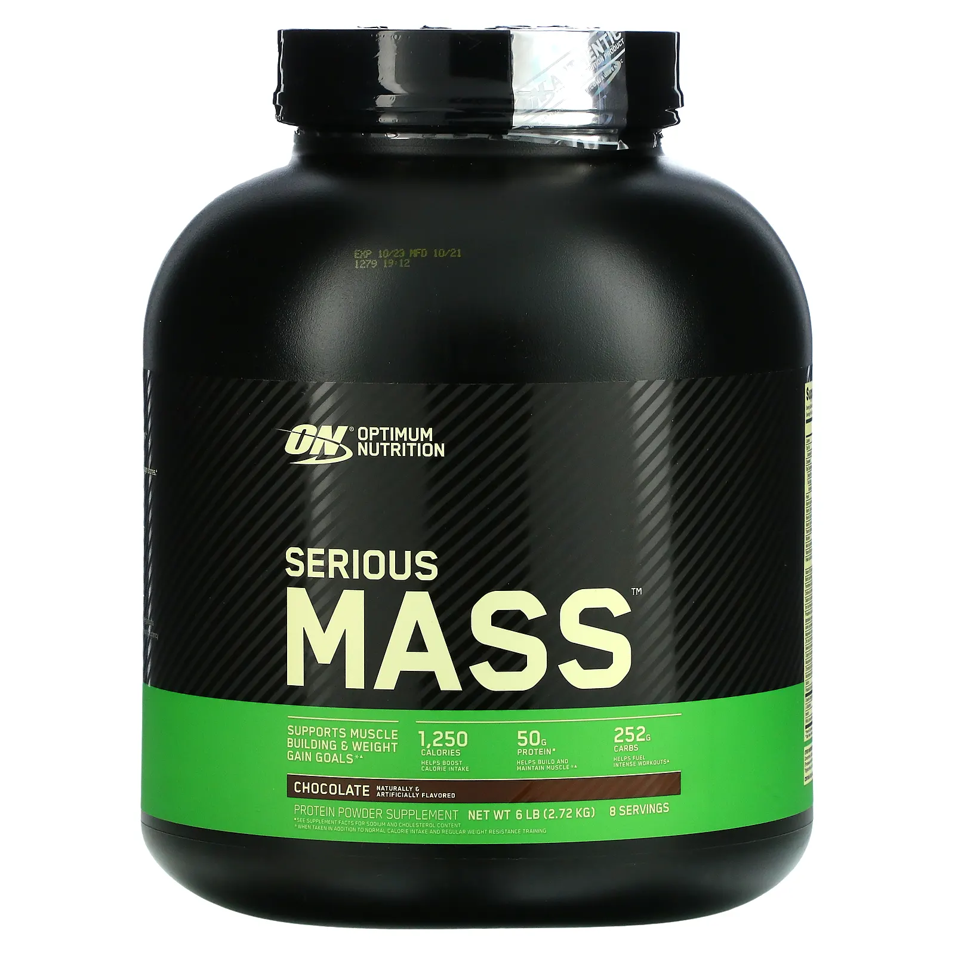
Mass and Weight
A lot of us think Mass and Weight are the same thing….their NOT.
Mass:
Whereas Mass is just how much space you take up...similar to your volume….how much matter you contain.
Weight:
Not really true Mass, but funny.
Weight is how heavy something is due to GRAVITY.
For example, you may weight 38 Kilograms on Earth, but 72 Kg on Saturn.

Slide 13
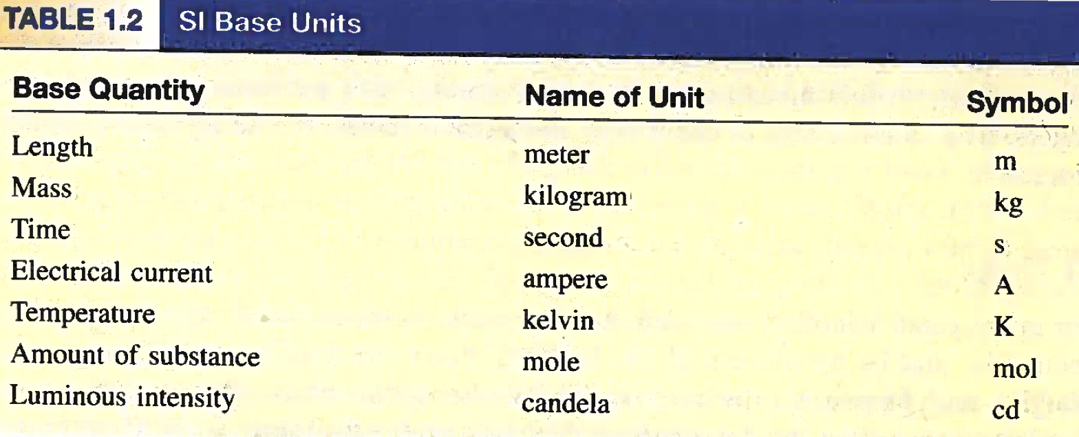
SI Units
Huh? Not Celsius?
Used A lot in Chemistry.

Slide 14
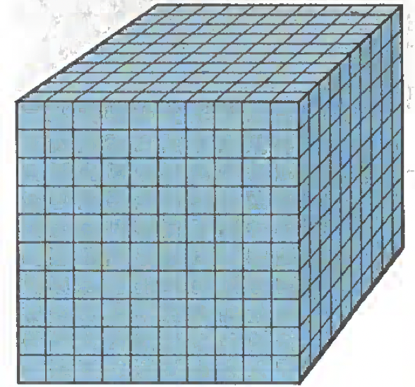
Volume
The SI unit is the cm³……”Cubic centimeter”.
1 cm³ = 1 ml
1 Liter = 1000 ml or 1000 cm³

Slide 15
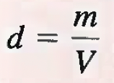
Density
Density is a measure of how heavy something is versus how big (volume wise) it is.
1 cm³ = 1 ml
The most common units for Density are g/ml, or g/cm³
You could also use kg/m³ (liter)….kg/L which is an SI Unit, but the answer REALLY small.
It’s like measuring the distance between you and the student next to you in Kilometers…..they are 0.0001 km away…so like 10 cm?

Slide 16
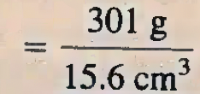
Example 1.1
Gold is a precious metal that is chemically unreactive. It is used mainly in jewelry, dentistry, and electronic devices. A piece of gold ingot with a mass of 301 g has a volume of 15,g cm³. Calculate the density of gold.
The density of the gold is 19.3g per cm³ or 19.3 g per ml.

Slide 17
Example: Practice Exercise 1.1
A piece of platinum metal with a density of 21.5 g/cm³ has a volume of 4.49 cm³ What is its mass?

Slide 18
Example 1.2
The density of mercury, the only metal that is liquid at room temperature, is
13.6 g/mL. Calculate the mass of 5.50 mL of the liquid.
rearranged
m = (13.6 g/ml) (5.50 mL)
m = 74.8 g
3 sig figs in question.
m ~ 74.8 g
The mass of the mercury is 74.8g.

Slide 19
Example: Practice Exercise 1.2
The density of sulfuric acid in a certain car battery is 1.41 g/ml. Calculate the mass of 242 ml of the liquid.

Slide 20
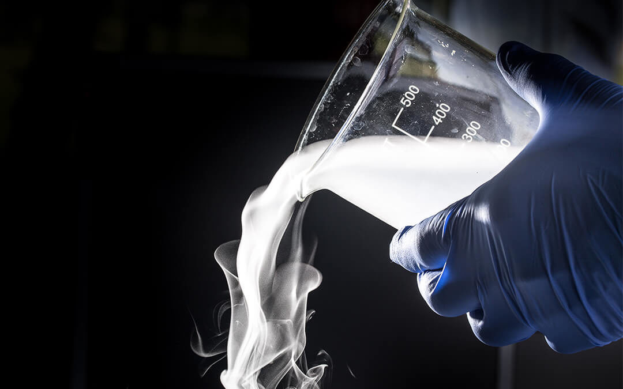
Temperature Scales
In Science we need to use a temperature scale that relates to how fast molecules are moving.
NEITHER ∘C or ∘F does this, as both have 0∘ but molecules are still moving.
The trend is that the colder an element is the slower that its molecules move.
But we have seen molecules can get REALLY cold and still move….so Celsius and Fahrenheit don’t really work.
Liquid Nitrogen

Slide 21
Temperature Scales
The big problem is the MATH, any calculations with 0∘C or 0∘F screws up our calculations.
So in Chemistry we needed a temperature scale with a really low 0.
The Answer to this problem:
The Kelvin (K) Scale
The Kelvin scale is very similar to the Celsius scale, but its “0” is much much colder than 0∘C or 0∘F

Slide 22
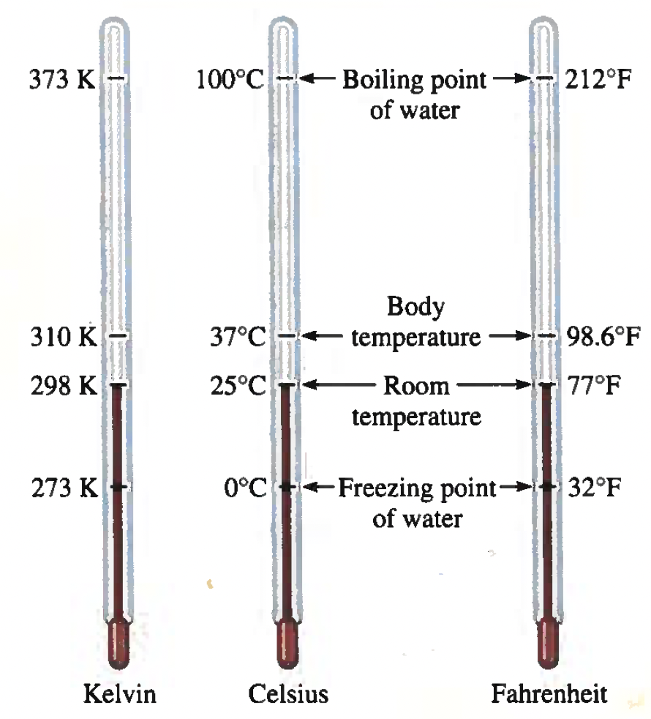
Temperature Scales
“0” K is very very cold, its when molecule don’t move at all.
0 K is called Absolute Zero.
So to convert between the different temperature scales there are TWO formulas you need to use.
∘C = (∘F- 32) (5/9)
0 ∘C = 273.15K
K = ∘C + 273.15

Slide 23
Example 1.3
Solder is an alloy made of tin and lead that is used in electronic circuits. A certain solder has a melting point of 224 ∘C. What is the melting point in Fahrenheit?
Helium has the lower boiling point of all the elements at -452∘F. Convert this temperature to degrees Celsius.
Mercury the only metal that exists as liquid at room temperature, melts at -38.9 ∘C. Convert its melting point to kelvins.

Slide 24
Example 1.3
Solder is an alloy made of tin and lead that is used in electronic circuits. A certain solder has a melting point of 224 ∘C. What is the melting point in Fahrenheit?
∘C = (∘F- 32) (5/9)
Rearranged to solve for ∘F
∘C = (∘F- 32) (5/9)
(5/9)
(5/9)
∘C = ∘F- 32
∘C + 32 = ∘F
(5/9)
(5/9)
+ 32
+ 32
224 + 32 = ∘F
∘F = 435
403 + 32 = ∘F
(5/9)

Slide 25
Example 1.3
b) Helium has the lower boiling point of all the elements at -452∘F. Convert this temperature to degrees Celsius.
∘C = (∘F- 32) (5/9)
∘C = (-452- 32) (5/9)
∘C = (-484) (5/9)
3 sig figs in question.
∘C = -268.888889
∘C ~ -269 ∘C or -2.69 x 10² ∘C

Slide 26
Example 1.3
c) Mercury the only metal that exists as liquid at room temperature, melts at -38.9 ∘C. Convert its melting point to kelvins.
K = ∘C + 273.15
K = 38.9 + 273.15
3 sig figs in question.
K = 312.05 K
K ~ 312 K

Slide 27
Example: Practice Exercise 1.3
Convert:
a) 327.5 ∘C (the melting point of lead) to degrees Fahrenheit
b) 172.9 ∘F (Boiling point of ethanol) to degrees Celsius.
c) 77 K (the boiling point of liquid nitrogen) to degrees Celsius.

Slide 28
1.8: Handling Numbers
When we have really large (1000000000000000) or really small (0.000000000000000001) numbers its easy to miss a ”0”.
So to make sure we don’t make mistake (Forget “0“s) we change the numbers into powers of 10 like in Math (Decimal moving).

Slide 29
Scientific Notation
The Technical/Science (fancy) term for Decimal moving is Scientific Notation.
Two Rules of Scientific Notation:
1. If the number is really large…..its a positive exponent. Ex. _____ X 10⁶
2. If the number is a decimal…..its a negative exponent Ex. _____ X 10⁻⁷
1560000 =
1.56 x 10⁶
Scientific notation is usually in the form of #.# x 10#

Slide 30
Significant Figures
Your final answer can never have more figures than the original question.
So count the number of Figures in the question AND
Use the smallest amount
Significant Figures and Scientific Notation is best learned by PRACTICE.
There’s Rules, but they don’t mean much until you ACTUALLY DO IT.
Scientific Notation and Significant Figures are usually used TOGETHER.

Slide 31
Significant Figures

Slide 32
Significant Figures

Slide 33
Example 1.4
Determine the number of significant figure in the following measurements:
a)478 cm
3 Sig Figs
4.78 x 10² cm
b) 6.01 g
3 Sig Figs
6.01 x 10⁰ g
c) 0.825 m
3 Sig Figs
8.25 x 10⁻¹ m
d) 0.043 kg
2 Sig Figs
4.3x 10⁻² kg
4 Sig Figs
1.310 x 10²²
e) 1.310 x 10²²
f) 7000 ml
4 Sig Figs
7.000 x 10³ ml

Slide 34
Example: Practice Exercise 1.4
Determine the number of significant figures in each of the following measurements:
24 mL
3001 g
0.0320 m³
6.4 x 10⁴ molecules
560 kg

Slide 35
Example 1.5
Carry out the following arithmetic operations to the correct number of significant figures:
11254.1 g + 0.1983 g
66.59 L – 3.113 L
(8.16 m)(5.1355)
(0.0154 kg)➗(88.3 mL)
(2.64 x 10³ cm) + (3.27 x 10² cm)
1124.2983 g
69.703 L
41.9 m
~1.74 x10⁻⁴
2967 cm

Slide 36
Example: Practice Exercise 1.5
Carry out the following arithmetic operations and round off the answers to the appropriate number of significant figures:
26.5862 L + 0.17 L
9.1 g – 4.682 g
(7.1 x 10⁴ dm) x (2.2654 x 10² dm)
6.54 g $÷$ 86.5542 ml
(7.55 x 10⁴ m) – (8.62 x 10³ m)

Slide 37
Accuracy and Precision
Everyone confuses Accuracy and Precision and think they means the same.
THEY ARE NOT THE SAME!
Accuracy:
How close you are the ACTUAL answer.
How correct you are.
How close you answers on multiple trial are TOGETHER.
Precision:

Slide 38
Accuracy and Precision
Everyone confuses Accuracy and Precision and think they means the same.
Accuracy:
How close you are the ACTUAL answer.

Slide 39
Accuracy and Precision
Everyone confuses Accuracy and Precision and think they means the same.
Precision:
How close your answer are TOGETHER.

Slide 40
1.9: Dimensional Analysis in Solving Problems
So, whether we realized it or not we have all use dimensional analysis in the past.
Dimensional Analysis:
Is a procedure used to convert between units…so unit conversion. Its also called the “Factor-Label” method.

Slide 41
1.9: Dimensional Analysis in Solving Problems
Often when using dimensional analysis to solve problems multiple steps are put together to save time (not recommended for beginners)
The idea is that you get a conversion factor (Factor-Label method)
1 dollar = 100 pennies
Then you write the conversion factor as a fraction.
1 Dollar
100 Pennies

Slide 42
1.9: Dimensional Analysis in Solving Problems
1 Dollar
100 Pennies
You make sure to label the conversion factor
(Hence: Factor-Label Method)
Once you have the labeled conversion factor you can solve questions and cancel units.

Slide 43
1.9: Dimensional Analysis in Solving Problems
1 Dollar
100 Pennies
How many pennies are in $14.65?
The main thing to remember is: You can only cancel units if they are on the ACROSS AND on the BOTTOM.
1 Dollar
100 Pennies
WRONG
$14.65 Dollars x
$14.65 Dollars x
100 Pennies
1 Dollar

Slide 44
1.9: Dimensional Analysis in Solving Problems
100 Pennies
$14.65 Dollars x
= 14.65 x 100
1 Dollar
= 1465
Pennies
There are 1465 pennies in fourteen dollars and 65 cents.

Slide 45
1.9: Dimensional Analysis in Solving Problems
How many seconds in 6.5 days?
1 Day
1 Hour
1 Minute
24 Hours
60 Minutes
60 Seconds

Slide 46
1.9: Dimensional Analysis in Solving Problems
How many seconds in 6.5 Days?
1 Day
60 Minutes
60 Seconds
6.5 Days
24 Hours
X
X
X
1 Day
1 Hour
24 Hours
1 Minute
= 561600 seconds
~ 5.6 x 10⁵ seconds

Slide 47
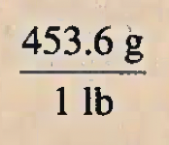
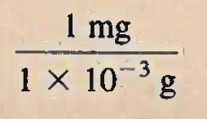
Example 1.6
A person’s average daily intake of glucose (a form of sugar) is 0.0833 pounds (lbs). What is this mass in milligrams (mg)? (1 lb = 453.6 g.)
&
0.0833 lbs
X
X
~ 3.78 x 10⁴ mg

Slide 48
Example: Practice Exercise 1.6
A role of aluminum foil has a mass of 1.07 kg. What is the mass in pounds?

Slide 49
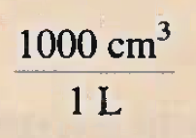
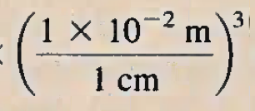
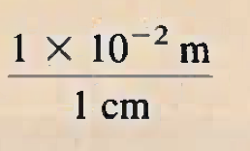
Example 1.7
An average adult has 5.2 L of blood. What is the volume of blood in m³?
Want these two units to be the same. The question has volume (³) so we want to conversions to be volume too.

Slide 50
Example 1.7
An average adult has 5.2 L of blood. What is the volume of blood in m³?
6
3
2 sig figs in question. AND Scientific Notation is better
= 0.00052 m³
6
3
5.2 L
X
X
~ 5.2 x 10⁻³ m³
3

Slide 51
Example: Practice Exercise 1.7
The volume of a room is 1.08 x 10⁸ dm³. What is the volume in m³?

Slide 52
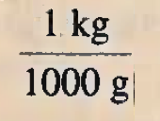
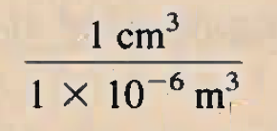
Example 1.8
Liquid nitrogen is obtained from liquefied air and is used to prepare frozen goods and in low-temperature research. The density of the liquid at its boiling point
(-196 ∘C or 77 K) is 0.808g/cm³. Convert the density to units of kg/m³.
0.808 g/cm³
X
X

Slide 53
Example: Practice Exercise 1.8
The density of the lightest metal, lithium (Li), is 5.34 x10² kg/m³. Convert the density to g/cm³.

Slide 54
Key Words
Accuracy (P. 26)
Chemical Property (P. 14)
Chemistry (P. 4)
Compound (P. 12)
Density (P. 15)
Element (P. 12)
Extensive Property (P. 15)
Heterogeneous Mixture (P. 11)
Homogeneous Mixture (P. 11)
Hypothesis (P. 9)
Intensive Property (P. 15)
International System of Units (SI) (P. 15)
Kelvin (P. 19)
Law (P. 9)
Liter (P. 17)
Macroscopic Property (P. 15)
Mass (P. 15)
Matter (P. 11)
Microscopic Property (P. 15)
Mixture (P. 11)
Physical Property (P. 14)
Precision (p. 26)
Qualitative (P. 8)
Quantitative (P. 8)
Scientific Method (P. 8)
Significant Figures (P. 23)
Substances (P. 11)
Theory (P. 9)
Volume (P. 15)
Weight (P. 16)

